Slide 1
WELCOME to the School of Business and Economics
Information session by the Faculty Administrative Office
Personal inquiries please refer to: ekonomihogskolan@lnu.se

Slide 2
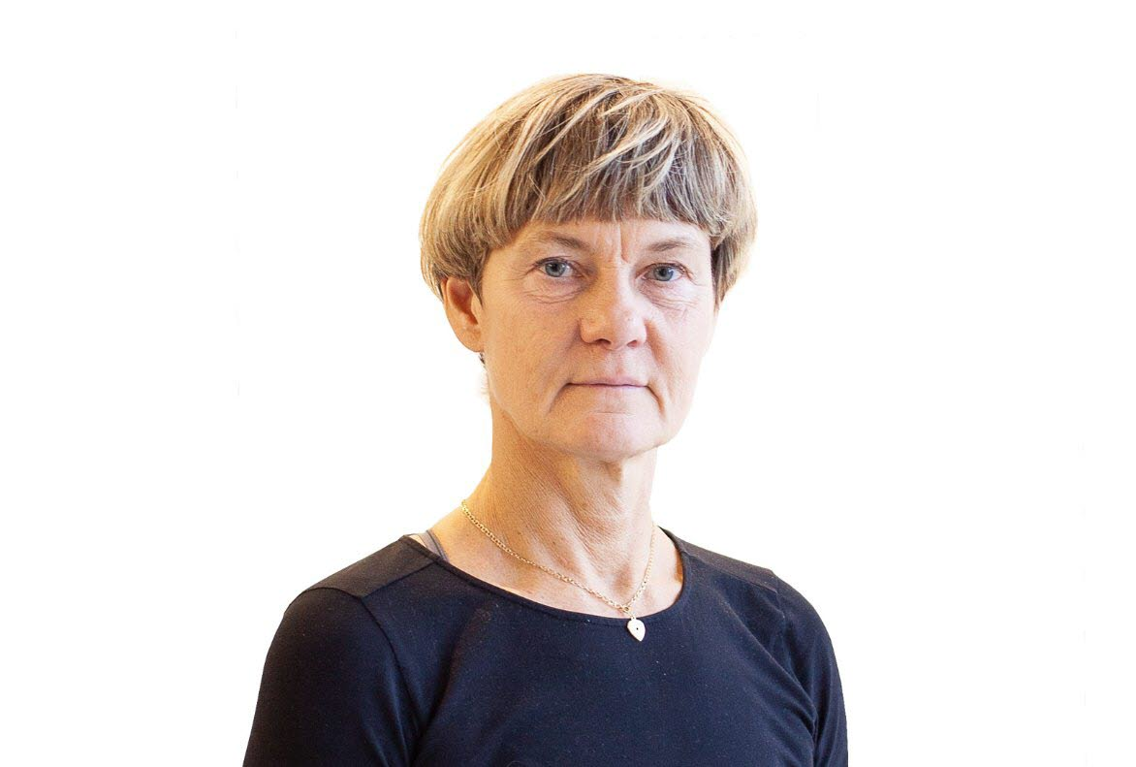
About 200 co-workers at the faculty
About 5000 students
About 450 international students
Knowledge Plattforms
Organisation
Department of Accounting and Logistics
Department of Organisation and Entrepreneurship
11 Bachelor Programmes
9 Master Programmes
3 PhD Programmes
Single-subject Courses
Dean of the School of Business and Economics, Susanne Ackum
Business Administration
Accounting, Finance
Organization Science, Leadership
Entrepreneurship, Innovation
Marketing, Customer Experience, Business Informatics, Logistics, Retail Management
Economics
Statistics
Tourism Studies
Legal Science
Department of Marketing
Department of Economics and Statistics
Faculty Administrative
Office
AACSB accredeted by
October, 2022

Slide 3
OUR MISSION:
We co-create knowledge, making people grow
The School of Business and Economics at Linnéuniversitetet is located in the southeast of Sweden. Campus in Växjö and Kalmar.
We are inspired by the region´s entrepreneurial tradition and experience of co-operation among all actors in society to create fruitful and sustainable use of resources.
Through co-creation we connect theory with practice, and education with research
Our aim is to give you the knowledge and skills you need to achieve your professional goals and to be competitive in the labor market …
… but also providing you with the prerequisites to grow into critical thinkers, as well as entrepreneurial and responsible citizens
Notes:
Till studenter: Examen från ett ackrediterat lärosäte står för kvalitet
AACSB
Vi är mitt i processen att ackreditera våra ekonomiutbildningar enligt AACSB
Startade våren 2016, godkänd iSER (initial Self Evaluation Report) våren 2018
Nu arbete med Final Self Evaluation Report (SER).
Mål att bli godkända av Peer Review Team under 2020.
Studenter som börjar sina studier kommer att ta examen från en utbildning vid ett ackrediterat lärosäte. (https://medarbetare.lnu.se/medarbetare/organisation/feh/moten-och-beslut/ekonomihogskolans-ackreditering/)
AACSB-Accredited Universities and Business Schools
There are 820 business institutions in 53 countries and territories that have earned AACSB Accreditation. Similarly, 187 institutions hold an additional, specialized AACSB Accreditation for their accounting programs. (https://www.aacsb.edu/accreditation/accredited-schools)

Slide 5
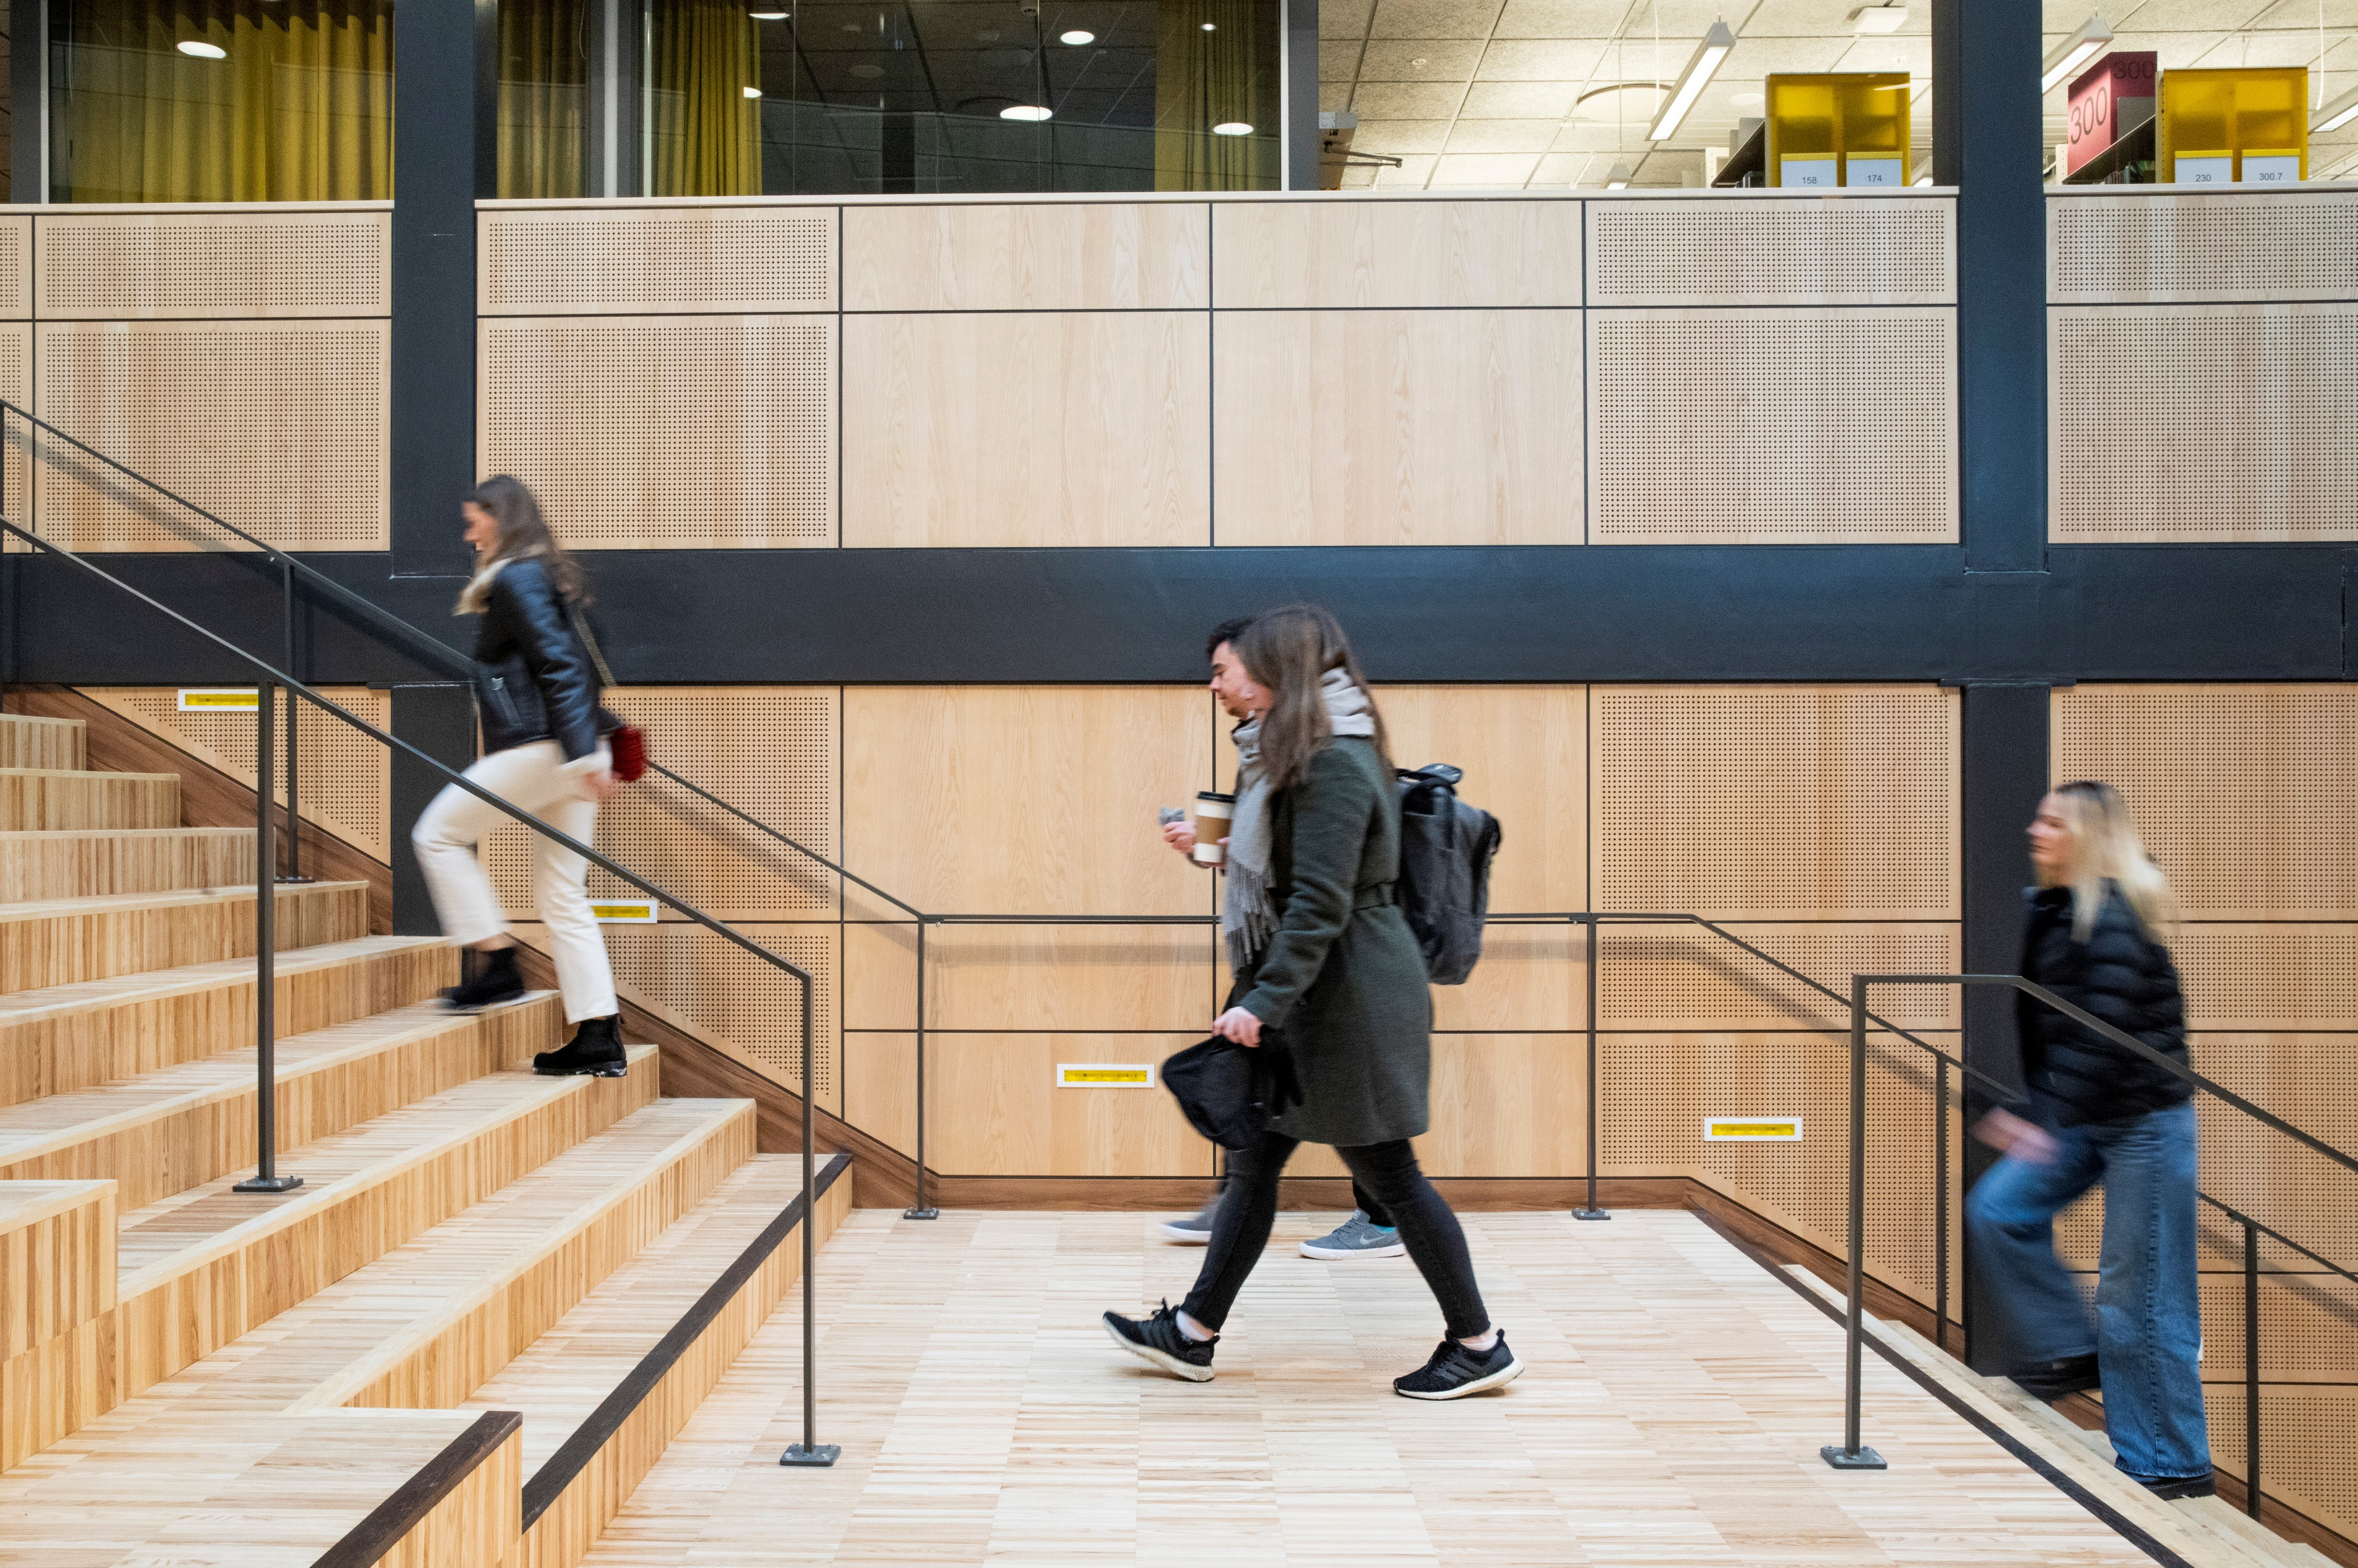
First steps
at the School of Business and Economics

Slide 6
This is how you create Your Roadmap to Success!
Make sure you have
Step 1:
Reviewed the Checklist for New Students https://lnu.se/en/student/new-student/
Acquired the Student Account;
Check the Student’s Page.
Step 2:
Accessed “My Moodle” – the learning platform;
Registered for your first course (thereafter for your next course, etc.)
Step 3:
Follow important information on your studies on My Moodle – platform, and in your student e-mail;
In due time, register for the examination;
At the end of the course fill in the course evaluation form;
Follow your study results in LADOK.

Slide 7
What is …?

Slide 8
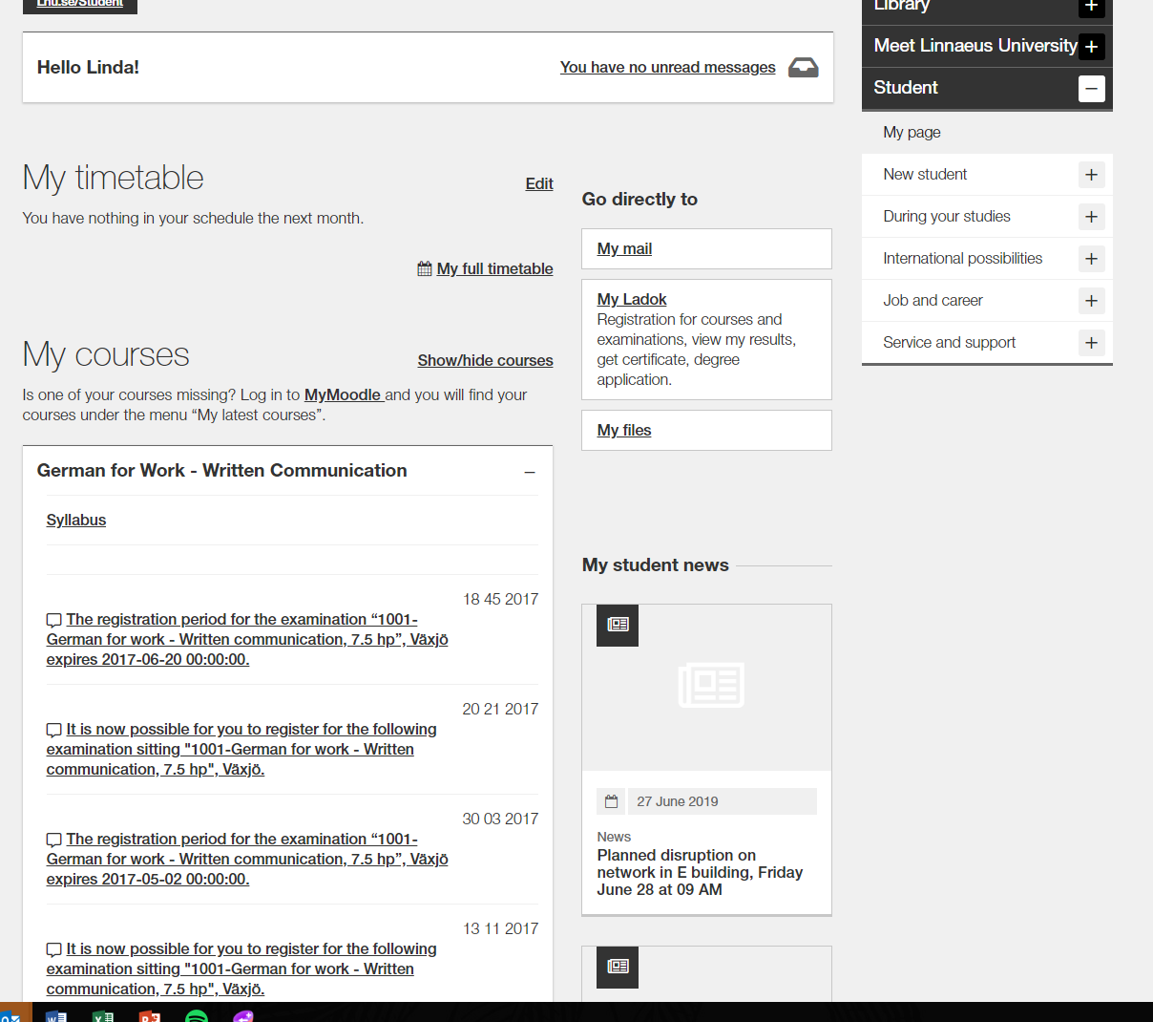
The Student’s Page
Lnu.se/student
Important information during your studies
My timetable
When you are registered to a course, you will find your schedule here
Ladok:
Registration
Results
Sign up for examination
Certificates
Click on the course:
Link to course room on MyMoodle
Link to course syllabus
Information about registration period for examination
My student news:
Latest news
Notes:
See study results, see courses you are registered on, register for new courses
You can see which courses you are currently registered for, check the timetable for the courses and get directly to the course room on Mymoodle
You register to your courses on Ladok, if the course is still closed you will see which date the registration starts and if the registration period is open you can easily register directly. You will get in your results in Ladok as well.

Slide 9
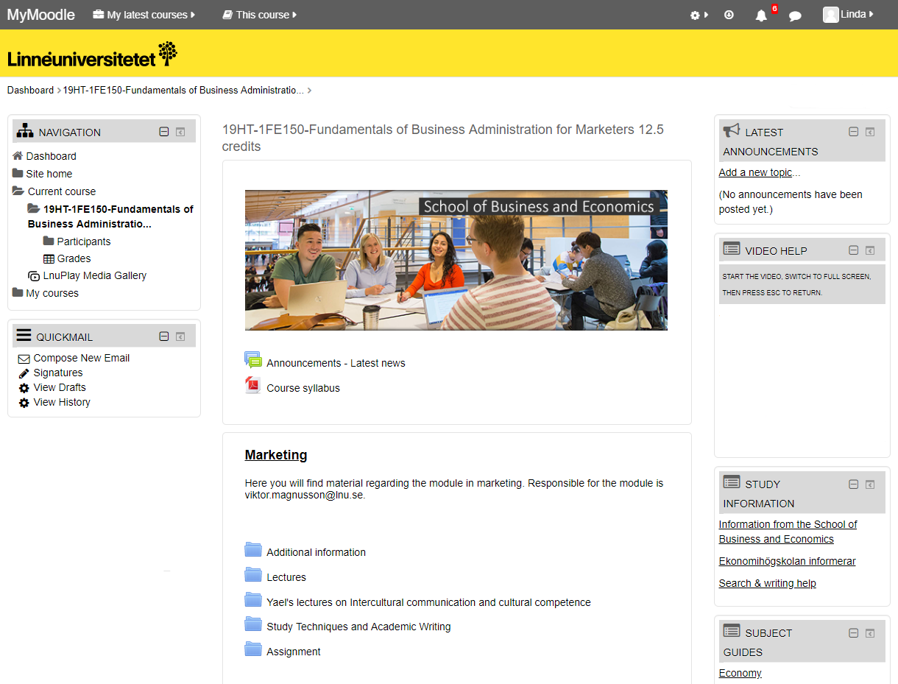
My Moodle – the learning platform
Course room
Programme room
Information from the School
Notes:
2FE407 länk till kursrum
Kolla länkarna!!!

Slide 10
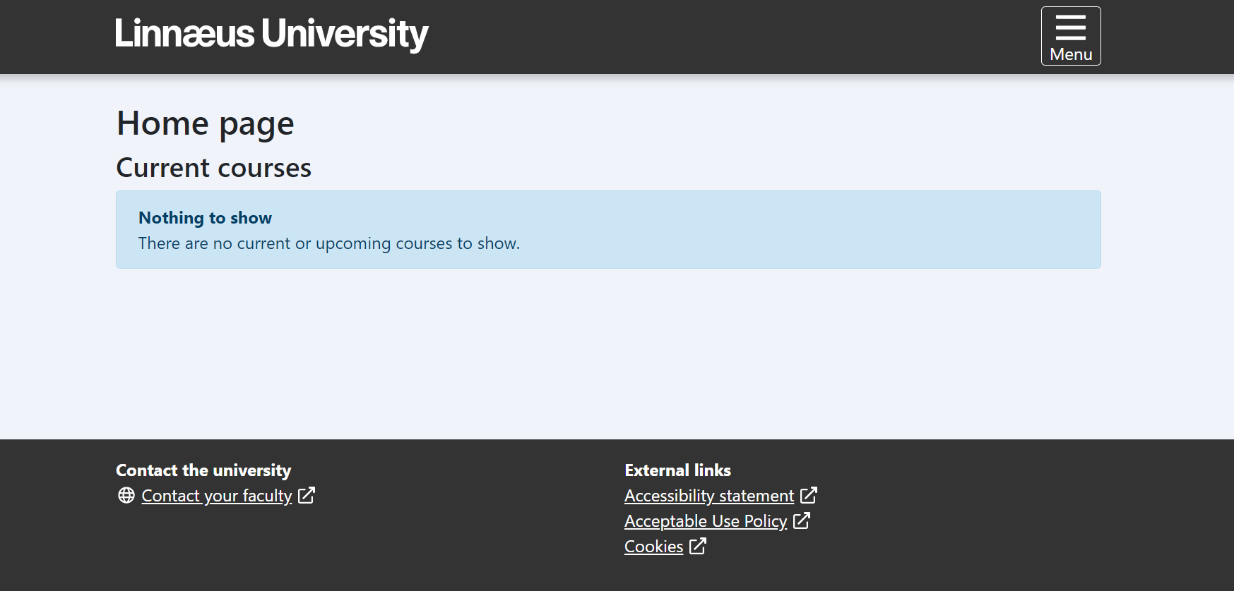
LADOK -
the digital system for your
study results,
certificates and
sign up for examinations
Notes:
Collect certificates

Slide 11
Programme and course syllabi
The programme syllabus regulates the programme’s objectives, structure, content and degree.
For individual courses, the course syllabus regulates the course objectives, content, examination, literature etc. You will also find what prerequisites you must meet in order to register for and study the course.
Always read through the course syllabus before each new course.
https://lnu.se/en/student/during-your-studies/course-and-programme-syllabi/

Slide 12
Examination
There are different types of examinations, for example; written exam, digital exam, assignment and seminars.
The course coordinator will inform you at the start of the course on how the course is examined. The form of examination/examinations is also stated in the course syllabus.
If you have received a passing grade, you cannot do the same examination again for a higher grade.
If you fail or miss an examination, there are possibilities for re-exam.

Slide 13
General grading criteria for the A-F scale at the School of Business and Economics
The grading scale is A-F (NOT ECTS). Your performance is measured in proportion to how well you have met the course objectives. All parts of the examination are relatable to specific learning objectives for the course. Some tasks have G/U (P/F).
Grade | Assessment | Your results are equivalent to one of the following criteria for each objective for the course
A | Excellent | Outstanding results with only a few minor shortcomings
B | Very good | Very good results with only a few shortcomings
C | Good | Generally good but with some shortcomings
D | Satisfactory | Acceptable level but there are several shortcomings
E | Sufficient | The results meet the minimum criteria
Fx | Insufficient | The Examiner/course coordinator may, in exceptional cases, decide that a student who is close to the threshold for E may perform assignments for extra credit to reach the grade of E. The examiner/course coordinator notifies the student in writing of the rules for submitting such extra credit assignments. The grade of F is assigned in anticipation of the extra credit , and the grade is changed to E if the extra credit is approved.
F | Insufficient | Significantly more work is required
Notes:
The School of Business and Economics’ grading scale
Länk till regeldokumentet finns i rubriken och går även att hitta på Ekonomihögskolan informerar på MyMoodle.
Gå igenom de olika stegen och poängtera att Fx går inte att få på en tentamen.

Slide 14
Weighing up of grades for the whole course
All of the course’s assessment tasks must be passed before the cumulative grade can be calculated.
The programme administrator performs the mathematical calculation using set principles.
The grade documentation is submitted to the examiner for a decision by signing the results list.
Grades are weighted when the programme administrator translates all assessment tasks graded for a course into figures in accordance to the table on the right.
A-F grading scale | Number scale for weighted average
A | 9.0
B | 8.0
C | 7.0
D | 6.5
E | 6.0
A-F grading scale | Mathematical grade thresholds
A | 8.51–9.00
B | 7.51–8.50
C | 6.76–7.50
D | 6.26–6.75
E | 6.0–6.25
Course X, 15 credits | Grade | Translation | Weighted average
Assessment task 1; exam 7.5 credits | B | 8 | 8*(7.5/15) = 4.0
Assessment task 2; case 4.5 credits | C | 7 | 7*(4.5/15) = 2.1
Assessment task 3; lab work 3 credits | D | 6.5 | 6.5*(3/15) = 1.3
Total |  |  | 7.4
Each assessment task is given the percentage weight that corresponds to the amount of credits it covers. As a result, the sample course gets a C, given that the average was 7.4.
Notes:
Grade weighting
Berätta att en kurs består av olika examinationsmoment och dessa sammanvägs sedan och ett helkursbetyg sätts.

Slide 15
What if …?

Slide 16
Personal inquiries please refer to:
ekonomihogskolan@lnu.se

Slide 17
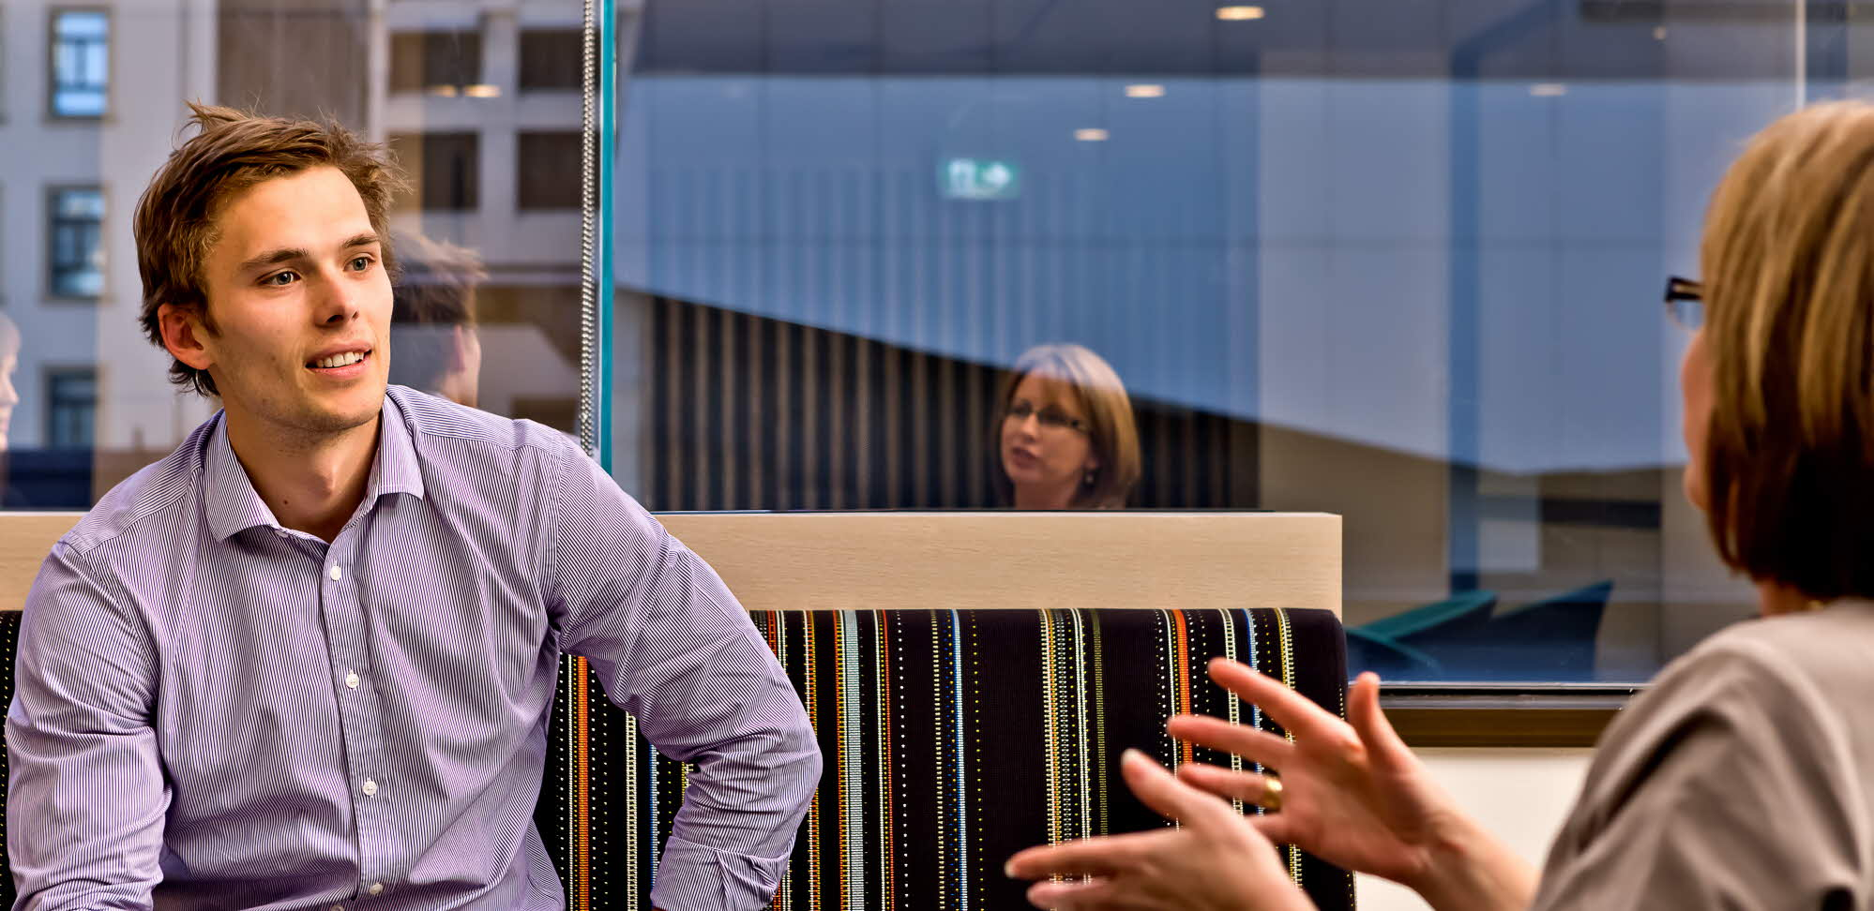
Study counselling at the School of Business and Economics
Susan Grahl Study counsellor, Kalmar E-mail: susan.grahl@lnu.se Office: Building Forma, 2:nd floor

Slide 18
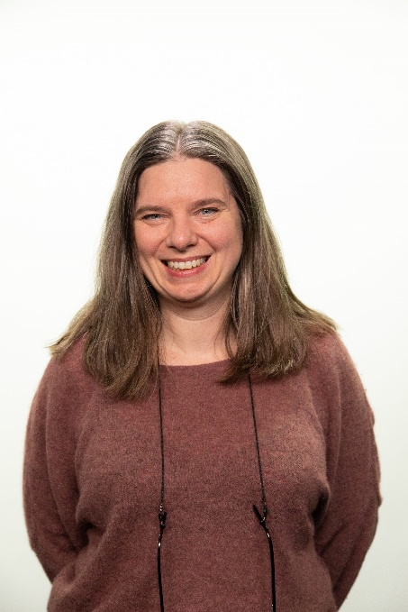
Study counselling at the School of Business and Economics
Mirja Sjögren Study counsellor, Växjö E-mail: mirja.sjogren@lnu.se Office: K-building, 1:st floor

Slide 19
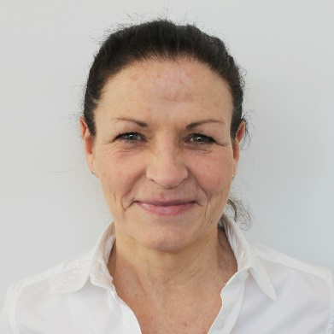
International possibilities campus Kalmar
As a student at Linnaeus University, there are several opportunities for internationalisation: exchange programmes, internships and the possibility of writing your degree project abroad.
International Relations Coordinator Victor Bohman Forma Building 2:nd floor
Questions regarding: - Exchange - Double Degree - Other international experiences
More information at: Study abroad
Contact person for international students
Terese Nilsson
Forma Building
2:nd floor

Slide 20
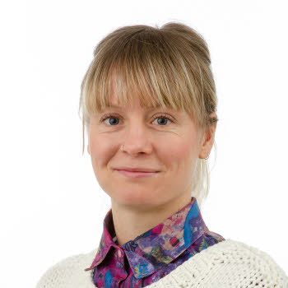
International possibilities campus Växjö
As a student at Linnaeus University, there are several opportunities for internationalisation: exchange programmes, internships and the possibility of writing your degree project abroad.
International Relations Coordinator
Andreas Poltan K buildning, 1st floor
Questions regarding: - Exchange - Double Degree - Other international experiences
More information at: Study abroad
Contact person for international students (parental leave)
Teresa Pauditz Forma Building 2:nd floor
Notes:
Uppdatera med Andreas också

Slide 21
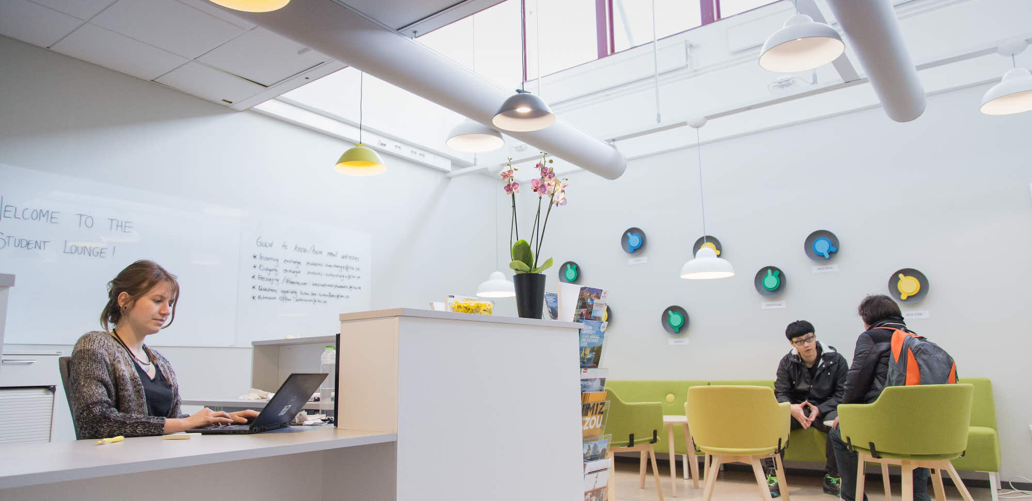
International Office – Student Lounge
Student lounge available via Zoom Monday – Thursday Noon – 2 pm.
inexchange@lnu.se
Notes:
Kolla zoom drop in
Teresa tar den

Slide 22
We wish you
EVERY SUCCESS!
Notes:
Glöm inte bort att uppmana studenterna att registrera sig idag.

