Slide 1
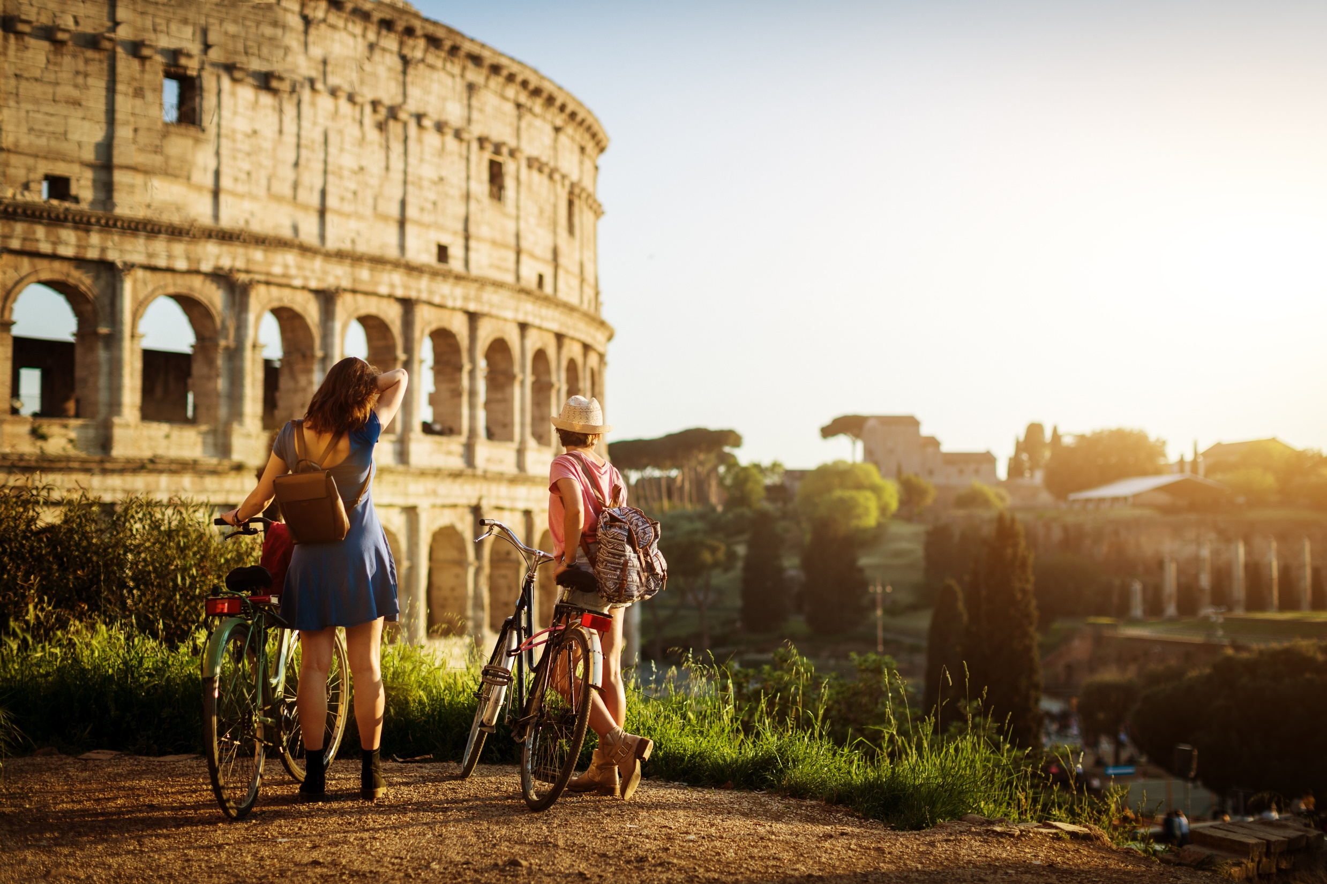
Master in TOURISM AND SUSTAINABILITY, 120cr Linnaeus University Master in Tourism and Sustainability
Programme director:
Per Pettersson Löfquist
Per.Pettersson@lnu.se

Slide 2
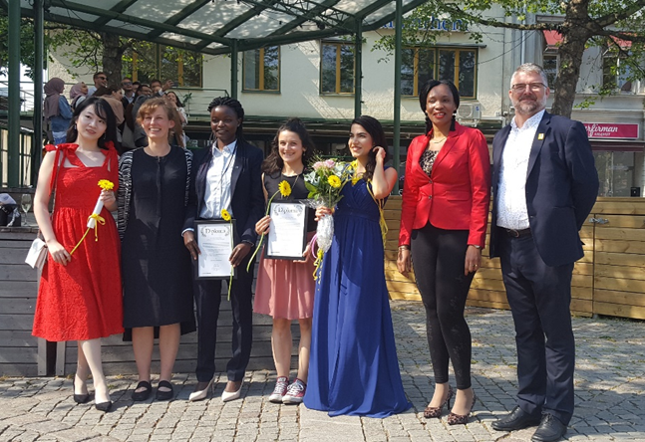
TOURISM AND SUSTAINABILITY, 120cr
Tourism and Sustainability, 2020-
1 | 1 | Tourism studies and tourism theory | Tourism in the Anthropocene |  | Business models for sustainability
 | 2 | Evaluation and planning of tourism sustainability | Developing sustainable destinations | Tourism environmental economics | Advanced individual project in Tourism Studies
2 | 3 | Introduction to research design | Advanced research methodology and data analytics | Internship
 |  | Electives (study abroad/other Master courses at LNU, etc.)
 | 4 | Master thesis

Slide 3
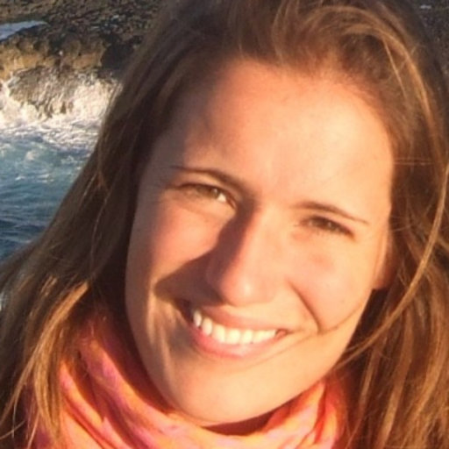
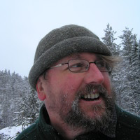
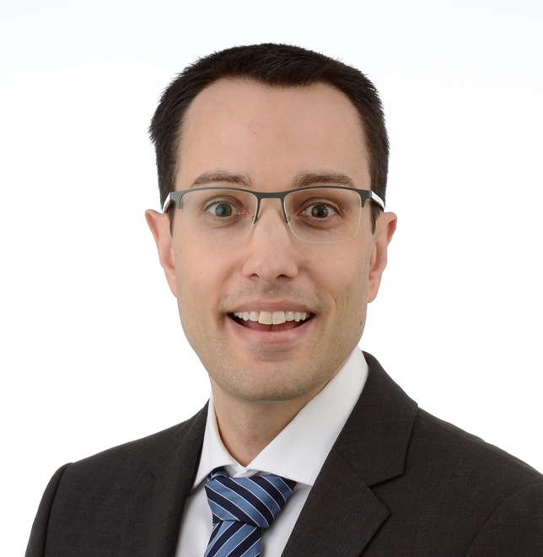
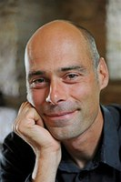
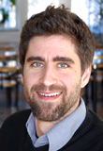
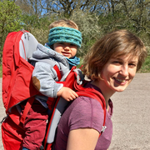
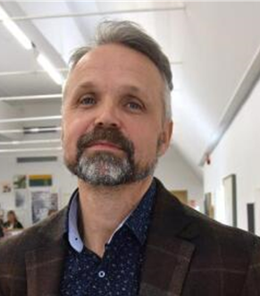
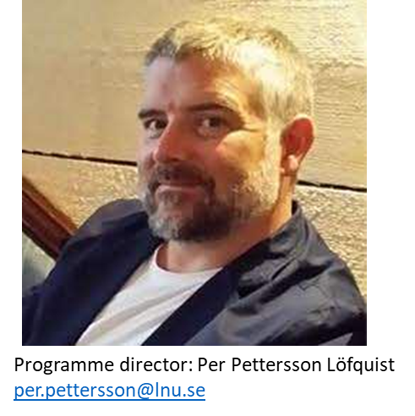
Linnaeus University Tourism Research Group
TOURISM AND SUSTAINABILITY, 120cr

Slide 4
Master in TOURISM AND SUSTAINABILITY, 120cr Linneaus University Master in Tourism and Sustainability
Programme director:
Per Pettersson Löfquist
Per.Pettersson@lnu.se
Emma Lundin (student)
el222nt@student.lnu.se
CONTACT:

