Slide 1
Welcome to the Linnaeus University School of Business and Economics
Setayesh Sattari and Dan Halvarsson setayesh.Sattari@lnu.se and dan.halvarsson@lnu.se
Directors of Marketing Master Program

Slide 2
About the program
Business Administration with specialization in Marketing
With focus on innovation and digitalization
Constantly update of the course material and assignments based on:
  Latest research,
  Students’ feedback,
  Lecturers and faculty feedback, and
  Industry’s needs.

Slide 3
About the program
Business Administration with specialization in Marketing
Focus on innovation and digitalization
Constantly update the course material and assignments based on:
  Latest research,
  Students’ feedback,
  Lecturers and faculty feedback, and
  Industry needs.

Slide 4
Alumni with occupation in industry
Relationship Manager at LinkedIn, Joakim Jörgensen
Global Innovation Manager, Start-up Management at DB Schenker, Pascalina Hiller
Global Product Marketing Manager at Elekta, Larry Mikano
Global Digital Marketing Manager at Blueair, Eduardo Tavares Junqueira
Head of Local Marketing, L'Oréal, Andreas Gartnell
Marketing Manager at Onetrak Pty Ltd, Kim Hansen
Marketing Manager at AdSalsa Nordics, Elma Macanovic
Digital Manager at Havas Media Group, Alena Larina
CEO and co-funder, Evide Group, Vidar Hwang
Communication Manager at IST Group, Josefin Ceder
Project Manager at Svenskt Näringsliv, Jakob Steinstö
Technical Sales Manager at Barry Callebaut Group, Ronny Huynh

Slide 5
Alumni with academic occupation
PhD candidates:
Stockholm University, Aylin Cakanlar
Stockholm School of Economics, Svetlana Kolesova
Jönköping International Business School, Sindi Sheri
Lappeenranta University of Technology, Sina Mortazavi
Linnaeus University, Pär Strandberg
Mälardalen University, Mosarrat Farhana
University of Auckland, Sam El-Tahan

Slide 7
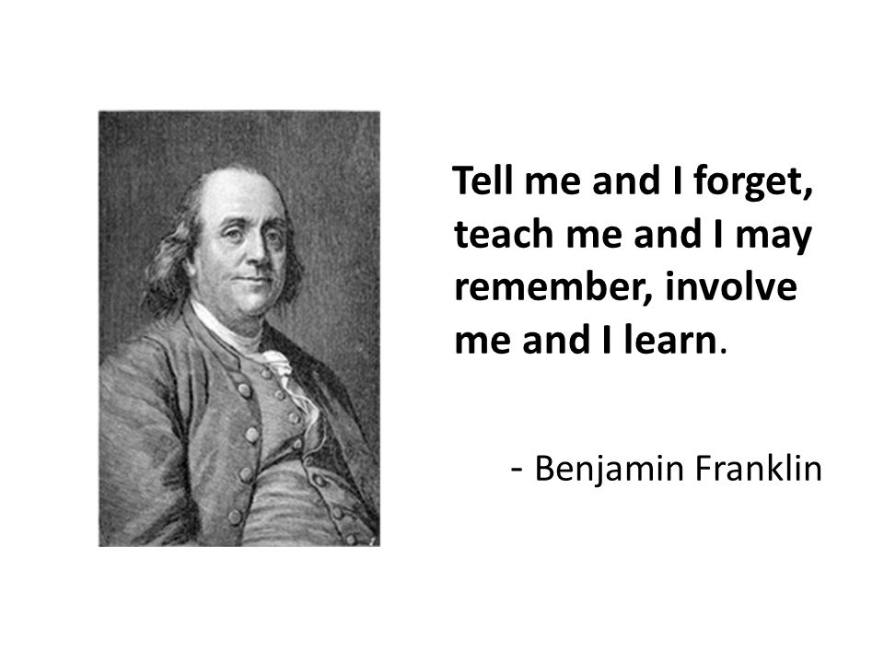
Marketing Master Program

Slide 8
Blooms Taxanomy
https://www.teachthought.com/learning/what-is-blooms-taxonomy-a-definition-for-teachers/

Slide 9
All courses are mandatory
First year
Applied Marketing Analysis, 15 credits,
International Marketing Strategy, 15 credits,
Managing Innovation and Entrepreneurship, 15 credits, and
Qualitative and Quantitative Methods and Applications, 15 credits.

Slide 10
All courses are mandatory
Second year
Contemporary Marketing Research, 15 credits
E-Business Management, 15 credits
Degree Project, 30 credits

Slide 11
Team of lecturers
Professor Anders Pehrsson
Assistant Professor Setayesh Sattari
Associate Professor Selcen Öztürkcan
Assistant Professor Kaisa Lund
Assistant Professor Clarinda Rodrigues
Associate Professor Rana Mostaghel
Assistant Professor Frederic Bill
Lecturer Dan Halvarsson

Slide 12
Thank you!

