Slide 1
Leadership and Management in International Context Master Program, 1 year
Linnaeus University School of Business and Economics

Slide 2
Overview of the program
1. Leadership in international context, 15 credits
2. Contemporary issues in management, 15 credits
3a. Consulting and leading change, 7,5 credits
3.b. Methodology and degree project management, 7,5 credits
4. Degree project (master thesis), 15 credits
Notes:
Going into the depth of leadership, as well as setting the scene of the whole program…
A theme based course (focusing on a choice of themes), with different lecturers who are especially interested in the particular theme.
Given in parallell with the Methodology course. Several previous students are working as consultants, and/or with leading change
Preparation for the master thesis, the discussion has to start early, that is why it is given in parallell with the Consulting and leading change course
Master thesis (written in pairs)

Slide 3
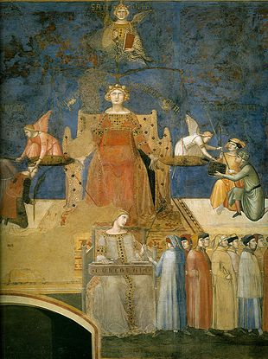
The spirit of the program
A program about leadership –and about You!
A program to be co-created, not consumed!
A truly diverse and multi-cultural learning environment!
The art of leading others goes through the art of leading oneself!
Notes:
Even more important than the individual courses is the overall spirit of this program!
We work actively with self-development activities. It is not only a program about leadership, it is a program about You and your leadership potential.
It builds upon the active involvement of every participant, students as well as teachers. Everyone has something valuable to contribute.
It is a truly diverse learning environment, with students coming from around 15 different nationalities every year. This provides interesting multi-cultural experiences, as well as future friends all over the world!
All of this contributes to the program motto: The art of leading others goes through the art of leading oneself!

