Slide 2
Welcome!
Emeli Wickström
Education Administrator

Slide 3
How to Avoid Plagiarism and Cheating
Sharla Alpenberg
The Academic Skills Centre
The University Library

Slide 4
AI

Slide 5
ACADEMIC INTEGRITY

Slide 6
Maintaining academic integrity is important because:
good academic work is underpinned by honesty, trust and respect
you want to acknowledge who created or developed new ideas or research
knowledge is created by many people, and we want to acknowledge each person's contribution
when you copy someone else’s work, you don’t actually learn anything.

Slide 7
Be honest and submit your own work in your assessments

Slide 8
Be fair and acknowledge the work of others

Slide 9
Be respectful when with others

Slide 10
What is the difference between academic writing and other types of writing?

Slide 11
use of references and citations of published authors
All academic writing is built on the work of others.

Slide 12
Academic Reasons
Shows reader you have done the legwork and know your topic.
To demonstrate that you have read the literature in your area
To add context to your work
to support the argument in your work
You are not considered to be an expert in the field. It adds credibility to your thesis if you can connect your arguments to arguments made by experts

Slide 13
Practical Reasons
To enable readers to trace your sources
To enable you to retrace your steps

Slide 14
Ethical Reasons
To acknowledge other people’s ideas
Avoids plagiarism

Slide 15
Definition
Plagiarism is the presentation of someone else's work as though it were your own" (JISC Plagiarism Advisory Service, 2003)

Slide 16
Understanding different forms of plagiarism is essential to avoid unintentional violations of academic integrity.

Slide 17
Common Forms of Plagiarism
Direct Plagiarism
Self-Plagiarism
Patchwork Plagiarism
Paraphrasing without Attribution
Misleading Citations
Inaccurate Citations
Ghostwriting
Fabrication
Translation Plagiarism

Slide 18
How do you avoid plagiasrism?
By knowing what needs to be documented and proper referencing
Quotations
Paraphrases

Slide 19
Quotations-Using the authors exact words. Must use quotation marks.
Paraphrasing-using the author’s information but putting it into your own words

Slide 20
Unacceptable paraphrase
The rise of industry, the growth of cities, and the expansion of the population were the three great devlopments of late 19th century American History. As new, larger, steam-powered factories became a feature of the American landscape in the East, they transformed farm hands into industrial labourers and provided jobs for a rising tide of immigrants. With industry came urbanization the growth of large cities (like Fall river) which became the centers of production as well of commerce and trade.
Original text from: Lizzie Borden: A case book of Family and Crime in the 1890’s by Joyce Williams.
The increase of industry, the growth of cities, and the explosion of the population were three large factors of 19th century America. As steam-driven companies became more visible in the eastern part of the country, they changed farm hands into factory workers and provided jobs for the large wave of immigrants. With industry came the growth of large cities like Fall River which turned into centers of commerce and trade as well as production.

Slide 21
Acceptable Paraphrase
The rise of industry, the growth of cities, and the expansion of the population were the three great devlopments of late 19th century American History. As new, larger, steam-powered factories became a feature of the American landscape in the East, they transformed farm hands into industrial labourers and provided jobs for a rising tide of immigrants. With industry came urbanization the growth of large cities (like Fall river) which became the centers of production as well of commerce and trade.
Original text from: Lizzie Borden: A case book of Family and Crime in the 1890’s by Joyce Williams.
Fall River was typical of northeastern industrial cities if the 19th century. Williams (1981) talks about steam powered production shifting labour from agriculture to manufacturing, the demand for workers ”transformed farm hands into industrial labourers” (p.156) and created jobs for immigrants. In turn, growing populations increased the size of urban areas. Fall River was one of these hubs ”which became the centers of production as well as of commerce and trade” (p.143)

Slide 22
Why is this a good paraphrase?
Accurately relays information
Gives credit to the source
Indictated which part is taken directly from the source by adding quotation marks and page number.

Slide 23
When and how?
You should provide a reference to any idea that is not your own.
Direct quotes, paraphrasing, images, tables etc.
You do NOT need to reference common knowledge

Slide 24
AI and Plagiarism: The Double-Edged Sword
AI tools can generate text, code, and creative content, which can blur the lines between original work and plagiarism.
The use of AI-generated content without proper attribution can constitute plagiarism.
Awareness of AI's capabilities and limitations is crucial for maintaining academic integrity.

Slide 25
How can you use AI as a tool?

Slide 26
Best Practices for Ethical AI Use in Academia
Always disclose the use of AI when it contributes significantly to your work.
Understand the limitations of AI: It can support your work but should not replace critical thinking.
Ensure AI-generated content adheres to academic integrity guidelines and avoids misrepresentation.

Slide 27
Academic Misconduct
If a student is suspected of academic misconduct, an investigation is carried out.
1. be dismissed with no further measures
2. result in a warning
3. be referred to the disciplinary board for scrutiny.
LNU Website (2023)

Slide 28
THE ACADEMIC SKILLS CENTRE
We are a free advisory service
We offer individual consultations with a learning advisor
Workshops, lectures, Drop-in assignment support
Online resources

Slide 29
What type of support do we offer?

Slide 30
Our formats
Lectures and digital resources
Workshops and individual consultations
Notes:
Those resources prepare you to take part in our other formats. These are student-centered formats where you work with something hands on and we are there to consult. If you are new to Sweden, you may notice that much of our teaching here is student-centered. You are expected to take responsibility for your own learning, and our formats are no different. We are giving you some of the answers, but primarily we are providing you with tools to develop your academic literacy so you can find the answers yourselves.

Slide 31
Open lectures on Zoom- How to succeed with your studies
An Introduction to Higher Education
Sept. 12th 15:00-16:00
Study Skills at University
Sept. 19th 15:00-16:00
Speaking and Presenting at Univeristy
Sept. 26th 15:00-16:00
Academic Writing and Referencing
Oct. 10th 15:00-16:00
https://lnu.se/en/library/library-consultation/how-to-succeed-with-your-studies/

Slide 32
When: Tuesdays
Time: 10-12
Where: 3rd floor of the Library
Room: Alexandria

Slide 33
Assignment and Search Support Online
Thursdays on Zoom 12:00-1:30 pm.
https://lnu-se.zoom.us/j/66923812274
Librarians and ASC staff are available.

Slide 34
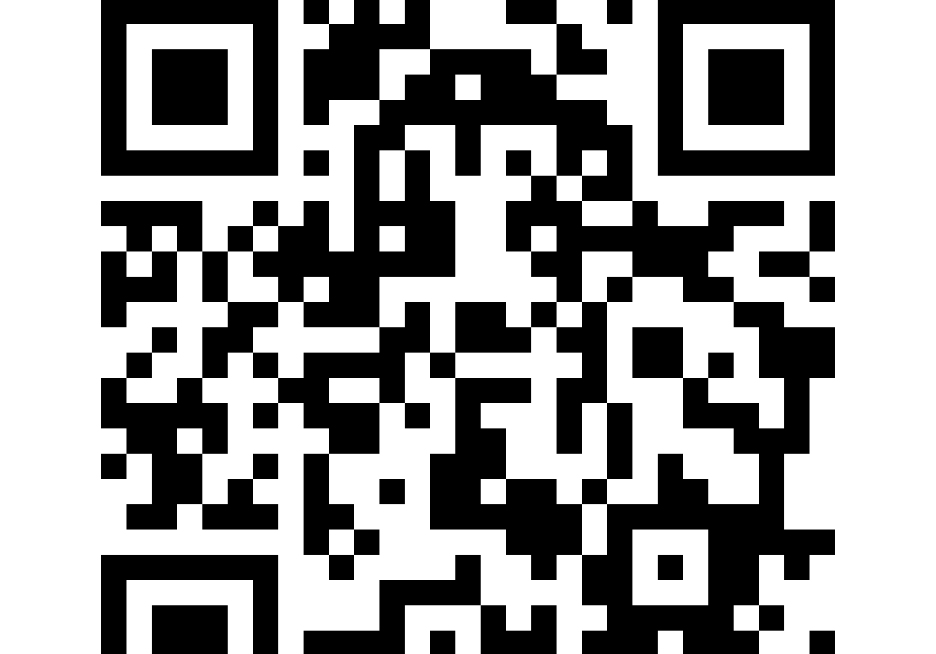
Individual Consulations-booking system

Slide 35
Study counsellors at the Faculty of Technology
Tina Karlsson
https://lnu.se/en/staff/tina.karlsson/
Johan Gylling https://lnu.se/en/staff/johan.gylling/

Slide 36
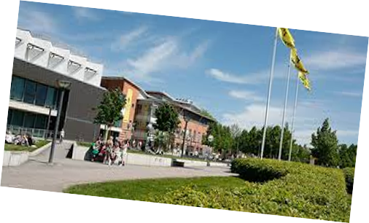
Agenda
Support during your studies
Study counselling
Student account
Support functions
The University – a public authority
Study handbook
Visa and CSN
Studying with a disability

Slide 37
Study guidance at the Faculty of Technology
Professional secrecy
Guidance counseling for admitted students
Approved leave of studies
Individual study plan
Entry requirements
Credit transfer
Courses and programs

Slide 38
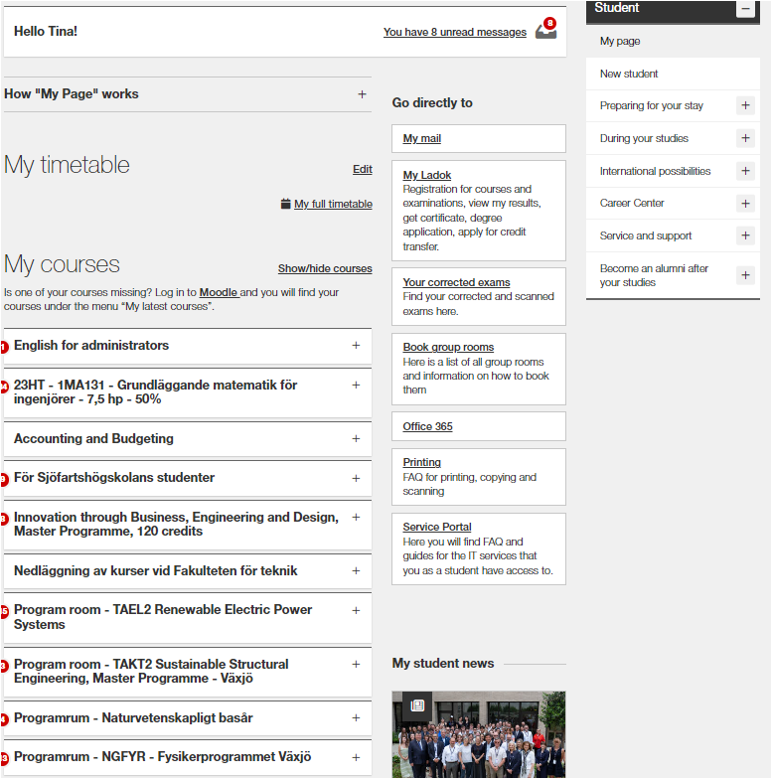
Student Account
https://lnu.se/en/
My student news
Schedule
Email
LADOK
Apply for courses
Registrations
Results
Apply for examinations
Certificates
Apply for degree
Service and support

Slide 39
Support during your studies
The University Library
How to succeed with your studies
Study counselling during your studies
Career Center
Student Welfare Office

Slide 40
The University – a public authority
Higher Education Act (Högskolelagen)
- regulates public universities in Sweden
- set up by the Swedish Government
Local regulations
Right and responsibillities
Programme and course syllabuses
Notes:
Glöm ej Study handbook

Slide 41
Visa
Fulltime studies every semester
Notes:
Glöm ej Study handbook

Slide 42
CSN
Please note only for
students who are entitled to study funds from CSN.
Swedish Board of Student Finance (CSN)
Inform CSN if you now longer have fulltime studies
Notes:
Glöm ej Study handbook

Slide 43
Studying with a disability
Apply for support via Nais
Individual support planned with a coordinator
Notes:
Glöm ej Study handbook

Slide 44
Thanks for listning!

Slide 45
Notes:
Presentationsmaterial ht2023

Slide 46
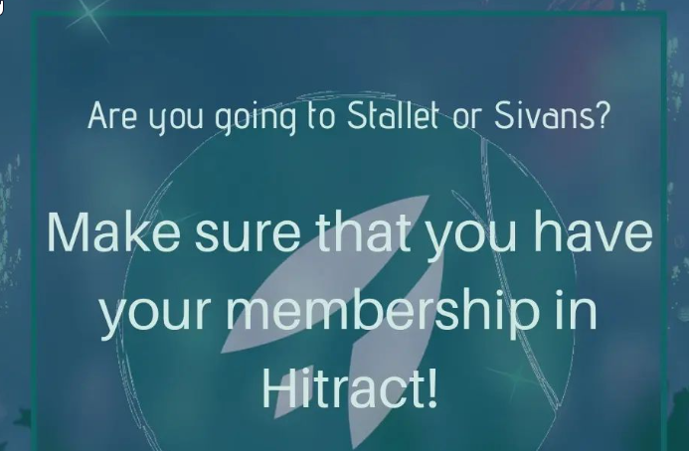
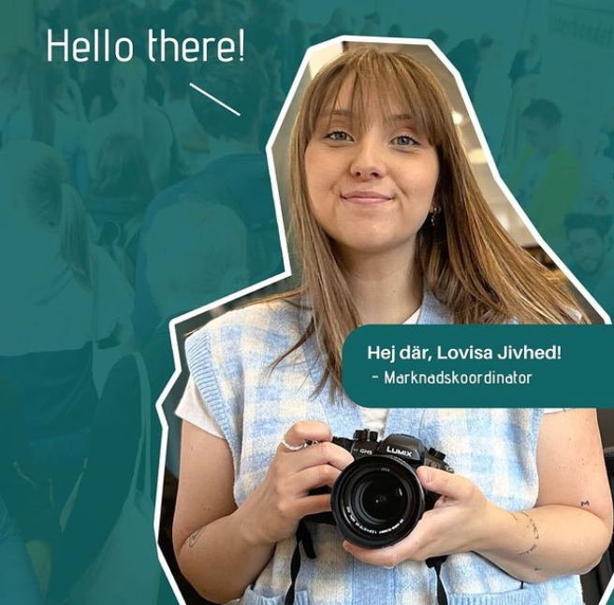
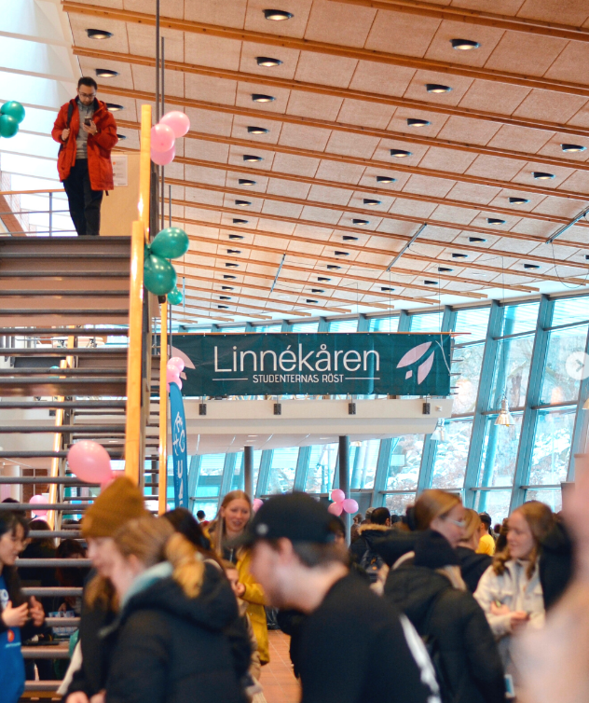
Linnaeus Union
Democratic non-governmental organization, politically and religiously independent
Educational quality and student social matters
Represents all students at LNU
4400 members
5 full-time and 6 part-time board members, 8 employees

Slide 47
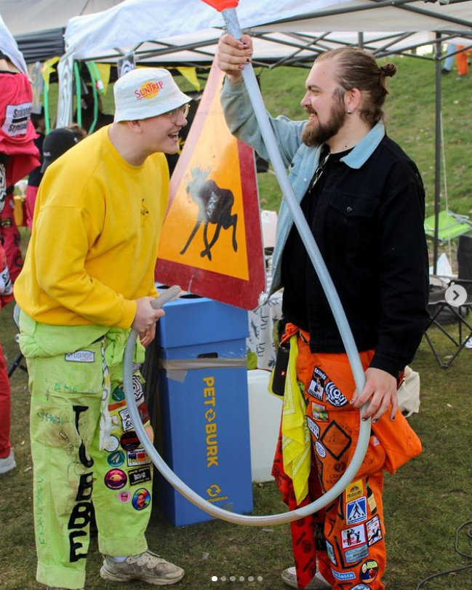
Social matters
Associations and pubs
Competitions and events
Introduction Week and Welcome Fairs
End of Summer Bash, Valborg (Walpurgis)
Housing agency and Job portal
International matters and the Buddy program
Campus safety, alcohol, drugs, LGBTQI+ matters
Reasonable rents and public transport
…etc.

Slide 48
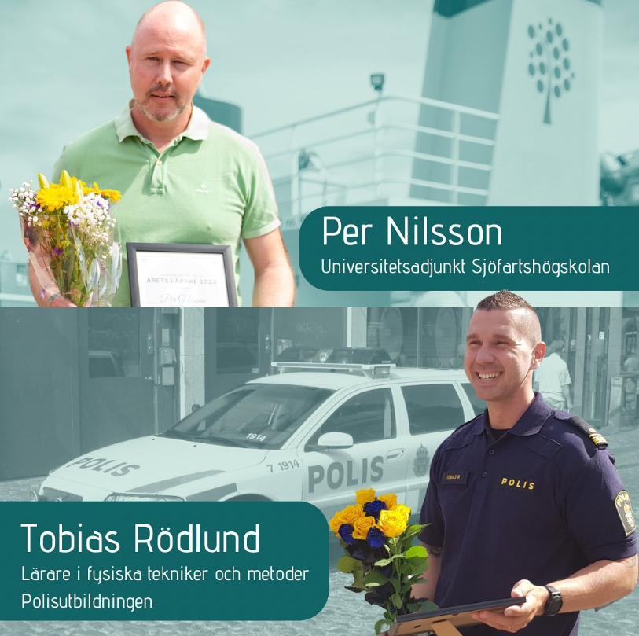
Educational quality
Advocating student matters
Quality evaluations
Student representation
Student safety representatives
Course literature grant, Dedication grant, Teacher of the Year
SFS and other student unions

Slide 49
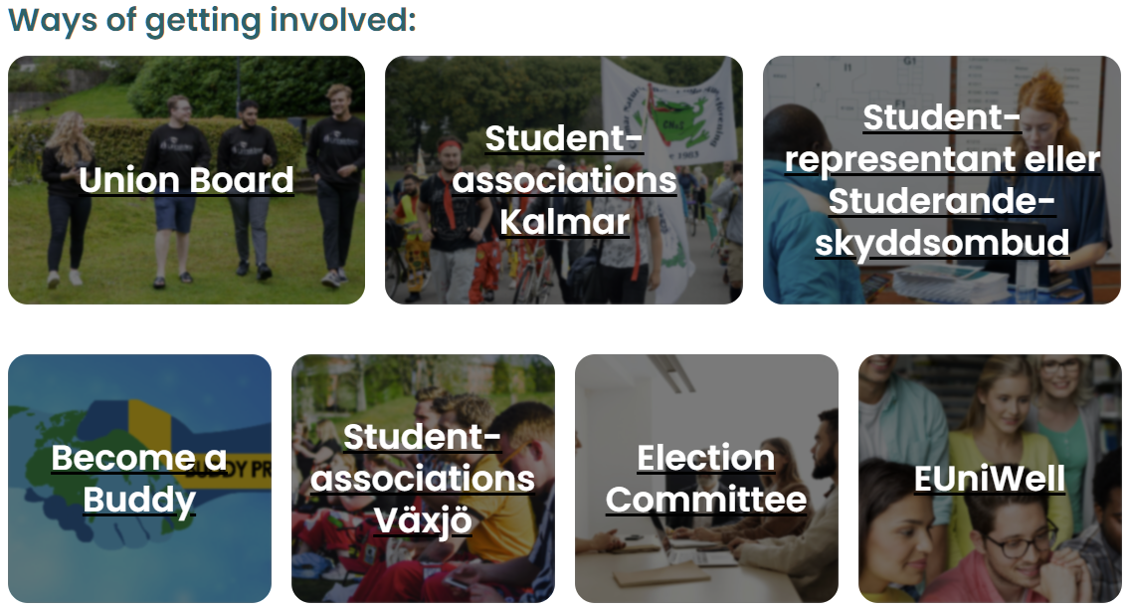
Get involved!

Slide 50
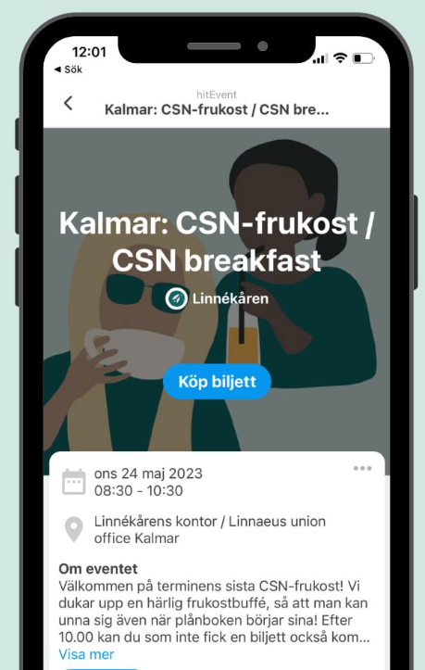
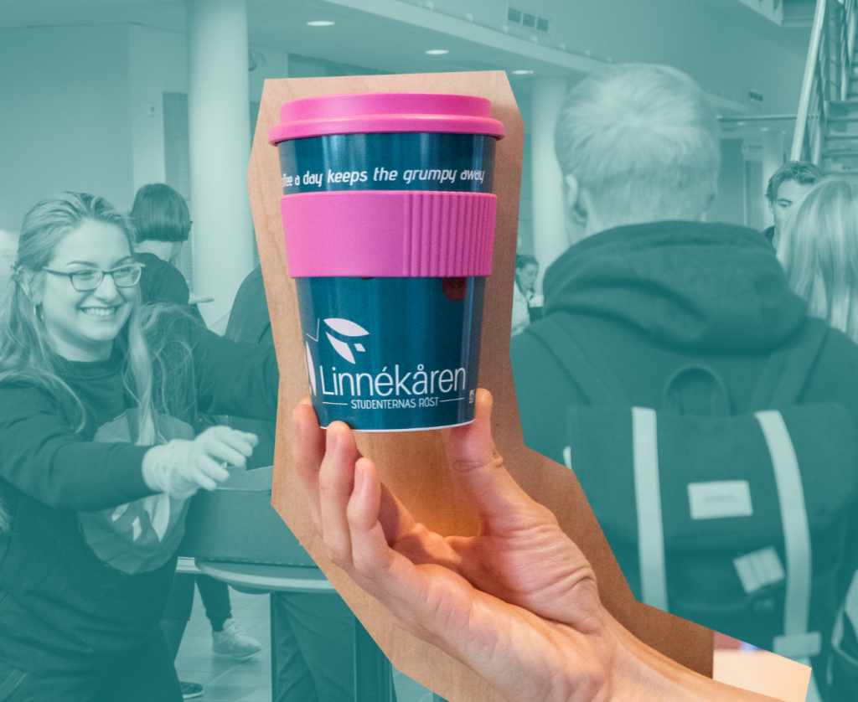
Member benefits
Member-exclusive events such as CSN-breakfast, Linnékåven, stipends, discounts, offers, trips
Member coffee every Thursday
Monthly newsletter
Access to student pubs

Slide 51
The Buddy program
https://linnek.se/eng/buddyprogrammet/
Buddy program administrator
Karin Siöö, studcoord@linnek.se

Slide 52
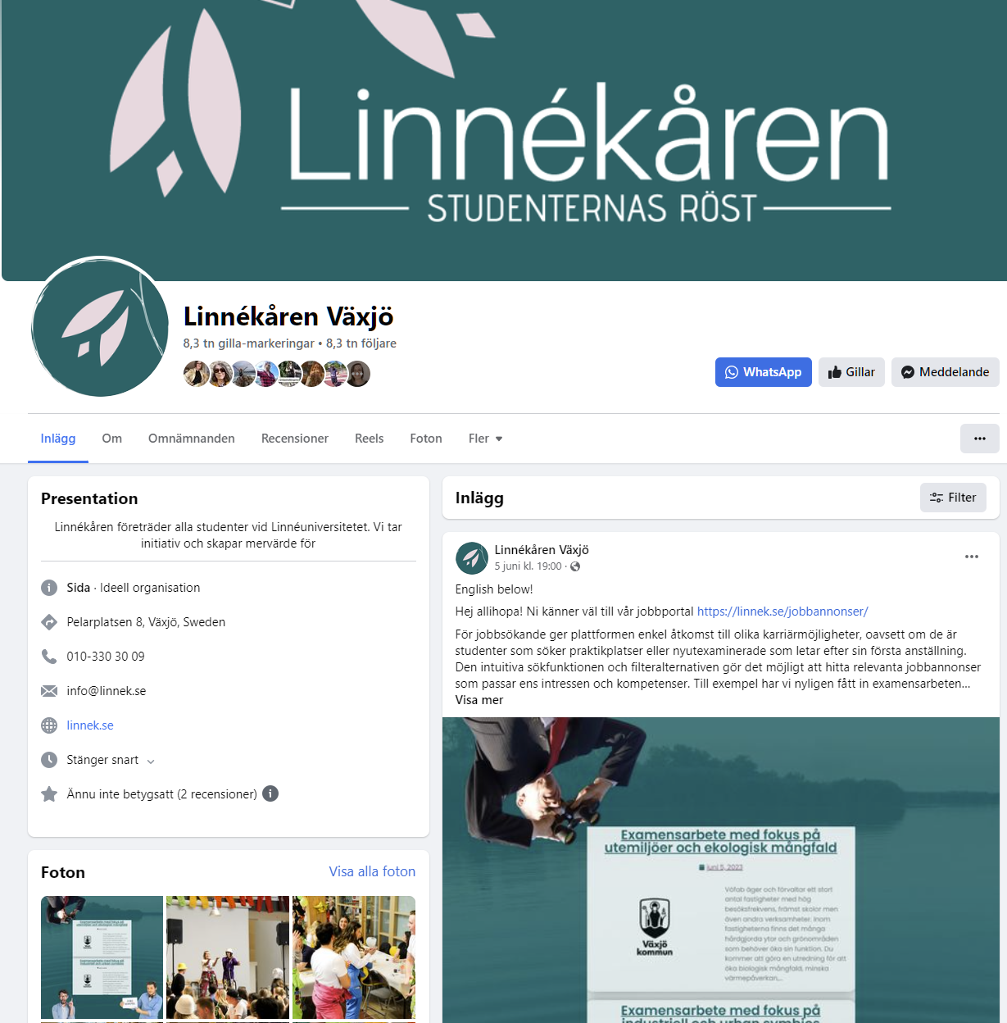
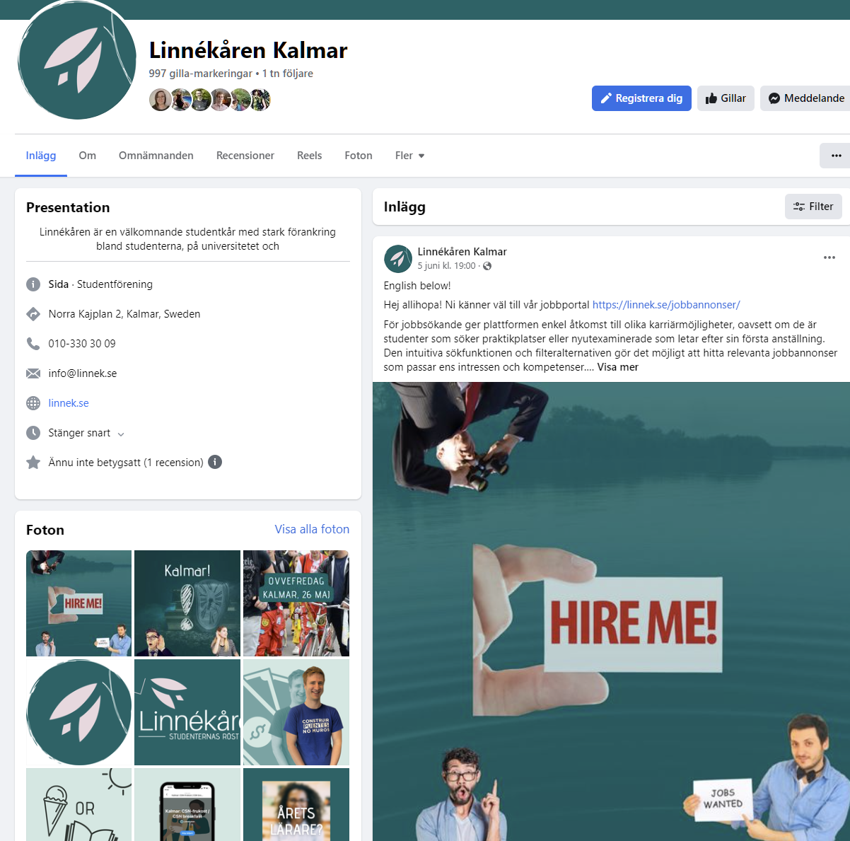
Find us on…
Hitract
Facebook
Instagram
YouTube
TikTok
Das Papier
Newsletter
Web
Mail
Phone
Offices in Kalmar and Växjö

Slide 53
New in Växjö?
Welcome package from the municipality when you register in the population register. To take part of this offer you must stay in Sweden longer than 12 months.
500 SEK gift voucher
500 SEK for local transport

Slide 54
Help and support
Laws, rules, guidelines
University routines and processes
Rights and responsibilities
Questions regarding courses and exams
Cheating and plagiarism, references, ChatGPT
Harassment and unacceptable behavior
Study environment issues

Slide 55
National student ID
When in Sweden you need a national student ID for discounts on travel, restaurants, hotels, computers, clothing etc.
STUK (Studentkortet) – recommended
Mecenat
WeStudents (requires Bank-ID)

Slide 56
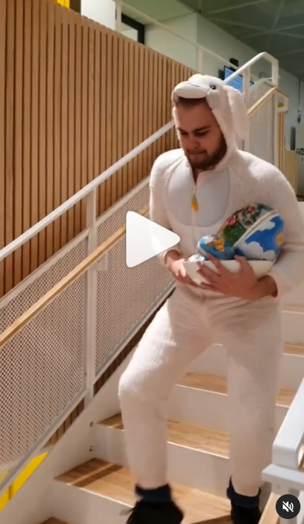
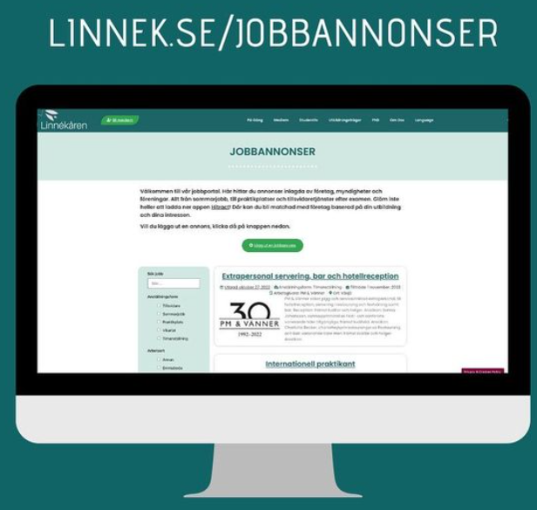
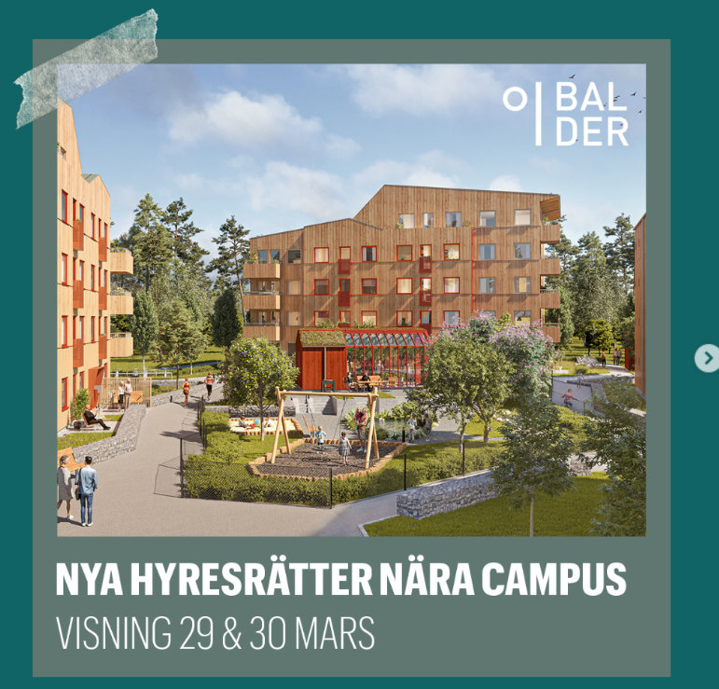
Contact us
Växjö: Pelarplatsen 8 (opposite library entrance)
Facebook Växjö Open Wed 12-14 & Thur 10-12
Kalmar: Hus Stella
Facebook Kalmar Open Wed 12-14 & Thur 10-12
010-330 30 09 (09:00-11:30)
info@linnek.se
https://www.instagram.com/linnek.se/

Slide 57
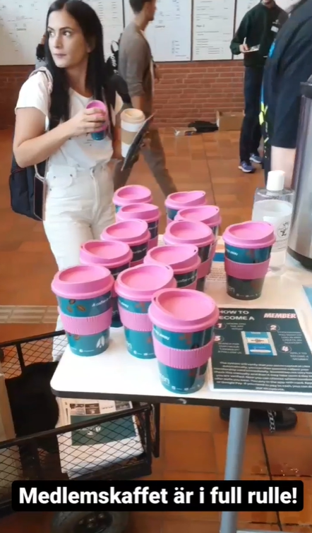
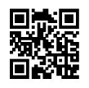
How do I join?
Download the Hitract app and create an account
Find our hitClub by searching for “Linnékåren”
Press “Bli medlem” and follow instructions
Done!

Slide 58
Get involved!

Slide 59
Member benefits
Member-exclusive events such as CSN-breakfast, Linnékåven, stipends, discounts, offers, trips
Member coffee every Thursday
Monthly newsletter
Access to student pubs

Slide 60
The Buddy program
https://linnek.se/eng/buddyprogrammet/
Buddy program administrator
Karin Siöö, studcoord@linnek.se

Slide 61
Find us on…
Hitract
Facebook
Instagram
YouTube
TikTok
Das Papier
Newsletter
Web
Mail
Phone
Offices in Kalmar and Växjö

Slide 62
New in Växjö?
Welcome package from the municipality when you register in the population register. To take part of this offer you must stay in Sweden longer than 12 months.
500 SEK gift voucher
500 SEK for local transport

Slide 63
Help and support
Laws, rules, guidelines
University routines and processes
Rights and responsibilities
Questions regarding courses and exams
Cheating and plagiarism, references, ChatGPT
Harassment and unacceptable behavior
Study environment issues

Slide 64
National student ID
When in Sweden you need a national student ID for discounts on travel, restaurants, hotels, computers, clothing etc.
STUK (Studentkortet) – recommended
Mecenat
WeStudents (requires Bank-ID)

Slide 65
Contact us
Växjö: Pelarplatsen 8 (opposite library entrance)
Facebook Växjö Open Wed 12-14 & Thur 10-12
Kalmar: Hus Stella
Facebook Kalmar Open Wed 12-14 & Thur 10-12
010-330 30 09 (09:00-11:30)
info@linnek.se
https://www.instagram.com/linnek.se/

Slide 66
How do I join?
Download the Hitract app and create an account
Find our hitClub by searching for “Linnékåren”
Press “Bli medlem” and follow instructions
Done!

Slide 67
International possibilities
Katarina Rönndahl, International Coordinator, Faculty of Technology
Denis Devlet, student Network Security Program

Slide 68
International possibilities
Exchange studies
Internship
International possibilities at home

Slide 69
Why?
You earn credits while you travel
Personal development
You gain better confidence and become more independent by learning to "survive" in a different environment..
International experience important in all professional areas.
You improve your communication skills and learn to master a new language or increase your competence in the language you already know..
The recruiter: "It shows a driving force."
New contacts, expanded network
International studies make you attractive in an international labor market and can be the tip of your CV.
You get to experience different cultures and traditions on site.

Slide 70
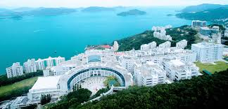
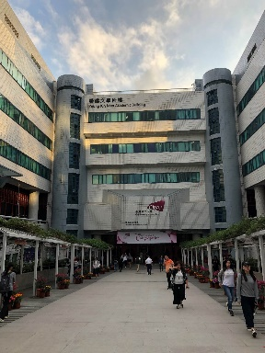
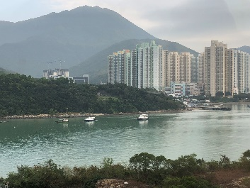
Exchange studies
1 or 2 semester study at one of LNU´s partner institutions
Exchange courses – credit transfer
No tuition fee at the partner university (if you pay tution fee to LNU, you will pay tution fee to LNU)
Erasmus scholarship. (EU Member States + Iceland, Norway, Liechtenstein, Macedonia, Serbia, Turkey.) The scholarship is 510 or 560 EUR/month depending on host country.
Visa/residence permit
Apply the academic year before the exchange.
Application deadlines 15 November and 1 March!
Information: https://lnu.se/en/student/international-possibilities/study-abroad/

Slide 71
Internship abroad
During the studies or after
You are responsible for finding the internship place
Erasmus scholarship if you do internship in the EU(+the other Ersmus countries)for at least 2 months - Ongoing application
Erasmus Intern is a collection database for internships at various organizations and companies throughout Europe. The site is managed by Erasmus Student Network (ESN), an international non-profit student association. https://erasmusintern.org/
IAESTE (The International Association for the Exchange of Students for Technical Experience) is a global exchange program that offers paid internships abroad in over 80 countries primarily for students in the fields of natural science, engineering and architecture.
Information: https://lnu.se/en/student/international-possibilities/InternshipAbroad/

Slide 72
Internationalization at home
Become a buddy / mentor for a foreign student
https://linnek.se/buddyprogrammet/
Linnékåren: https://linnek.se/eng/

Slide 73
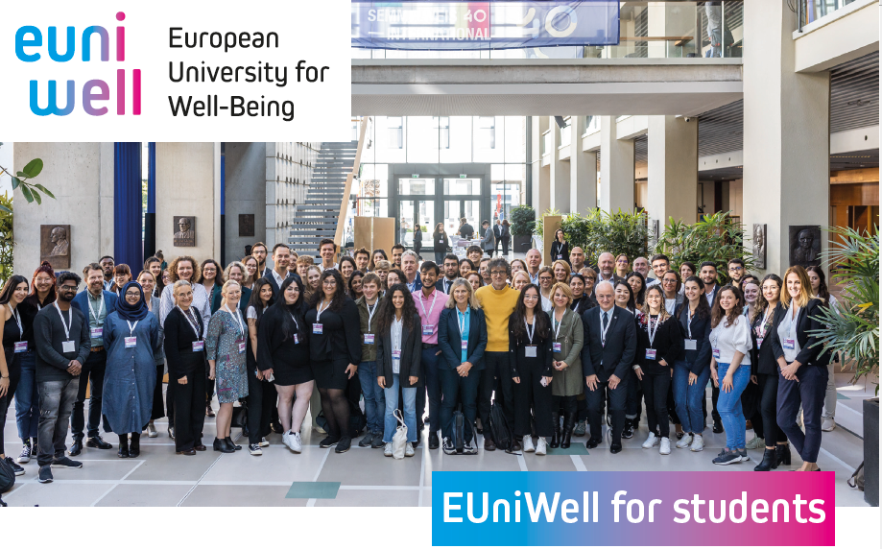
https://lnu.se/en/student/international-possibilities/euniwell-student/
Notes:
EUniWell, is an alliance of several universities working together on education and research in the field of well-being.

Slide 74
Contact info – how does what?
Faculty of Technology:
Katarina Rönndahl, internationell koordinator
E-mail: katarina.ronndahl@lnu.se
International Office:
Student Lounge in H-building:
E-mail: outexchange@lnu.se
Follow our students on exchange at instagram @lnuabroad

Slide 75
Questions?

Slide 76
EXCHANGE STUDIES
Kwansei Gakuin University, Nishinomiya, Hyogo, Japan

Slide 77
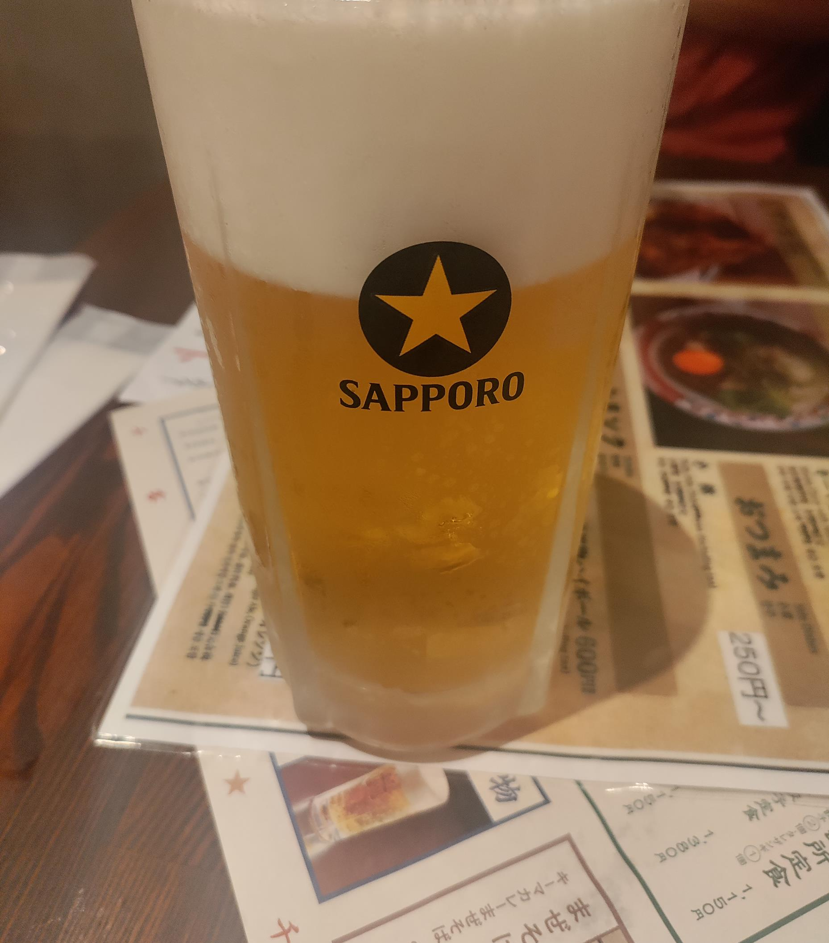
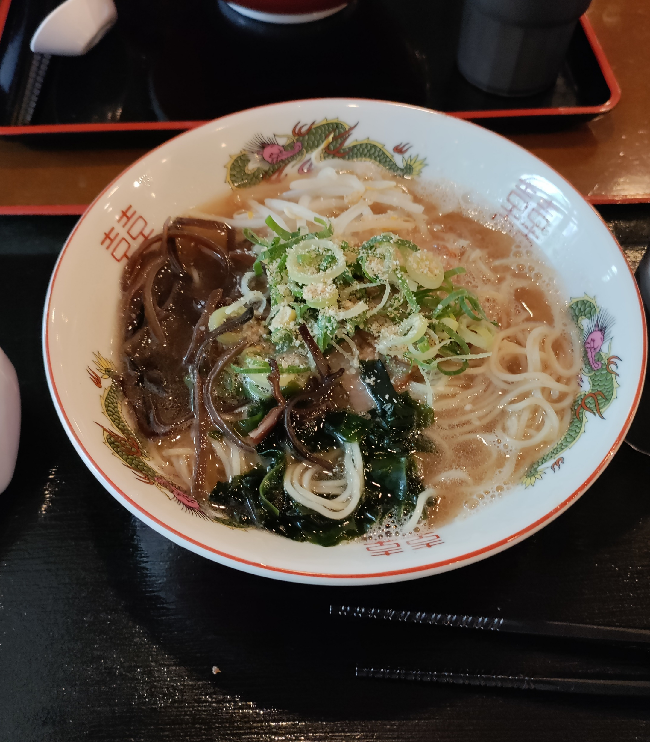
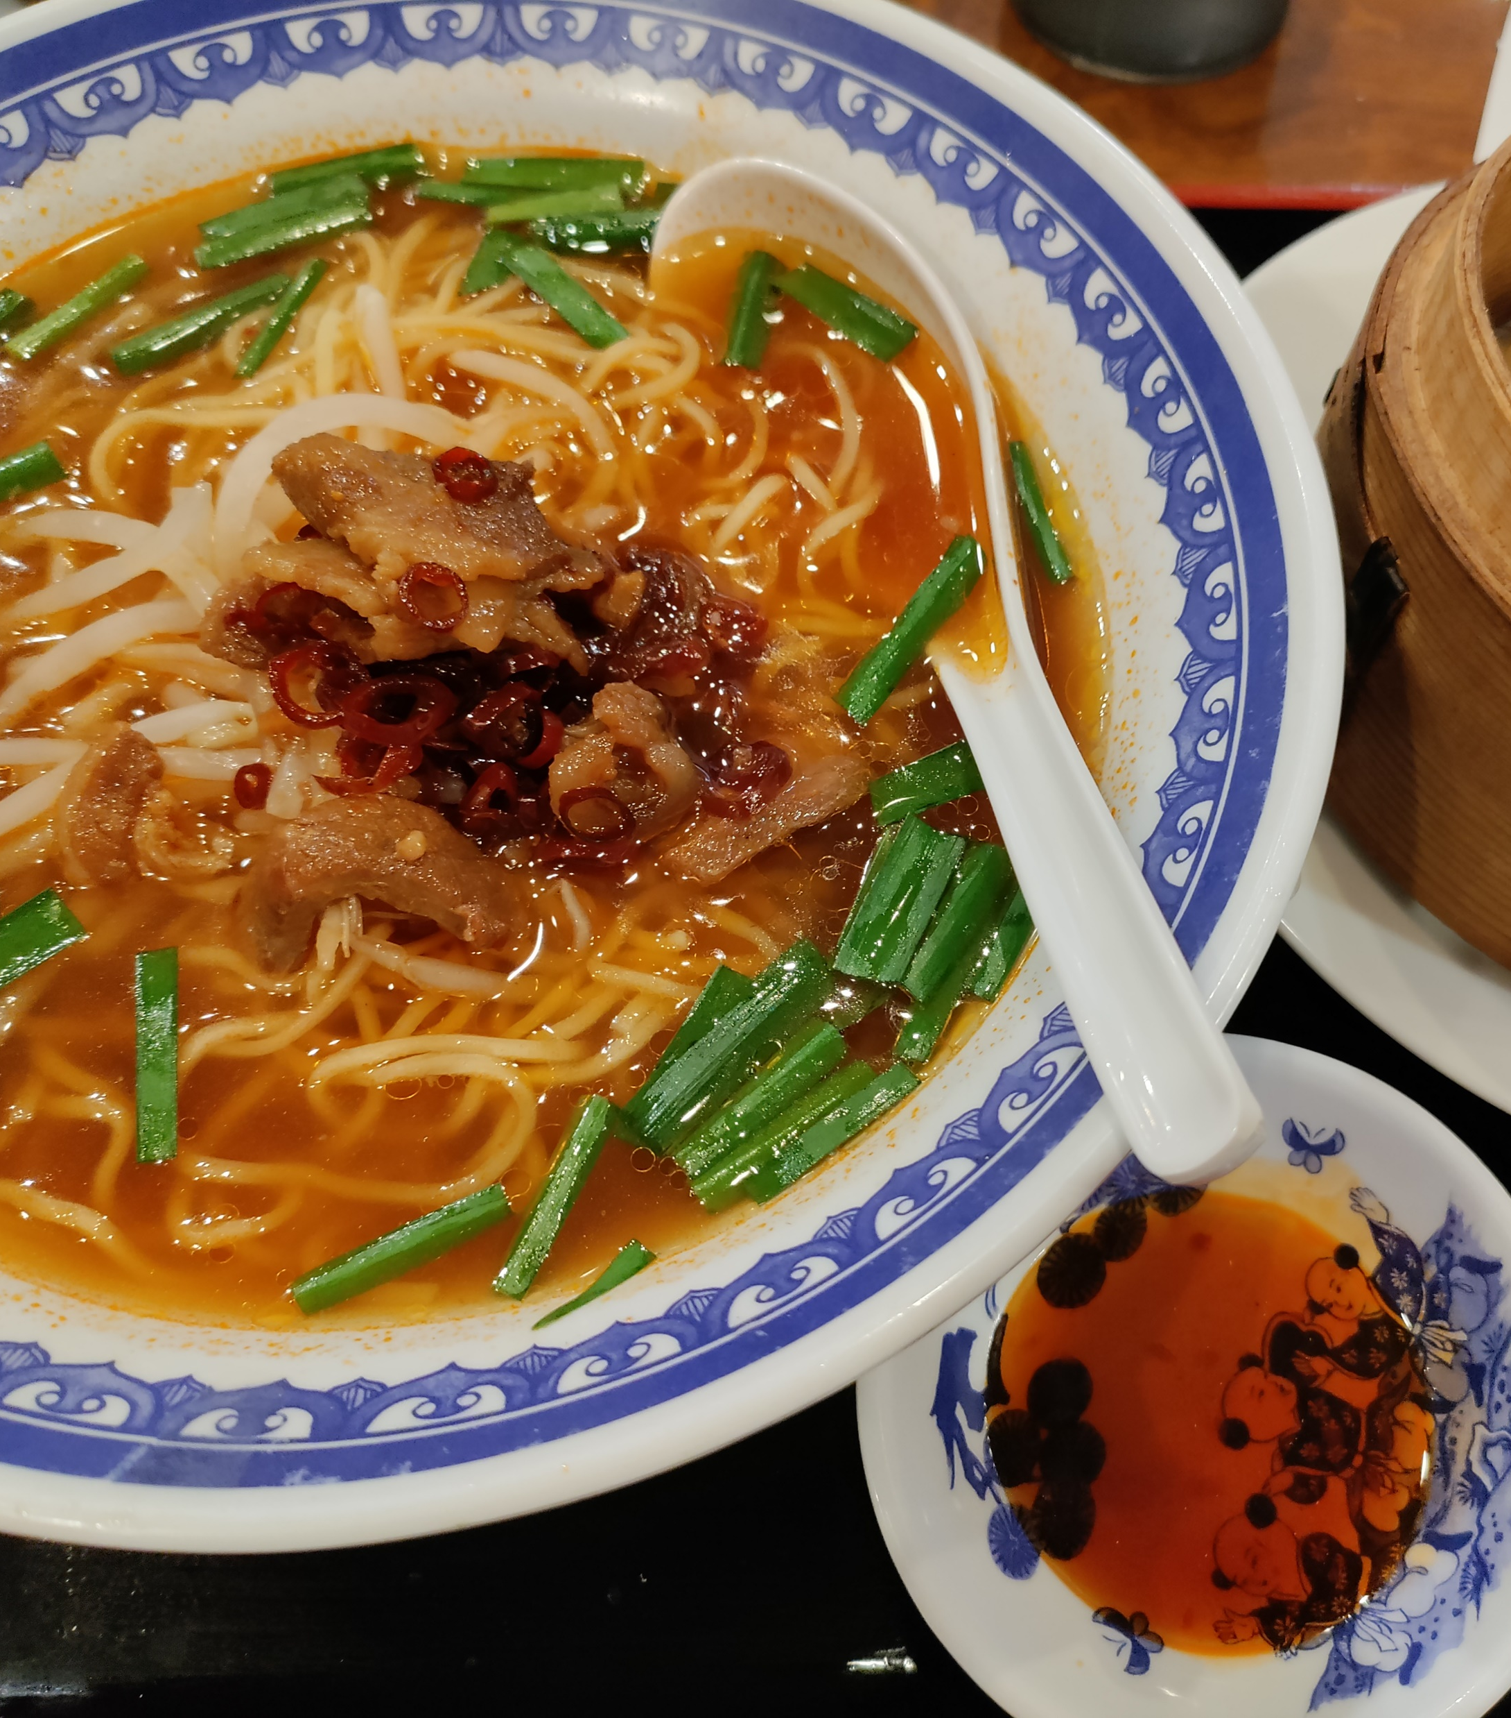
The food

Slide 86
To take an examination at LNU:
.
Written assignment?
Check if there is a submission date.
Re-exam?
Find out if there are any changes.
Find out what applies at the course introduction.
In groups or individually?
Laboratory work
Seminars
Assignments
Oral examination
Online exams
Written exams
Ask questions during the lessons throughout the course!
Sample exam?

Slide 87
Written exam
Bring along:
Pencil, rubber, ink pen.
Anonymisation code.
Valid ID.
Indicated examination aids. (ie. calculator)
Something to drink/eat.
Studying with a disability:
Ask your coordinator about adaptions.
Register for the exam in Ladok.
Note your anonymisation code.
You get an email about your room placement a few days before the exam.
You can enter the examination room 30 min before start.
Second admission:
45 minutes after the start of the exam.
Primarily for participants who arrived late.
Not registered – subject to space.

Slide 88
Contact with companies and organizations Collaboration
Jan Novak
jan.novak@lnu.se
0470-70 80 16

Slide 89
Collaboration can be many different things
Internship
Degree projekt
Case studies
Mentoring program
Fairs
The career portal

Slide 90
Career Day Technology 2024 18 nov 2024
a full day for companies, organizations and students in the educational fields of construction, data/IT and technology
Career Day Technology 2024 | lnu.se

Slide 91
Educational associations

Slide 92
Thank you!

