Slide 2
Welcome to the Faculty of Health and Life Sciences at Linnaeus University
Programme
Period
Notes:
Welcome to the Faculty of Health and Life Sciences at Linnaeus University
Fill in the programme title and period
Feel free to post this ppt in your Moodle course room.

Slide 3
Checklist – new student
On Lnu.se, you will find a checklist and practical information for new students.
lnu.se/en/student/new-student/
Notes:
Student at Faculty of Health and Life Sciences
Checklist for new students: https://lnu.se/en/student/new-student/
The following information is available via this link:
Obtaining a student account
Registration – is possible one week before the course starts, must have student account to be able to register. Any issues, ask students to contact the education administration at FHL. On the next slide, you can show the students where to click to register.
Some practical information like:
Student web
E-mail
Swipe card
IT-support
The University LIbrary
etc.

Slide 4
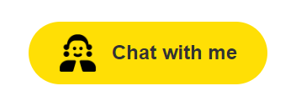

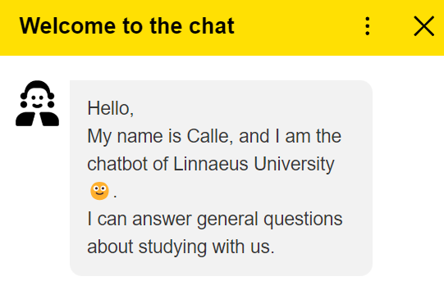
Get help directly from our chatbot!
Get help from Calle the chatbot, our digital assistant who can answer many of the questions you might have as a new student.
You can find the chatbot on in the lower right corner of Lnu.se.
Notes:
Get help directly from our new chatbot!

Slide 5
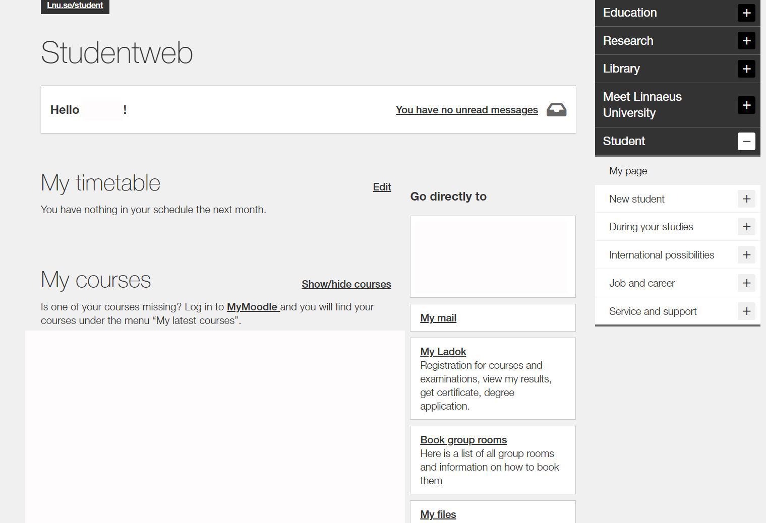
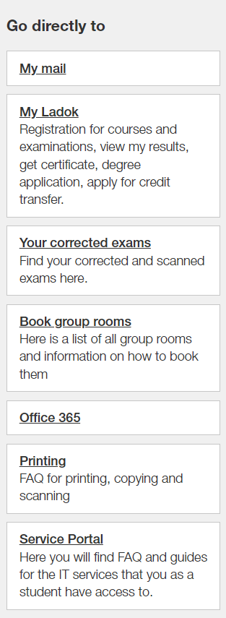
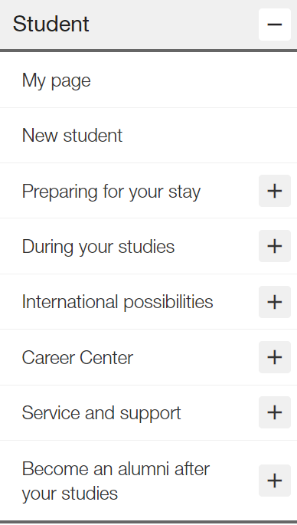
Student web
*Name*
Log in to lnu.se/en/student/ to see if you have received any new messages, register for your exam, see your results, and much more relating to your studies.
*When you are registered to a course it will be visible here*
Notes:
Student web
This is the view when the student is logged in to lnu.se/student, and they will be able to find the following:
My timetable
My courses – There is a direct link to the MyMoodle course room. When the student is registered to the course it will be visible under My Courses.
My Ladok:
Registration for course – opens one week before the course starts
View my results
Registration for examinations, exam at alternative location
Get certificate
Etc.
When they are logged in, they can find important information on the right hand side of the screen, such as:
During your studies: Registration, Timetables, Course syllbi, IT support, registration for examination and degree project information
International possibilities: International Office, information abour study abroad
Job and career: Activites, Mycarrer, the metor programme etc.
Service and support: info center, Technical support, student services, etc.
While logged in they can also find My student news and events, where information regarding them is published, such as open lectures or reminders.

Slide 6
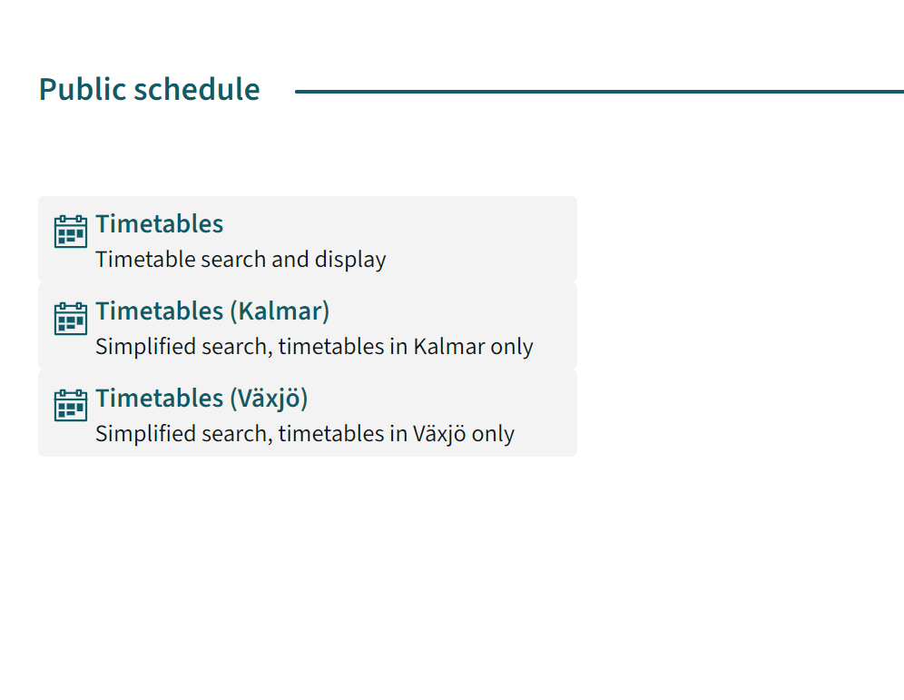
Timetable
Before you are registered to a course, you can find your timetable via TimeEdit.
Notes:
Timetable
Once the student is registered to a course, he or she can access a personalized timetable via ”My full timetable. Again, the student must be registered in order to be able to access the timetable on lnu.se/student.
If a student wants to check a course timetable prior to the registration period of said course, this can be done via TimeEdit. Beware that timetables on TimeEdit are usually published, at the earliest, one month prior to course start.

Slide 7
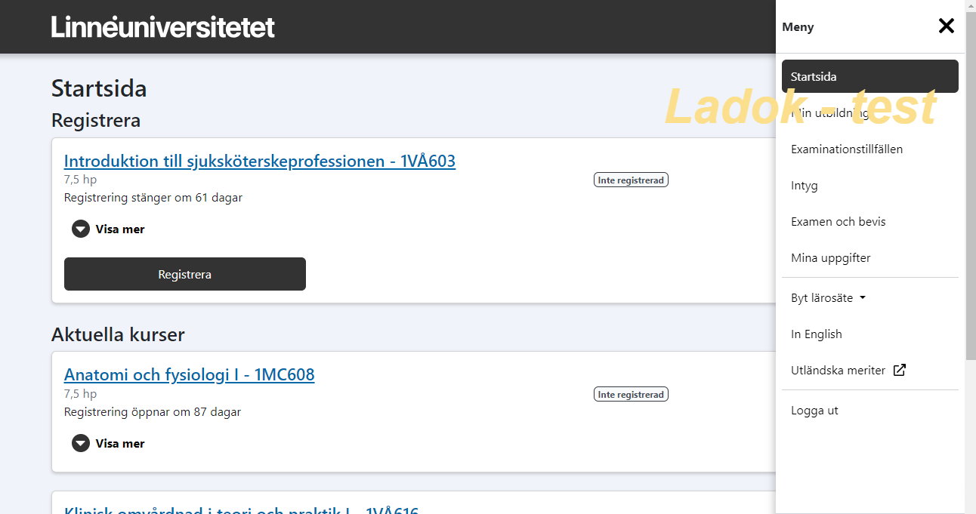
Ladok
In Ladok, you can find grades, certificates, and exam registration.
*When you are registered to a course it will be visible here*
Notes:
Ladok
Picture only in Swedish, but it looks the same in English
Students get here via the student web. This is how it looks on the home page with the menu expanded to the right. All current courses are shown here. In this example, a course that is open for registration and one that is not yet open for registration.
Under "My education" in the menu on the right, the student can access all courses, including not started and completed, TG etc. When a student has clicked on a course, they can also register and cancel
They can do the following:
Registration for course – opens one week before the course starts.
View my results
Registration for examinations
Get certificates
Etc.

Slide 8
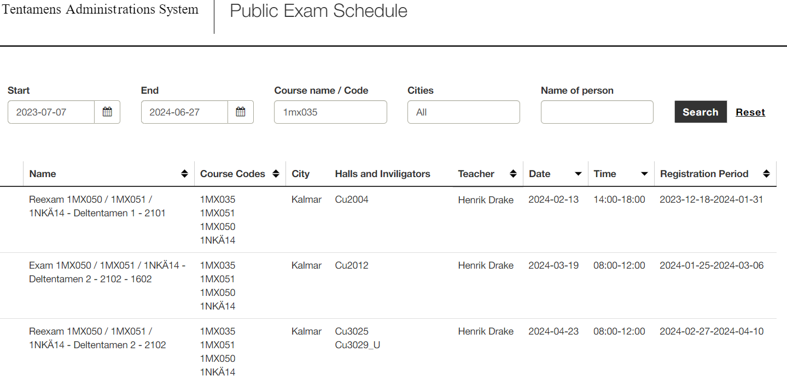
Exam Schedule
By visiting salstentamen.lnu.se, you can see the date of the next exam in advance.
Notes:
Exam Schedule
Students can see the next opportunity to take an exam by going to salstentamen.lnu.se (link in picture).
When searching, make sure to fill in the following:
End (final day for search query)
Course name / code
Under Date – the date when the exam is given
Under Registration period – the dates when the exam is open for registration
Note that the registration for an exam is not made through the exam schedule, but through Ladok, accessed via the student web.

Slide 9
The learning platform Moodle
Moodle is the digital learning platform at Linnaeus University.
Programme room
Course room
On this page in Moodle, you will find information compiled for students at the Faculty of Health and Life Sciences.
Notes:
The learning platform Moodle
Add the link to your programme room
Add the link to the first course room
Here you can find student related information
LNU uses the platform Moodle, which is a digital course- and program platform.
Feel free to present the different platforms of Moodle:
Programme
Course

Slide 10
Course and programme syllabuses
The programme syllabus governs a programme’s objectives, structure, content and degree.
The course syllabus governs the learning objectives, content, examination, literature etc. of the respective course. It always specifies what prerequisites must be met to be eligible to register for the course.
Always read through the course syllabus prior to each new course. You find course- and programme syllabuses here.
Notes:
Course and programme syllabuses
Show the students where to find program- and course syllabi, namely via the following link:
https://lnu.se/en/student/during-your-studies/course-and-programme-syllabi/
Important to show in the course syllbus is:
Prerequisites - Mention that the student’s prior courses and credits determine whether or not the student is eligible for a course (show where in the course syllabus this is mentioned). In other words, a student can be denied access to a course, if said the student does not meet the requirements and terms for that course.
Also, make sure to show the students where to find the course literature in the course syllabus.

Slide 11
Course examination
There are different types of examination, for example written exams, digital exams, written assignments and seminars.
The responsible course coordinator informs about how the course is assessed. This is also stated in the course syllabus.
If you recieved a passing grade you cannot retake the same examination in order to obtain a higher grade.
Notes:
Course examination
List the different types of course examination, such as:
Written exam,
Take-home examination,
Written assignment,
Quiz,
Digital exam,
Case,
etc.
Feel free to make an example of the first course and its forms of examinations and present its course syllabus.
Important to mention is: If you recived a passing grade you cannot retake the same examination in order to obtain a higher grade.

Slide 12
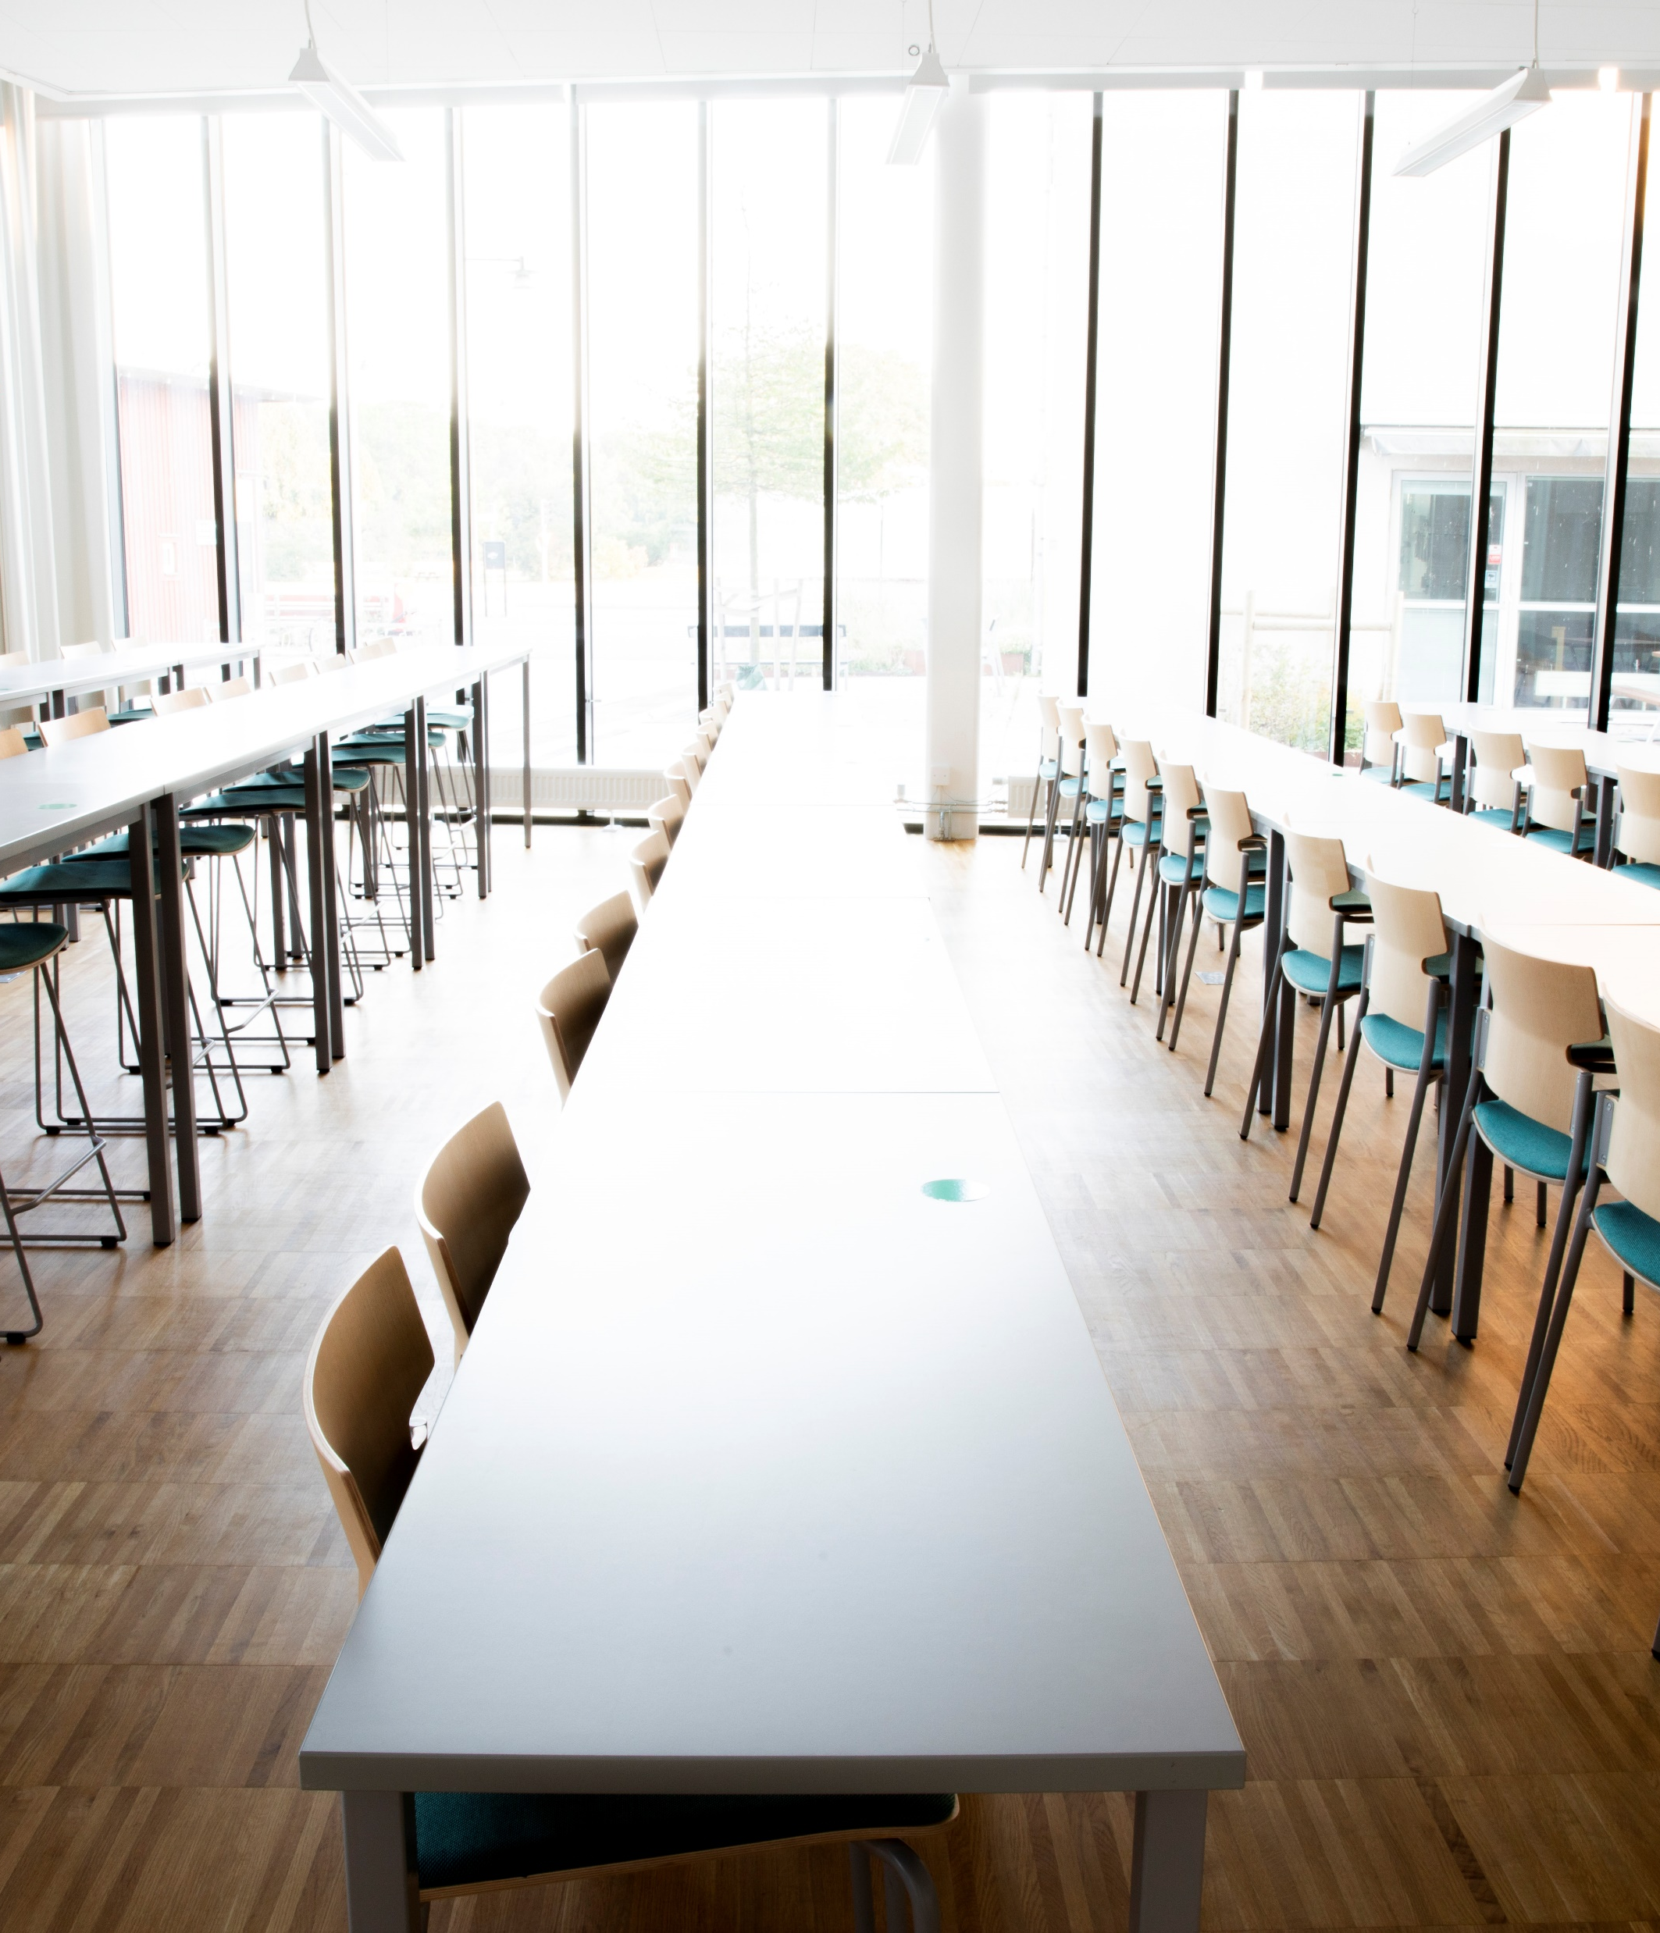
Written classroom examination
It is compulsory to sign up for written exams.
Late sign-up is not possible.
A valid ID must be presented for a written classroom exam in order to have the right to write the examination.
Plan your studies – see Exam Schedule
Notes:
Written classroom examination
It is compulsory to sign up for written exams.
Late sign-up is not possible. Neither teachers nor administrators can sign up a student for an exam after the deadline.
Show the exam schedule – link in slide, and inform that knowing the dates of exams are a way to plan your studies. Point out that it is not a good idea to skip the first exam and only take the re-examination, since a passed exam might be needed to be allowed to start the next course.

Slide 13
Failed examinations…
… can lead to you not fulfilling the prerequisites for the next course and cannot study further.
… may involve problems with Visa, the Swedish Migration Agency or CSN as they are required for study performance.
Do not delay too long with re-examination as the course structure may change to the next academic year.
Notes:
Failed examinations
… can lead to you not fulfilling the prerequisites for the next course and cannot study further.
… may involve problems with Visa, the Swedish Migration Agency or CSN as they are required for study performance.
Do not delay too long with re-examination as the course structure may change to the next academic year.

Slide 14
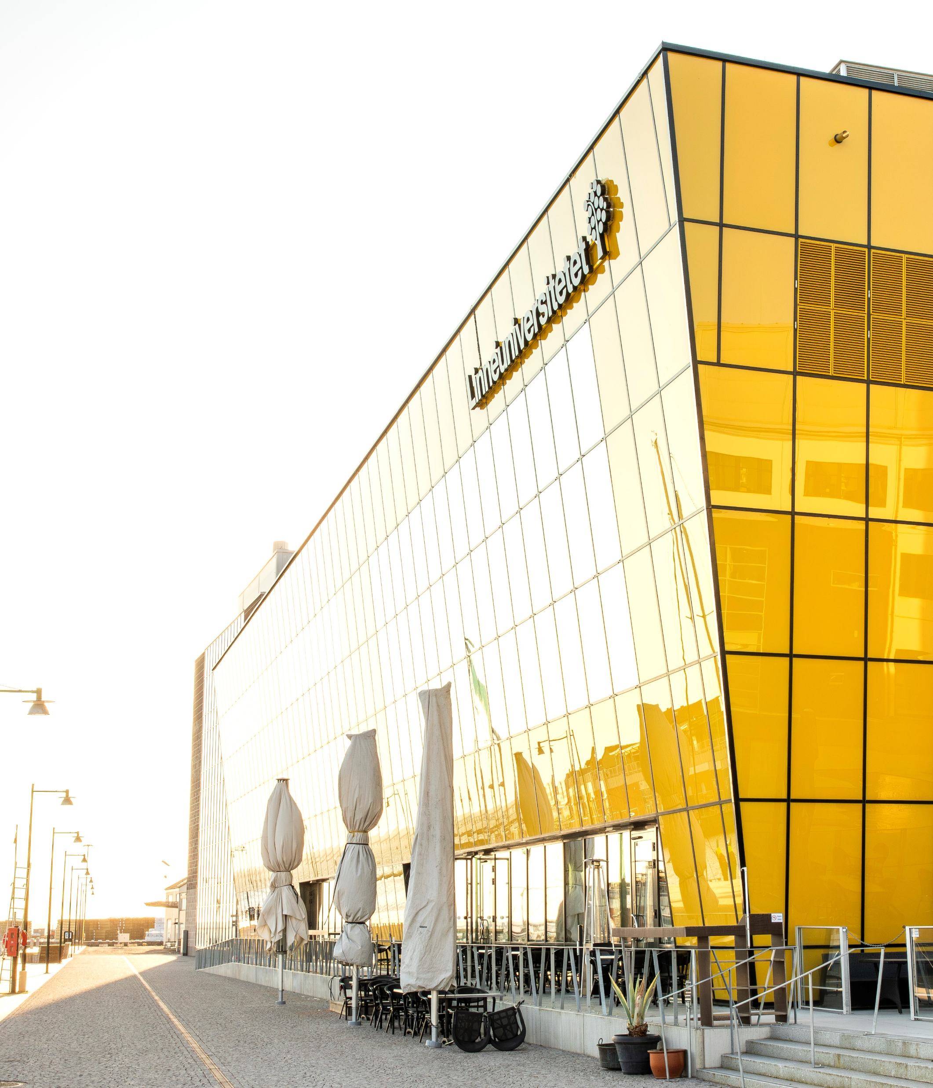
Infocenter – Kalmar
Building Stella, main entrance
Opening hours:
Monday-Wednesday and Friday: 8.00-16.00
Thursdays 8.00-15.00
General questions, information, and services.
Notes:
Infocenter
As a student, you are always welcome to infocenter when you are looking for general information and service, directions or guidance concerning whom to turn to within the organisation. At infocenter, you can also:
• get registration certificate showing your course registrations
• get certificate of enrolment showing your completed courses, credits and grades
• buy profile products
• top up your printing credits
• collect your swipe card (only in Växjö)

Slide 15
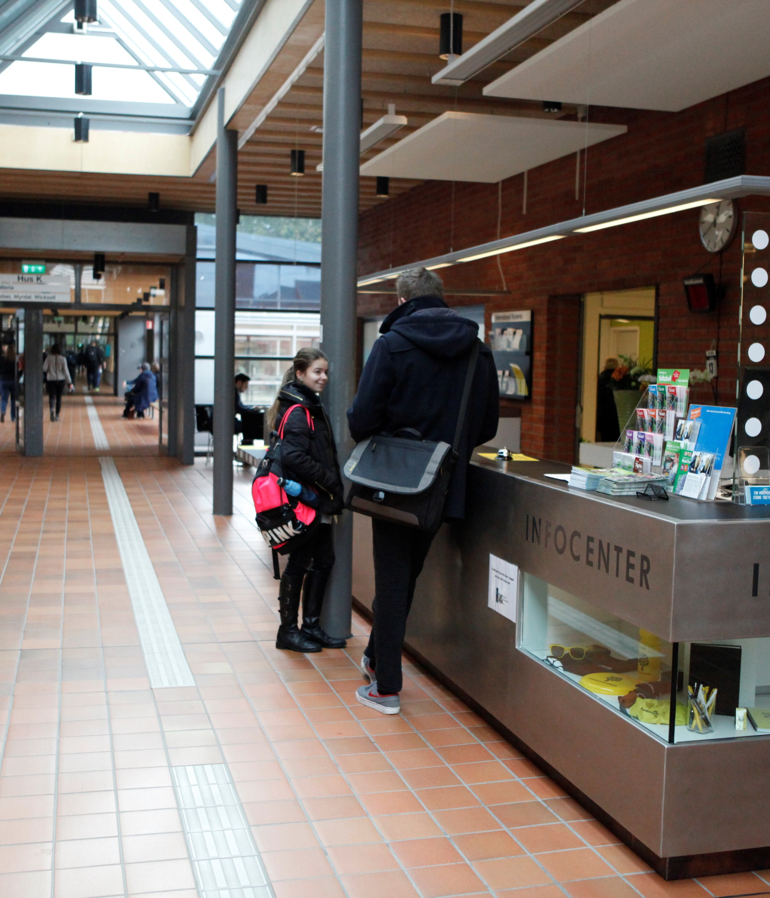
Infocenter – Växjö
Main entrance building H
Opening hours:
Monday-Wednesday and Friday: 8.00-16.00
Thursdays 8.00-15.00
General questions, information, and services.
Notes:
Infocenter
As a student, you are always welcome to infocenter when you are looking for general information and service, directions or guidance concerning whom to turn to within the organisation. At infocenter, you can also:
• get registration certificate showing your course registrations
• get certificate of enrolment showing your completed courses, credits and grades
• buy profile products
• top up your printing credits
• collect your swipe card (only in Växjö)

Slide 16
Course evaluations
After each completed course – please fill out the course evaluation!
The course evaluation is your chance to influence, comment and contribute to good course quality.
If you want to take part of previous course evaluations, you can order them from: arkiv@lnu.se
Notes:
Course evaluations
After each and every completed course, students fill out a digital course evaluation. Stress the importance of this tool!
Students can access prior course evaluations, via mailing arkiv@lnu.se . By doing so, they will receive a compilation in a pdf format.

Slide 17
Apply for your programme courses
Applications for next semester’s courses are made through www.universityadmissions.se
You will receive information regarding whether or not you need to apply for courses within your particular programme.
Application period is open:
ca October 1-15 for Spring semester
ca April 1- 15 for Autumn semester
Application problem? Contact admisson@lnu.se
Notes:
Apply for your porgramme courses
As a student you need to apply for the courses in the upcoming semester and this is done via antagning.se/universityadminssions.se just as when they applied for their programme.

Slide 18
Operational support at the
Faculty of Health and Life Sciences
Notes:
Operational support at the Faculty of Health and Life Sciences

Slide 19

Internationalisation
As a student at Linnaeus University, there are several opportunities for internationalisation: exchange programmes, internships and the possibility of writing your degree project abroad.
For more information, contact:
Alexandra Holtti
International coordinator for mobility and international collaborative agreements
mobility.fhl@lnu.se
Notes:
Internationalisation
As a student at Linnaeus University, there are several opportunities for internationalisation: exchange programmes, internships and the possibility of writing your degree project abroad.
Contact at FHL:
Nadja Heinvall
International coordinator for mobility and international collaborative agreements
nadja.heinvall@lnu.se

Slide 20

Career counselling
Do you need help starting up your job search process?
Contact us!
Sofie Edström
Career Counsellor in Kalmar
sofie.edstrom@lnu.se
Fanny Elheim
Career Counsellor in Växjö
fanny.elheim@lnu.se
More information at lnu.se
Notes:
Career counselling service
The link directs to the Career counselling service
Career counselling service arranges different Lectures, workshops och events, such as:
CV-writing help
Career course
Interview training and lectures
Your personal trademark- lecture
LinkedIn – lecture and workshop
Students also have the opportunity to meet a career counsellor.

Slide 21
Studying with a disability
If you are a student and have some form of disability, it is possible for you to get pedagogical support during your studies. Examples of such help are, help taking notes, sign language interpreter or extended time at examination sittings. The support is individual and planned together with you and your coordinator.
Contact us or read more at Lnu.se
Mathilda Karlsson Aldén
Coordinator for Faculty of Health and Life Sciences in Kalmar
mathilda.karlsson.alden@lnu.se
Mari Ericsson
Coordinator for Faculty of Health and Life Sciences in Växjö
mari.ericsson@lnu.se
Notes:
Studying with a disability
If you are a student and have some form of disability, it is possible for you to get pedagogical support during your studies. Examples of such help are, help taking notes, sign language interpreter or extended time at examination sittings. There is a contact person for Kalmar and one for Växjö
Read more - link in slide

Slide 22

The University Library and Academic Support Centre
Search and writing assistance is available at the University Library and through the writing guide.
At the Academic Skills Centre you can get support with your academic writing as well as help with study techniques.
Read Refero – the anti-plagiarism Tutorial a web-based textbook that shows you how you properly use others’ texts in your academic writing.
Notes:
The University Library and Acacemic Skills Centre
At the university library there are a large number of places and rooms to study. Some of the rooms and seats are available for booking via the library’s web page lnu.se/ub. Contact info: ub@lnu.se. Contact the library for searching and writing assistance (link in slide).
At Academic skills centre students at bachelor and master levels of study can receive guidance in academic writing and study techniques.
Show and talk about the writing guide available via the library (Link in slide), availble in both Swedish and English.

Slide 23

Student Welfare Office
The Student Welfare Office is available to students at Linnaeus University in both Kalmar and Växjö.
Student Welfare Office takes a preventative approach to lifestyle issues and provides counselling and coaching.
More information at Lnu.se
Notes:
Student Welfare Office
The Student Welfare Office organises several different classes for students, such as:
The power of yoga
Våga tala
Mindfulness
More information at: https://lnu.se/en/student/service-and-support/student-welfare/

Slide 24
Get involved in your studies
Programme council
Linnéstudenterna
Student associations
Course evaluations
Linnébarometern
Notes:
Get involved in your studies
The student associations elect student representatives from every year.
As a student, make sure to ask for when the course evaluation will be sent out, and make sure to complete the evaluation survey.
Contact the teacher directly if you experience any issues. Your programme coordinator and the Student Union (Linnéstudenterna) are also able to help.

Slide 25

Get involved as a student – become a student representative
As a student, you have the opportunity to serve as a representative in all decision‑making and preparatory bodies at the university that are relevant to education and students’ study situation. You apply through the Student Union, which also appoints student representatives.
As a student representative, you influence your education and build networks while enriching your study experience and strengthening your CV. In addition, the role is compensated.
At FHL, you can get involved in everything from the Faculty Board, the Education Council, and the Course Syllabus Committee to Programme Councils and the Internationalisation Council.
Do you have any questions? Talk to your programme coordinator!

Slide 26

The journey of education
From upper secondary school through university to career!
Your attitude and ambition affects you and your surroundings
Your responsibility!
Requirements and expectations of students and from students
Academic freedom
Scientific knowledge
Notes:
The journey of education – from upper secondary school through university to career!
Your attitude and ambition affects you and your surroundings
Your responsibility!
Requirements and expectations of students and from students
Academic freedom
Scientific knowledge

Slide 27
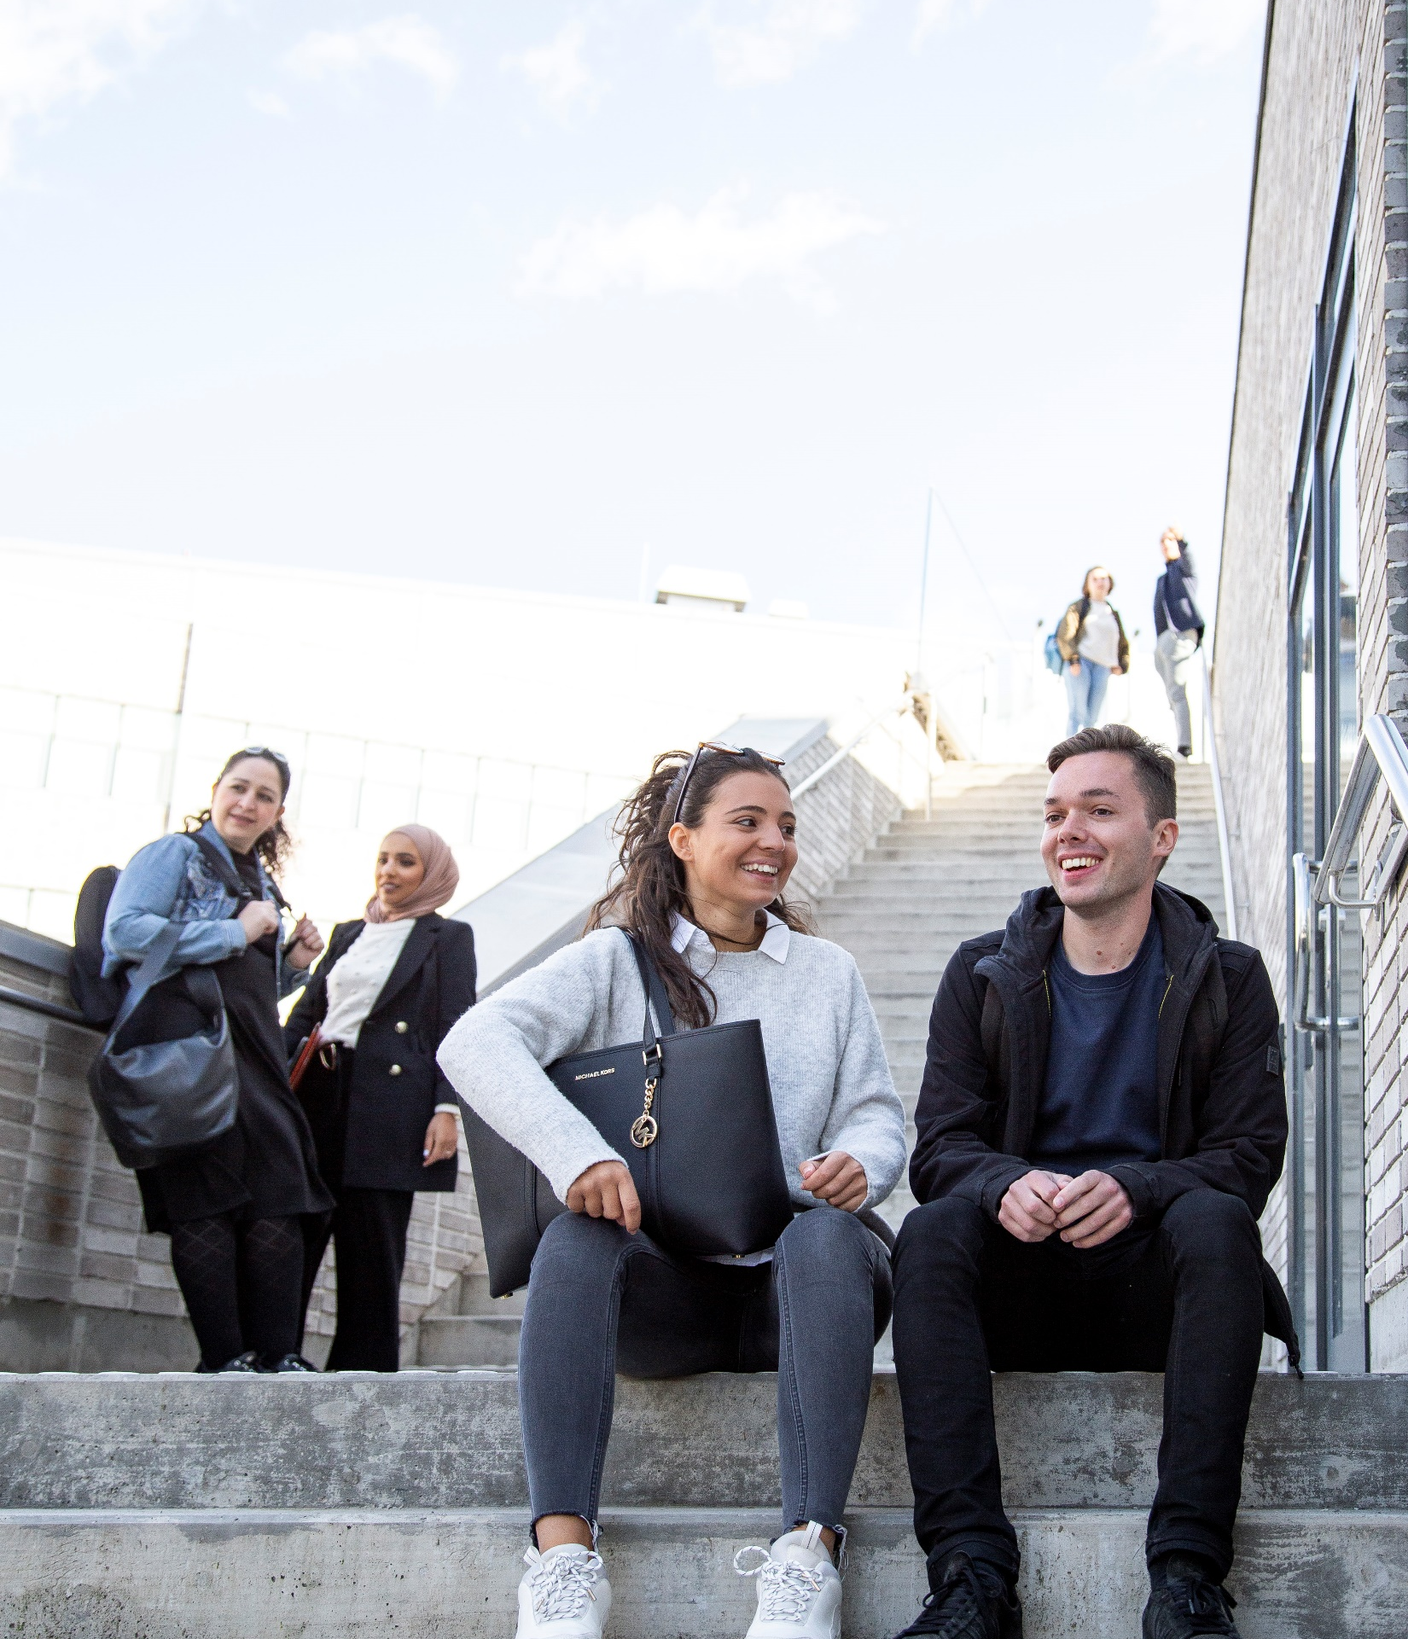
Become one of our alumni after your studies
Your work-related experiences are important to us and our students.
As an alumnus, you can contribute to your former study programme.
For instance, we have alumni who lectur or have companies that are available as case companies for different projects.
If you are interested in becoming an alumnus in the future, please contact us, more information at Lnu.se
Notes:
Become one of our alumni after your studies
The link in the header directs to a short information video (2,5 minutes) explaining what an alumni network is.
More information about the alumni network can be found on lnu.se, where they can also join the network.

Slide 28
Warm Welcome!
Don't forget to register for the first course today!

