Slide 1
Masters in Innovation through
Business, Engineering and Design
Dr.Soniya Billore
Program Director
School of Business and Economics
Current student – Carin Kindberg

Slide 2
Innovation
A piece of rock, wood and water – and that is all it takes…
and a little sprinkle of human capital.

Slide 3
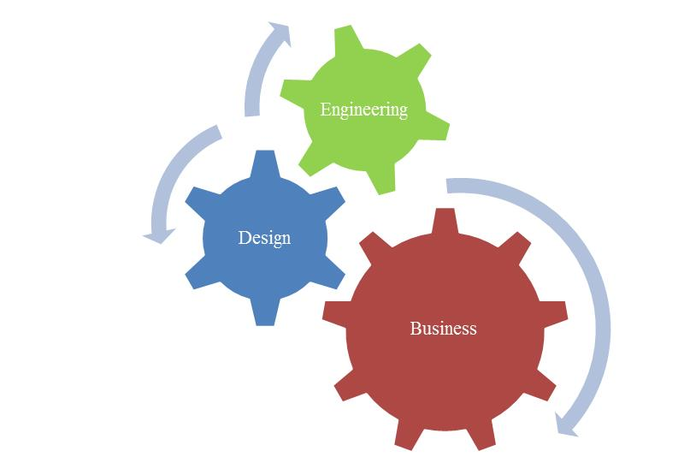
What does this mean?
Cooperation
Collaboration
It is not only that you do your part but that you actively engage in all parts in the process of the delivery.

Slide 4
Innovation and co-creation in a multi disciplinary environment–
Business, Engineering and Design
Project based Learning
Supported by class room lectures , workshops, lab work and Company interactions in each discipline
Lectures :
  Theory of CORE discipline - teachers across 3 faculties
  Methodology related to project work and project management
  Skills at work – professional ethics and leadership

Slide 5
Scholarships available for admissions –
https://lnu.se/en/education/study-at-linnaeus-university/scholarships/
Contact : Jessica Lind, International Coordinator

Slide 6
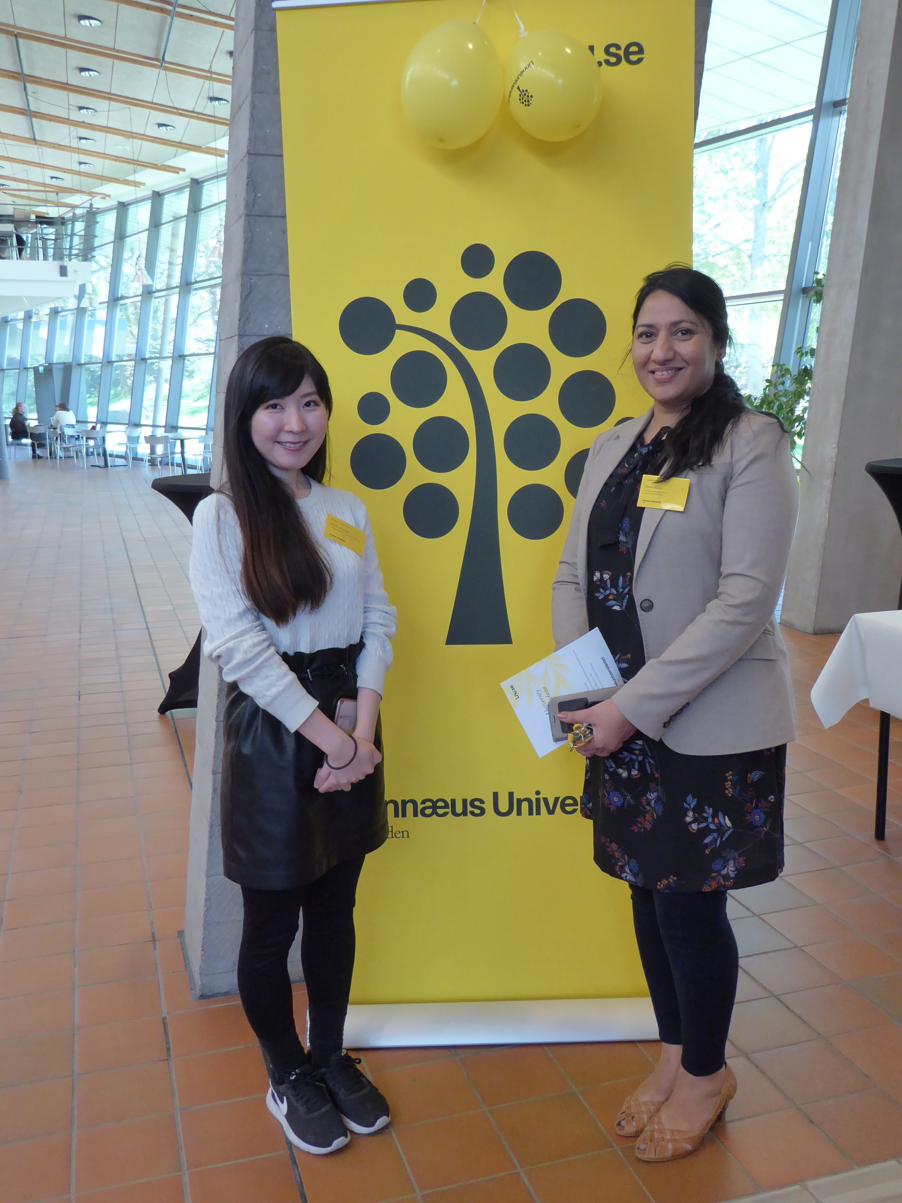
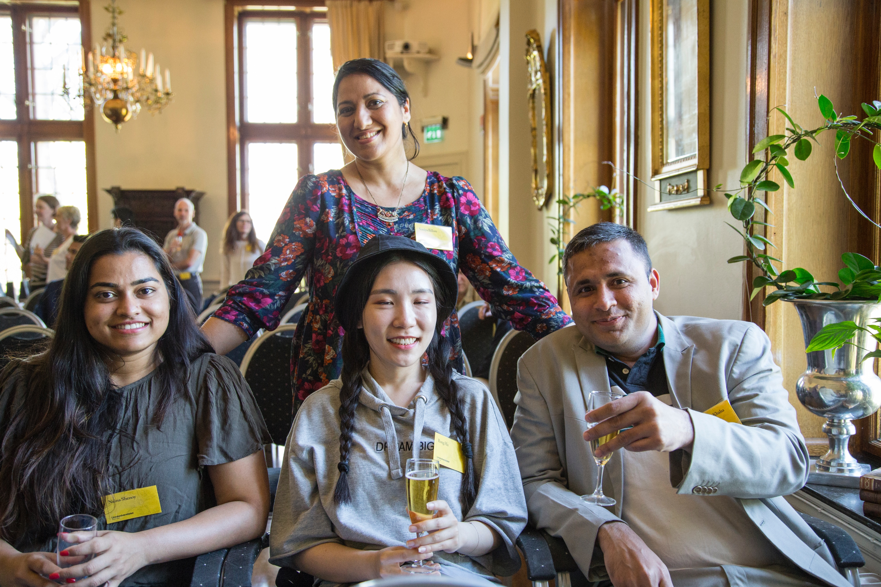
Scholarship students luncheon
2018
Naina, Rong and Ameet
2019
Misako

Slide 7
The class room dynamics
Dedicated classroom at LNU for the course –N1037 is HOME for 2 years !!
International class room – students from Sweden, India, Japan, China, Iraq, Iran, Palestine, Germany, UK, Australia, France, Chile, Columbia, Austria, Kazakistan , Turkey, Brazil, Indonesia…..
Multinational , interdisciplinary faculty
All courses in English
Public presentations to company clients as as the projects progress with the company brief
Alumni meet with students

Slide 8
Innovation Master
Semester 1:
Local Innovation
Semester 2 :
Global Innovation
Semester 3:
Studies at LNU or abroad
Semester 4:
Master Thesis
First Year
Second Year

Slide 9
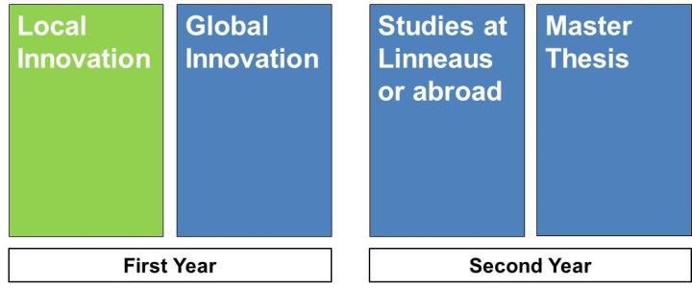
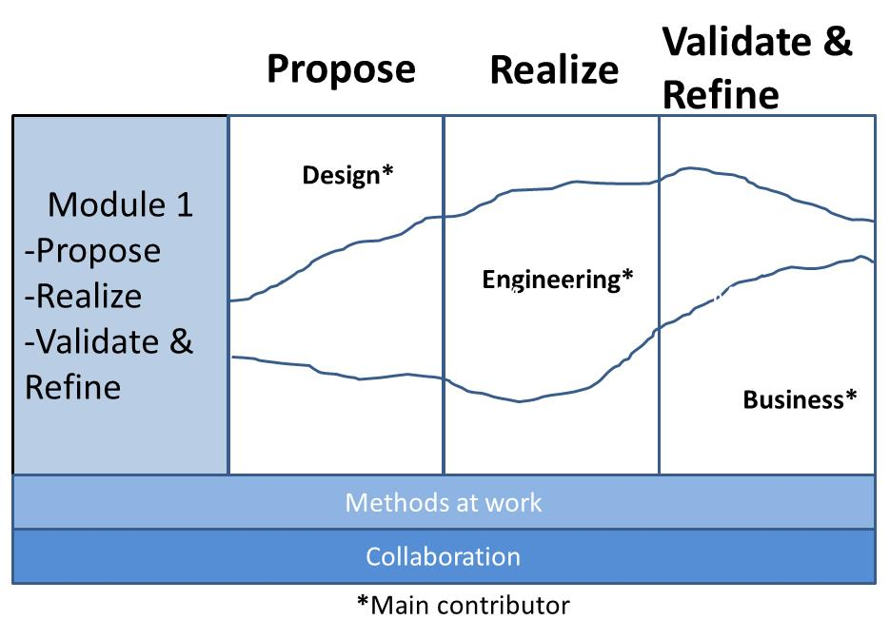

Slide 10
Semester 1 – Local Innovation, Module 1-IKEA Module
Working with product designers and experts from IKEA on the product briefs given by them to design a product for IKEA
Workshops and design meetings at IKEA product development HQ in Älmhult, working with Living Labs
Working in Interdisciplinary teams to create the end result
Design boards, Prototyping, Target segmentation, Target costing , Customer mapping and feedback
Wash council with IKEA designers – presentation, opinion, feedback and critique

Slide 11
Semester 1 - Module 2, 3 and 4
Local Innovation with companies from Småland

Slide 12
Semester 2 - Global Innovation
Issues related to global contexts and problems such as Conservation, Recycling, Restructuring, Open innovation, Frugal innovation and Resource optimization
Work on projects related to Landscapes, Housing, Energy projects, Smart housing, Sustainable food production, International employees and Employee behavior

Slide 13
Other activities in Semester II
Talent day at IKEA in February
Innovation week at LNU with corporate stakeholders, guest lecturers in March
Circular economy contest in May
Stockholm furniture fair representation in June
Collaborations – Waseda and Keio university , Japan, Arizona State University, US and IMED, India to name a few….

Slide 14
Semester 3 – Courses of your discipline
3rd semester at their home department or faculty and engage with masters level students and the masters classes
Exchange studies semester at partner universities
Internships in companies
Students have been to China, India, South Korea on exchange projects

Slide 15
Semester 4 - Masters thesis
30 hp , Groups of 2 students from core discipline
2 ways :
IKEA thesis – multidisciplinary thesis projects with tutors from LNU and IKEA
Choose to do thesis with your own idea or contact company

Slide 16
Learning for Skill
Learning core discipline in the practitioner’s shoes
Ability to deliver in a team – multidisciplinary work
Knowledge outside your field
Deeper knowledge within the field – core discipline
.
Innovation
Identification of issues
Co-Creation
With stakeholders
Contribution to sustainibility

Slide 17
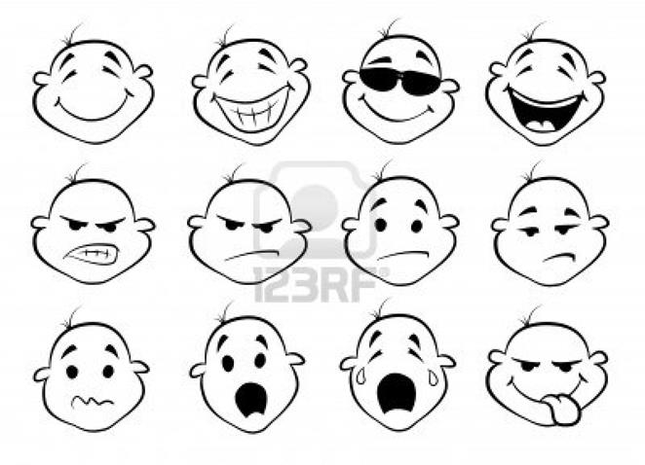
Learnings for Life
What do we learn ?
Respect
Discipline
Curiosity
Engagement
Endurance
Why do we look like this?

Slide 18
Jobs
The world is yours to take…..☺
Jobs related to Marketing, Product design, Product Innovation, Sustainibility, Marketing strategists
We equip you with - Multidisciplinary skills to work with multidisciplinary jobs in multinational enviornment
Our biggest employer - IKEA

Slide 19
Video about the program
https://lnu.se/en/programme/innovation-through-business-engineering-and-design-specialisation-design-master-programme/vaxjo-international-autumn/
https://www.instagram.com/p/BcE4Y7_Bb9A/?taken-by=linneuniversitetet
https://www.linkedin.com/groups/8985130/
Thank you and Welcome to the Excitement !!!

