Slide 1
Master in Business Process Control &
Supply Chain Management
Prof Helena Forslund (Logistics/Supply Chain Management specialization) helena.forslund@lnu.se
Dr Hana Hulthén (Management Accounting specialization) hana.hulthén@lnu.se
Alumni Ester Lisnati Jayadi ej223fz@student.lnu.se

Slide 2
Ideas behind this programme
A unique combination of important knowledge areas – Management Accounting & Logistics/SCM
MA is a common topic, SCM is often linked to engineering schools
“Controlling and logistics management in supply chains”
Business processes/flows/supply chains are in focus
Clear research connection and practical relevance
Less individual written exams and ”textbook-studying”
More cases, paper, seminars and scientific articles

Slide 3

Logistics/ SCM Topics
Alignment in the supply chain
Postponement strategies
Information quality
Supply Chain visibility
ERP systems in logistics
APS – Advanced Planning Systems
Closed loop supply chains
Innovation in logistics/supply chain
Sales and operations planning (S&OP)
Humanitarian logistics
Contracts in supply chains
VMI - Vendor Managed Inventory
Reverse logistics
Value added distribution
4PL, 5PL
Supply chain event management
Supply chain risk management
Supply chain resilience
TCO – Total Cost of Ownership
Supplier development
Packaging in logistics
Codes of conduct
Supply chain coordination/integration
Etc.

Slide 4

Our research areas
Performance management in supply chains
External and internal integration of processes
Supplier development
Inventory management
Logistics development in the forestry industry
Sustainable logistics innovation
Sustainable transport chains

Slide 5
Possible careers – source LinkedIn
Supply planner
Demand planner
Business controller
Audit associate
After sales logistics planner
PhD student
Regional supply business area specialist
Operational customer service
Business development manager
Junior lead buyer

Slide 6
Two specializations
Frontiers in logistics & supply chain management
https://lnu.se/en/programme/business-process-control-and-supply-chain-management-master-programme-eabs2/frontiers-in-logistics-supply-chain-management-vaxjo-international-autumn/
Frontiers in management accounting & process-based control
https://lnu.se/en/programme/business-process-control-and-supply-chain-management-master-programme-eabs2/frontiers-in-management-accounting-process-based-control-vaxjo-international-autumn/

Slide 7
Eligibility
L/SCM: bachelor’s degree in business administration or with at least 90 hec in business administration and at least 7,5 credits in logistics/SCM/transport/purchasing/
operations management
+ English B/6
MA/BPC: bachelor’s degree in business administration or with at least 90 hec in business administration and at least 30 credits in management accounting
+ English B/6

Slide 8
Programme overview
Log/SCM
MA/BPC
(1 year)
”short exit”
Fall Year 1 Spring Fall Year 2 Spring
Subject Course
Method course
Thesis

Slide 9
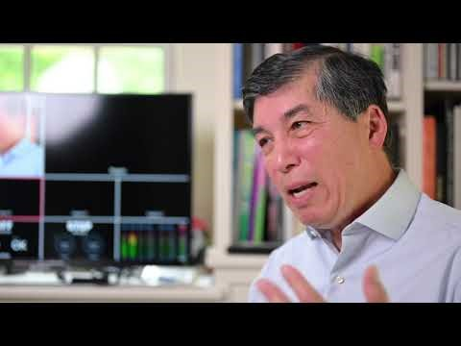
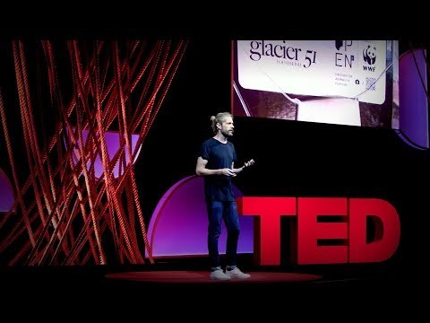
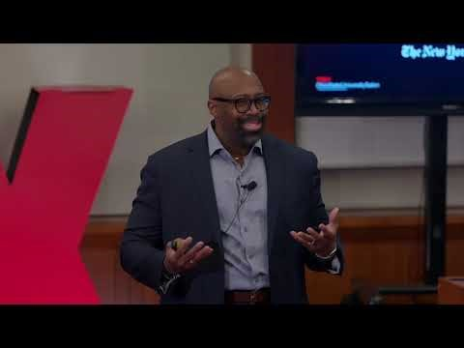
Ted Talks – Logistics/ SCM

