Slide 1
Learning Agreement meeting Faculty of Technology Katarina Rönndahl, International Coordinator at the Faculty of Technology, katarina.ronndahl@lnu.se
240411

Slide 2
Agenda
Short presentation round
Who does what IO/Faculty
What is expected of you
Learning Agreement (LA) – what is it and why is it needed?
Before the exchange - How to prepare the Learning Agreement
During the exchange - What to do if you need to change courses?
After the exchange – Applying for credit transfer
What to do if semester times overlap?
Questions

Slide 3
Short presentation round

Slide 4
Who does what IO/Faculty?
Faculty of Technology
Answers questions about the academic part of the exchange. The program manager approves which courses you can take and how they can be credited, the international coordinator coordinates the writing of the Learning Agreement and the credit transfer.
Program managers + International coordinator (Katarina Rönndahl) katarina.ronndahl@lnu.se
or ftk.outexchange@lnu.se
International Office
Answers practical questions about your application to the host university, information about course lists, insurance, the Erasmus scholarship, questions about Mobility Online, accommodation and other practical questions about the exchange. outexchange@lnu.se
Notes:
Om vi tittar på sökstatistiken för MASTERHT24 och IKHT24 i jämförelse med förra året så minskar Lnu relativt kraftigt, ca 25%, i MASTERHT24 och ökar något, +5%, i IKHT24. Detta innebär en något större minskning för Lnu jämfört med Sverige, (ca -5% minskning) i MASTERHT24 och liten ökning IKHT24 jämfört med Sverige där det minskar med ca 1%.
Resultatet är svåranalyserat detta år generellt, delvis pga avstora svängningar mellan olika länder, vissa ökar kraftigt och andra minskar kraftigt. Utvecklingsländer minskar generellt, vissa, som exempelvis Nigeria, Pakistan och Sri Lanka kraftigt i båda omgångar. Många ”västerländska” länder som exempelvis USA och Kina ökar.
Jag går igenom detta mer senare.

Slide 5
What is expected of you

Slide 6
That you study full-time, corresponding to 30 credits/semester
- register for exchange studies in Ladok, important for CSN i.a. (remember to apply for CSN for a whole year as it may take some time before you get your points credited in Ladok)
That you write a Learning Agreement and get it approved by your program manager
- also applies if you study outside the programme, e.g. as free-standing courses after you have finished your program
That you apply for credit transfer when you return
- and get the courses credited either within the program or as free standing courses

Slide 7
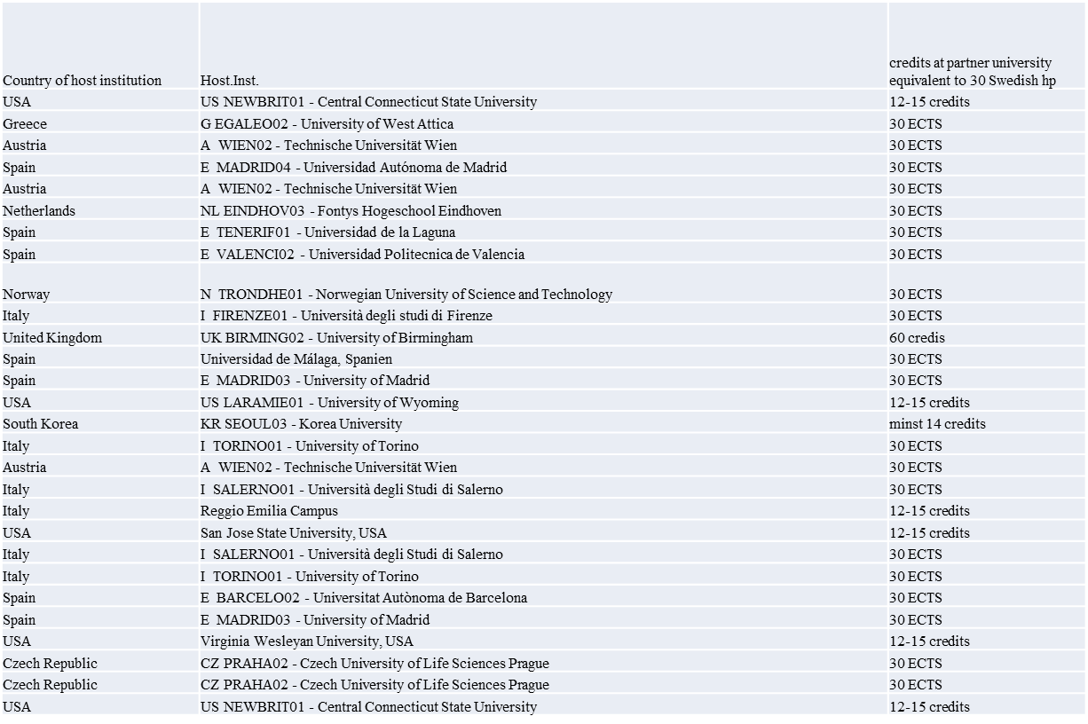
How many credits do you need to take for it to count as full-time studies?
In general, 30 credits correspond to:
EU/Erasmus/Nordlys – 30 ECTS
UK – 60 credits
USA + USAC: 12 - 15 credits
Syd Korea: 14 - 18 credits
Check the instructions from the host university and the International Office

Slide 8
Learning Agreement

Slide 9
Learning Agreement - what is it and why is it needed?
The Learning Agreement is a document that states which courses you will study during the exchange and how these will be credited when you return. It is a guarantee for you so that you know in advance that the courses you take can be credited either within the program or as free standing courses so that you get your credits. If you go through Erasmus, it is also necessary for you in order to receive your scholarship.
The Learning Agreement is filled out by you as a student in consultation with your program manager. It is important that you before the meeting with the program manager have done thorough preparatory work and that you have a first draft of course selection. In order for the program manager to be able to make an assessment, it is important that you have relevant course information with you.
Things to consider when choosing a course:
Not choosing courses similar to those you have already studied or will study later in the program.
That the courses are at the right level (check the prerequisites)
Notes:
The Learning Agreement is a document that states which courses you will study during the exchange and how these will be credited when you return. It is a guarantee for you so that you know in advance that the courses you take can be credited either within the program or as free standing courses so that you get your credits. If you go through Erasmus, it is also necessary for you to receive your scholarship.
The Learning Agreement is filled out by you as a student in consultation with your program manager. It is important that you before the meeting with the program manager have done thorough preparatory work and that you have a first draft of course selection. In order for the program manager to be able to make an assessment, it is important that you have relevant course information with you.

Slide 10
Preparing the Learning Agreement
Talk to your programme manager about which courses you can transfer towards your programme
2. Fill in your Learning Agreement:
- If you are going with Erasmus or Nordlys – fill in the DLA (Digital Learning Agreement) in Mobility Online. See the guide that was sent out with the invitation to this meeting for instructions.
- If you are going with a bilateral agreement, ISEP or USAC – fill in the Learning Agreement for bilateral exchange Word template. Use the word template that was sent out with the invitaiton to this meeting.
3. The Learning agreement/DLA needs to be signed by the student, the programme manager and the faculty coordinator (katarina.ronndahl@lnu.se)
And, if you are doing the DLA also by the host university, before the mobility starts.
The signed LA/DLA will be registered and receive a diarienumber at LNU.
Notes:
Visa bilaterala mallen och gå igenom den . Gå även igenom DLA

Slide 11
During the exchange

Slide 12
What to do if you need to change courses during the exchange?
It can happen that a course is cancelled, two courses are clashing, you find another course that you want to take instead….
Contact your program manager via e-mail to get an approval of the course change. Provide information about the new course (course name, number of credits, course description) and information about what course it will replace. So that the program manager can make a new assessment.
-DLA: make the changes online click on “request changes to the Learning Agreement”
- If you use the word template, you do not need to create a new Learning Agreement, the approval via e-mail is OK, but save the e-mail communication and the new approval of the course changes, you will need it for your credit transfer!

Slide 13
During the exchange
Examinations: The local regulations at your host institution applies. For instance, regarding grading and re-examination.
What to do if semester times overlap?
If you have to leave before the semester ends. Check with the teachers at the host university. If there are exams or re-examinations scheduled after you have left it can often be organized so that you can do the examination from LNU. But this always needs to be negotiated in advance and it is the teacher at the host university who decides. Talk to the teachers as soon as possible.
If you decide to come back to LNU later – check with the LNU teachers of the courses that starts the next semester if you can begin the courses on-line for example. Check if you need to make any particular preparations. Keep in contact with other students in your class.
Trancsripts of records from the host university
If possible, ask for your Official Transcript of Records already before you leave your host institution. If this document is not finalized it will be sent to either you or to Linnaeus University, International Office and the will send it to you.

Slide 14
After the mobility

Slide 15
Applying for credit transfer
After your exchange period, your host institution will provide you with a transcript of records stating which courses you have passed and which grades you received for each course. You normally receive this document within 5 weeks after the end of your exchange period.
How to apply for credit transfer and get the credits in Ladok?
To apply for the credit transfer you send the following documents to registrator@lnu.se
Transcripts of Records from your host university
Your Learning Agreement (approved by your program manager and faculty coordinator)
If you have made any changes to your courses to what is mentioned in the Learning Agreement and got an approval from your program manger via e-mail during your exchange you should also attach the e-mail with the approval of the course changes.
The credits for passed courses will be registered in Ladok after we have received your application with all required documents.

Slide 16
What happens if you do not pass a course?
You may need to take additional courses at home. In your program syllabus you can see what is required in order to take the degree. It does not matter for the degree if you take the courses abroad or at home.
Discuss with your program manager or contact the study councellor if you need advice or an individual study plan to finish your program.

Slide 17
Questions?

Slide 18
Getting Ready to go - meeting organized by International Office
7 May at 14-16 in Växjö
8 May at 11-13 in Kalmar
Skillmill app – helps to verbalize your soft skills.
Notes:
To help verbalize your soft skills. The app

Slide 19
During the exchange
Be a good ambassador for Linnaeus University and for Sweden!
If you need information material about Linnaeus University please contact International Office at outexchange@lnu.se.
We and the International Office encourage you to contact us during your exchange for any questions you might have.
If you want to prolong your exchange period this is only possible for student who go abroad during autumn semester. Please send an email to International Office, outexchange@lnu.se and they will find out if it is possible.
Share your experiences @lnuabroad
Notes:
To help verbalize your soft skills. The app is created by Uppsala University

Slide 20
We wish you a good exchange!

