Slide 1
Outgoing exchange students ht22 – vt23
Faculty of Technology
Learning agreement information meeting
Katarina Rönndahl
ftk-outexchange@lnu.se
International Coordinator
Faculty of Technology

Slide 2
What is the purpose of this meeting?
What do we expect from you?
What is a Learning Agreement/OLA/ course pre-assessment?
What is the Learning Agreement process from now until you come back?
  Step 1: Before the mobility
  Step 2: During the mobility
  Step 3: After the mobility
Questions?

Slide 3
the Faculty of Technology
  Handles administrative procedures related to academic matters (Learning Agreement, Credit Transfer)
  ftk.outexchange@lnu.se or katarina.ronndahl@lnu.se
International Office
  Handles other practical issues related to studying abroad (grants, insurance, contact with partner university etc.)
  outexchange@lnu.se or directly to the contact person you have got.

Slide 4
What do we expect from you?
We (LNU and your host institution, CSN for those who use that) expect that:
  You study full time, the equivalence of 30 hp /semester
    EU destinations: 30 ECTS credits
    Destinations outside the EU: depends on the host institution
  You apply for a credit transfer when you come back
    Within your programme
    Free standing courses

Slide 5
How many credits do I need to take per semester?
ForeignUniversity | ForeignCountry | Credits equalent to one semester full time/30 hp
University of Northern British Columbia, UNBC | Canada | 9
TERI- The Energy and Resources Institute | India | 16-22
Bemidji State University | USA | 12-15
ISEP | World wide | 12-15
Yonsei University | South Korea | 15-18
Otterbein University | USA | 12-15
Universitas Indonesia | Indonesia | 15
San Francisco State University | USA | 12-15
Central Connecticut State University | USA | 12-15
Fontys Hogeschool Eindhoven | Netherlands | 30 ECTS
Fontys Hogeschool Eindhoven | Netherlands | 30 ECTS
Halic University | Turkey | 30 ECTS
Politecnico di Milano | Italy | 30 ECTS
Politecnico di Milano | Italy | 30 ECTS
Syddansk Universitet | Denmark | 30 ECTS
The State University of New York at Oneonta | USA | 12-15
Universidad Politecnica de Valencia | Spain | 30 ECTS
Universidad Politecnica de Valencia | Spain | 30 ECTS
Universidade do Porto | Portugal | 30 ECTS
Università Degli Studi Dell’Insubria Varese-Como | Italy | 30 ECTS
Università Degli Studi Dell’Insubria Varese-Como | Italy | 30 ECTS
Università Degli Studi Dell’Insubria Varese-Como | Italy | 30 ECTS
Università degli studi di Firenze | Italy | 30 ECTS
Universitat Autònoma de Barcelona | Spain | 30 ECTS
University of Hertfordshire | UK | 30 ECTS
Waseda University | Japan | 13-15 (som regel 14)

Slide 6
What is a Learning Agreement/A course pre-assessment?
Learning Agreement = a document that states
  Which courses you will be taking in your host institution
  How the credits you earned will be transfered at LNU
Course pre-assessment = an assessment made by your programme manager about which courses you can study abroad and transfer back home. The assessment is based on:
  the course’s content
  the course’s level
  the course’s subject area
  whether the course is academic or not (e.g.: Sport, Crafts, etc. is not considered academic)
  how the course’s credits will be transferred (programme course or free-standing course)

Slide 7
Which courses should I select?
If you are going abroad on your 2nd or 3rd year within your program
Look at your host institution’s course catalogue and try to find courses that match those you would have studied at home. Look in the programme syllabus for your program and check with your programme manager. It is important that you before the meeting with the program manager have done a thorough preparatory work and that you have a first draft of course selection. Include relevant course information for the program manager to make an assessment.
  Note: the courses at the host institution may not be exactly the same as those you follow at home. What matters is that the overall content of your study plan abroad matches this of your study plan at LNU

Slide 8
Which courses should I select?
If you are going after you have finished your program
You want to broaden your skills
  Look at your host institution’s course catalogue and select the courses you are interested in
You want to pursue a master’s degree
  Look at your host institution’s course catalogue and select the courses you are interested in. The requirements are the following:
    You should only study at graduate level
    You should check the prerequisite for the Master program courses you want to study at LNU in the Spring (and apply for those around October 15th.)

Slide 9
What am I not allowed to study?
•Courses on level 100/1000 in the US/Canada/Asia= HighSchool courses
•Courses that overlap what you have already studied/will study in your programme/degree
•Practical courses, e.g. tennis, pottery, choir singing, sightseeing, wine tasting, camping, these are not ok!

Slide 10
The LA process – Before the exchange
1. Find suitable courses. Discuss with your program manager so that you know if the courses can be transferred and be a part of your degree at LNU.
2. Fill in your Learning Agreement
  Erasmus students fill in the OLA. Register an account at www.learning-agreement.eu see the guide with instructions if needed.
  Non Erasmus students fill in the LA for bilateral exchange, use the word template (there is one version were you can also add buffert courses).
3. Get the signature on your LA/OLA from your program manager
  Erasmus students: Download the filled in OLA as a PDF
  Non Erasmus students: get the signature on the LA
  (digital signatures are OK)
4. Once it is signed by your program manager send your OLA or LA to the International Coordinator at your Faculty (katarina.ronndahl@lnu.se)
If you have questions/need LA template/OLA guide send me an e-mail katarina.ronndahl@lnu.se

Slide 11
What will we do with your Learning Agreement?
  I will send your Learning Agreement to the Registrator’s office, which will file it and give it a Registration Number/Diarienummer. You will get a scanned version of the registered Learning Agreement.
For Erasmus students I will sign your OLA on-line. Once it has been signed in the OLA platform, it will be automatically sent to your host university (receiving institution) for signing. You can follow the status of your document online.

Slide 12
During the exchange – what if you need to change courses?
It can happen that courses has been cancelled, two courses are clashing etc. What to do?
Contact your program manager via e-mail to get an approval of the course change. Provide information about the new course (course name, number of credits, course description) and information about what course it will replace. So that the program manager can make a new assessment.
If you have ”buffer courses” already aproved in your Learning Agreement use them to replace the missing course. You do not need to contact us if the ”buffer courses” have already been approved as long as they are freely exchangeable. But if the buffert courses are not freely exchangeable (for example if you drop a course that is mandatory in your programme you can not replace it freely with something else): Contact your programme director and ask for approval of the course change.
Note: save the e-mail communication and the new approval of the course changes, you will need it for your credit transfer!

Slide 13
Examinations
The local regulations at your host institution applies!
For instance regarding grading and re-examination.
In some cases when if there are re-examinations and it is held after you have left it can in some case be organized so that you can do the examination at LNU. But this always needs to be negotiated in advance and it is the teacher at the host university who decides.

Slide 14
After the exchange -When you come back home – apply for credit transfer
After your exchange period, your host institution will provide you with a transcript of records stating which courses you have passed and which grades you received for each course. You normally receive this document within 6 to 8 weeks after the end of your exchange period either to your home address or through our International Office.
You will then need to apply for a credit transfer by sending the transcripts of records (betyg) you have received from your host university together with your Learning Agreeement to registrator@lnu.se . If you have made any changes to your courses to what is mentioned in the Learning Agreement and got an approval from your program manger via e-mail during your exchange you should also attach the e-mail conversation with the approval of the course changes.

Slide 15
Credit transfer
Once we have received all required documents from you we will register your credit transfer in Ladok and you will get an e-mail when the credits have been registered.
• Only finalised, passed courses will be transferred
•The grades will not be converted, but put in as they were given
•Local credits will be re-calculated to Swedish credits (hp)

Slide 16
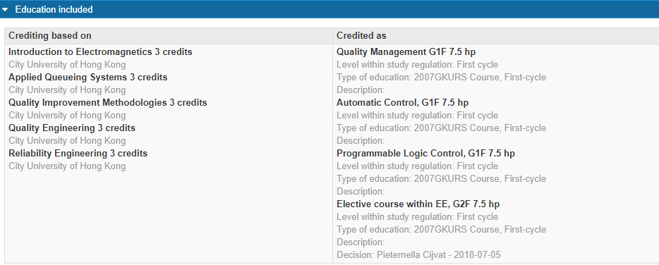
How can you see the credit transfer in Ladok an example

Slide 17
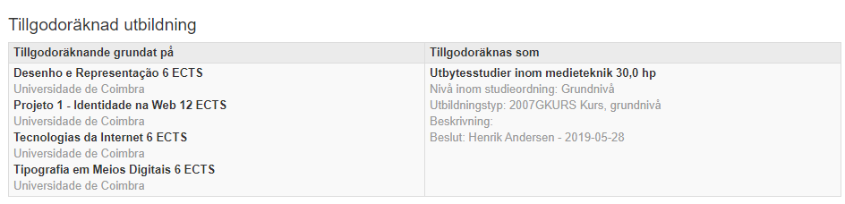
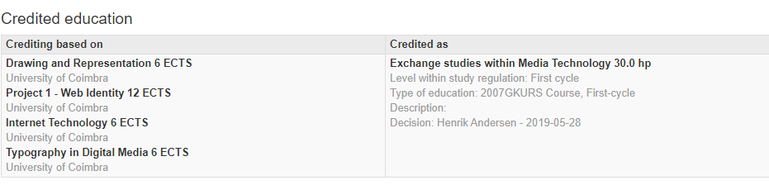
How can you see the credit transfer in Ladok an example

Slide 18
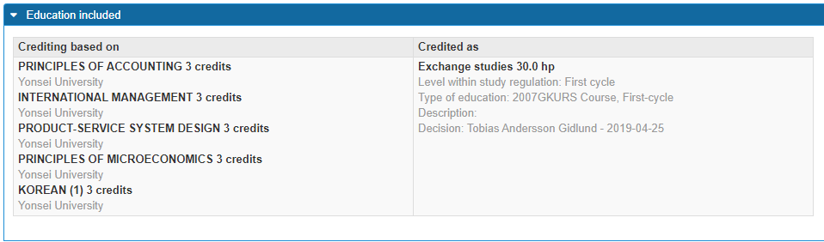
How can you see the credit transfer in Ladok an example

Slide 19
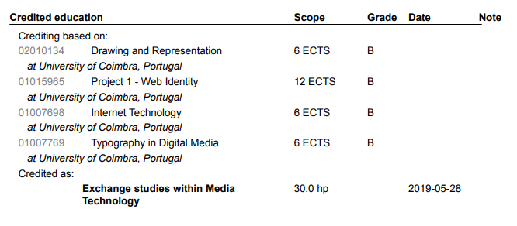
Transcripts of records from Ladok/
Resultatintyg från Ladok an example

Slide 20
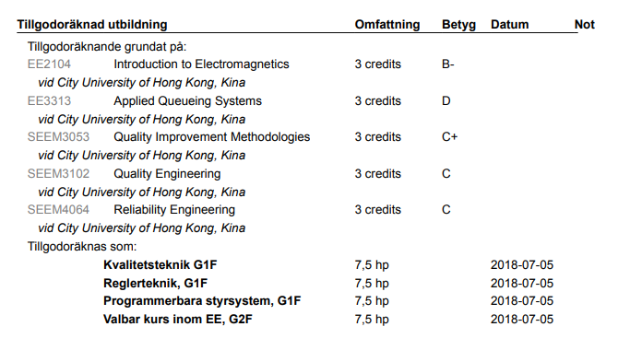
Transcripts of records from Ladok/
Resultatintyg från Ladok an example

Slide 21
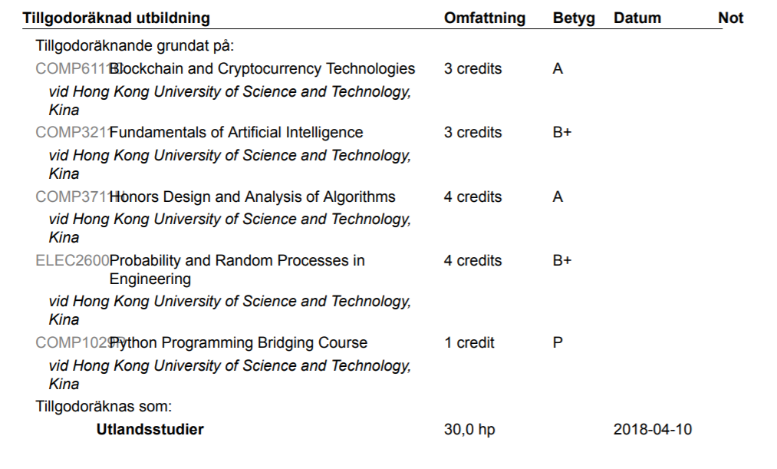

Slide 22
More information
MyMoodle room: Faculty of Technology – international possibilities/Internationella möjligheter
https://mymoodle.lnu.se/course/view.php?id=23226
International Office – LNU web
https://lnu.se/student/internationella-mojligheter/Utlandsstudier/ (sv)
https://lnu.se/en/student/study-abroad/study-abroad/ (eng)
Contacts at the faculty: katarina.ronndahl@lnu.se
Contact at International Office: outexchange@lnu.se

Slide 23
Questions?

Slide 24



