Slide 1
Welcome to the School of Business and Economics at Linnaeus University
Marketing Master Program
Director: Dan Halvarsson dan.halvarsson@lnu.se
Notes:
Welcome students to the School of Business and Economics at Linnaeus University
Fill out your name and programme see red text
Kindly publish the ppt to the programme room on Mymoodle

Slide 2
How to contact the administration at LNU.se?
As a general rule – send an E-mail to: ekonomihogskolan@lnu.se and they will direct you to the right person, who can help you with your question

Slide 3
LNU educations are part of ”The association to advanced collegiate Schools of Business” (AACSB)
AACSB Promo - LnuPlay - Linnaeus University MediaSpace

Slide 4
Do you want to be one of two representative for you class in the program council for the program?
In program council we evalute the current master program and its executiong - and we discuss how to improve the program even more (course contant, and more general questions as how to handle AI, Company project etc)
Two persons. Hand in your name to dan.halvarsson@lnu.se when interested – as soon as possible

Slide 5
Establish external relations in relation to your studies: company projects, thesis projects etc
* Smålandsnavet – working with relaiton with small and medium sized firms
smalandsnavet@lnu.se
* BusinessLab at the School of Business and Economics
https://lnu.se/en/medarbetare/organisation/school-of-business-and-economics2/Organisation/BusinessLab/
* Office of External Relations
https://lnu.se/en/meet-linnaeus-university/Organisation/university-administration/office-of-external-relations/
* Questions on Work permits, Swedish Migration Agency etc.
For instances: Questions on how Swedish Migration Agency might affect international students who secure jobs while studying at LNU.
Contact ”Student counselling at the School of Business and Economics” at LNU. For instance Mirja Sjögren on mirja.sjogren@lnu.se

Slide 6
Do you want function as a mentor for some Bachelor students on the marketing program?
Mentorship in form of that you give support, discuss, guide – other students.
Contact dan.halvarsson@lnu.se

Slide 7
Four important support systems in your education
1 Studentweb
2 Ladok
3 TimeEdit
4 Mymoodle.lnu.se - with its Zoom conference system

Slide 8
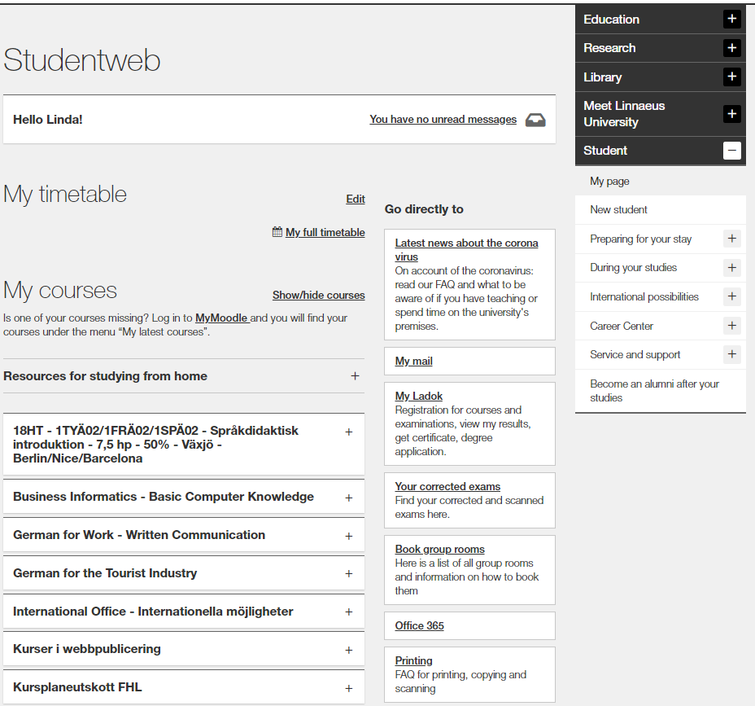
Studentweb
Important information during your studies
When you are registered to a course, you will find your schedule here
Ladok:
Registration
Results
Sign up for examination
Certificates
Click on the course:
Link to course room on Moodle
Link to course syllabus
Information about registration period for examination
My student news:
My student calendar
Notes:
Studentweb
This is the view when the student is logged in to lnu.se/student, and they will be able to find the following:
My timetable
My courses – There is a direct link to the Moodle course room. When the student is registered to the course it will be visible under My Courses.
Under Go directly to students will be directed to Ladok and will be able to find the following:
My Ladok:
Registration for course – opens the week before the course starts
View my results
Registration for examinations
Retrieve certificates
While logged in they can also find My student news and student calender, where information regarding them is published, such as open lectures or reminders.

Slide 9
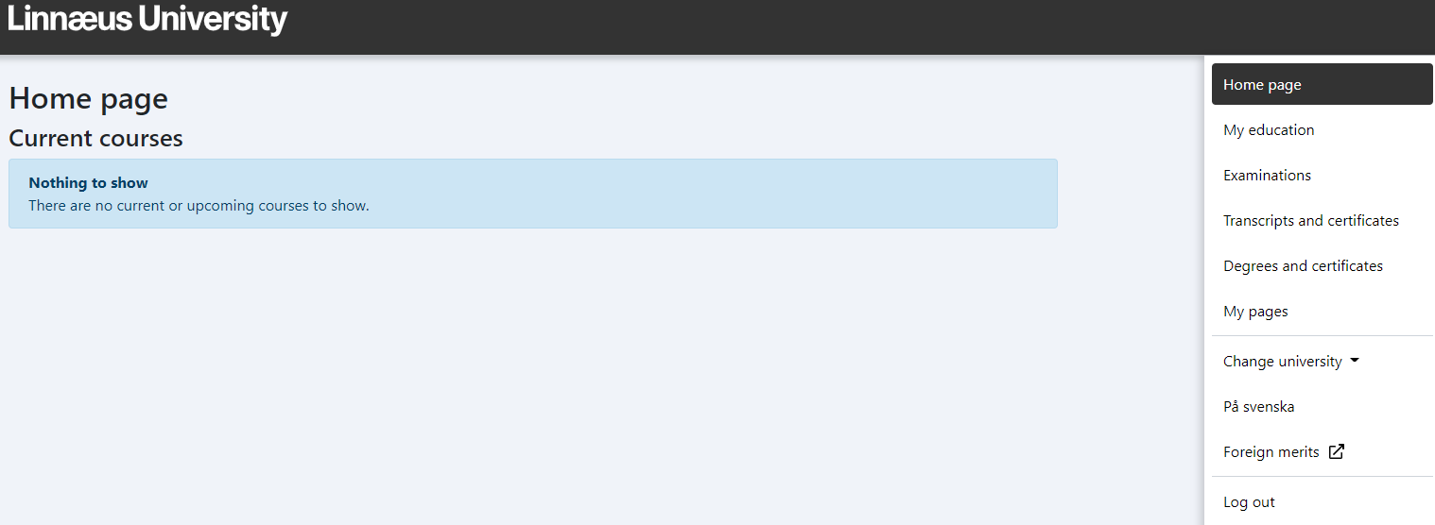
LADOK
Results, Certificates and sign up for examinations
My education you find:
grades for courses and programmes that are: completed, not completed and credited
Examination:
Here you sign up for the exam. You also see not signed up, passed
Change university:
To be able to see courses and grades on courses that you study at LNU, you must choose Linnaeus University
Notes:
Ladok
Students will be directed here from their student web (slide 3). They can do the following:
Register for courses
View their results
Register for examinations
Retrieve certificates

Slide 10
Connect your current email and stay updated
To ensure you do not miss out on important information regarding your studies we advise you to connect your current email to your student account.
You can change this setting via your student account at Lnu.se/student/mypages in ’My Ladok’ under ’My pages’.
More information can be found at IT-support for students.

Slide 11
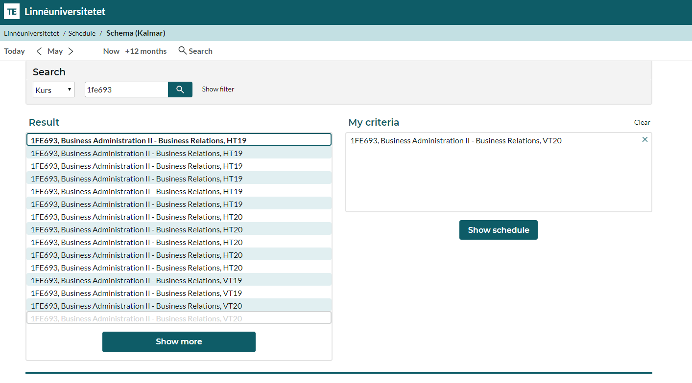
Timetable
Once a timetable is published, you can find it via TimeEdit
Notes:
Timetable
You can always find your timetable before you are registered:
Typing your course code or (part of) the course name
Click on the correct semester
Click on Show schedule

Slide 12
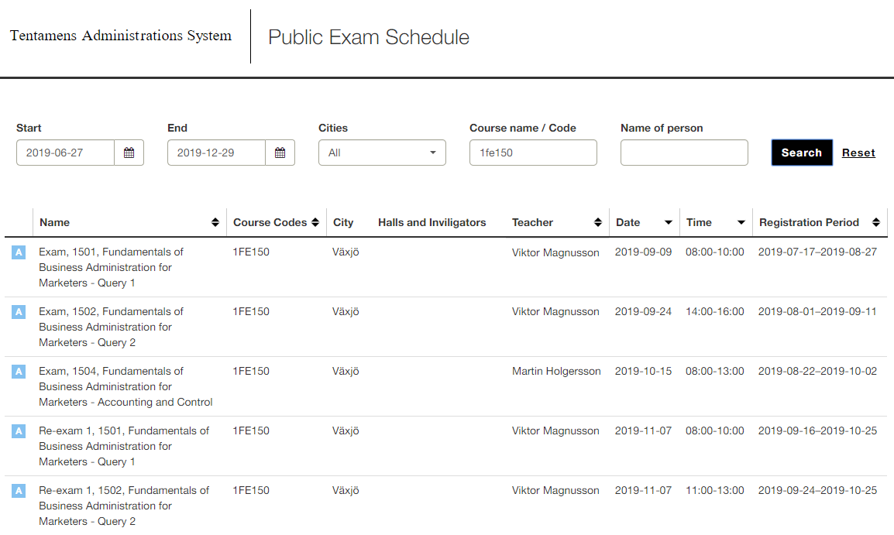
salstentamen.lnu.se
Notes:
Exam Schedule (only applicable at courses given on campus)
Students can see the next opportunity to take an exam by going to salstentamen.lnu.se (link in picture).
When searching, make sure to fill in the following:
End (final day for search query)
Course name / code
Under Date – the date when the exam is given
Under Registration period – the dates when the exam is open for registration
Note that the registration for an exam is not made through the exam schedule, but through Ladok, accessed via the student web.

Slide 13
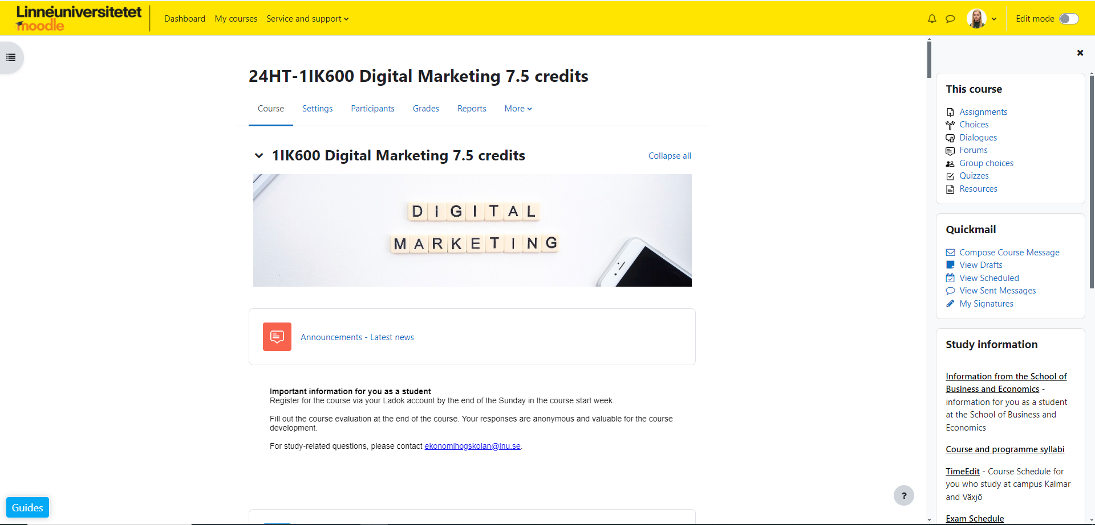
The learning platform Moodle
Programme room Marketing, masterprogram 120 credits
https://moodle.lnu.se/course/view.php?id=4190
Course room 4FE124
https://moodle.lnu.se/course/view.php?id=64318
General information
Information from the School of Business and Economics
Notes:
Add the link to your programme room at the first row of red text.
Add the link to the first course room at the second row of red text.
The learning platform Moodle
Shows your programme room and course room!
Make sure to present Information from the School of Business and Economics (link in slide). Here, students can find information about:
Contact information for the education administration
Semester- and course periods
Information regarding qualification requirements and conditions, as well as course options within programmes
Exam registrations, exam timetable and exams in different city
Help and support for academic writing

Slide 14
Course and programme syllabus
The programme syllabus governs a programme’s objectives, structure, content and degree. The course syllabus governs the learning objectives, content, examination, literature etc. of the respective course. It always specifies what prerequisites must be met to be eligible to register and take the course.
Always read through the course syllabus prior to each new course.
Notes:
Course and programme syllabus
Show where the student can find the course and programme syllabus https://lnu.se/utbildning/under-studierna/studentwebben/kurs-och-utbildningsplaner
Important to show in the course syllabus:
Prerequisites – Explain that the prerequisites dictate if a student is eligible or not to a course. Note that if the student does not meet the requirements they can be denied the right to start a course.
Literature list– is last on the course syllabus – obs the list can change until 8 weeks before course start, so it is not a good idea to buy all the litterature the year before the course is given.

Slide 15
See programme syllabus
Fall - first year courses
Period 1-2:
4FE124 Applied Marketing Analysis, 15 credits = Course responsible Åsa Devine
Period 3-4:
4FE136 Digital marketing Strategy, 15 credits = Course responsible Anders Pehrsson

Slide 16
See programme syllabus
Spring - first year courses
Period 1-2:
4FE125 Managing Innovation and Entrepreneurship, 15 credits = Course responsible Tatiana Anisimova
Period 3-4:
4FE114 Quantitative Methods and Applications 7,5 credits A1F (electives)*. Course responsible Viktorija Kalonaityte
4FE115 Quantitative Methods and Applications in Business Administration, 7,5 credits A1F (electives)*. Course responsible Setayesh Sattari
(*Note: the course is compulsory for all students who want to finish the full master programme (2 years))
Alternative
4FE25E Degree project in Business Administration (master), 15 cr, A1E, (elective)**. Course responsible Frederic Bill
(**alternative - if only one year study on the program)

Slide 17
See programme syllabus
Fall - second year courses
Period 1-2:
4FE080/4FE127 Contemporary Marketing Research, 15 credits = Course responsible Clarinda Rodrigues
Period 3-4:
4FE081/4FE128 E-Business Management, 15 credits = Course responsible Tatiana Anisimova

Slide 18
See programme syllabus
Spring – second year courses
Period 1-4:
5FE05E Business Administration with specialization in Marketing, Degree Project, 30 credits = Anders Pehrsson

Slide 19
Examination
There are different types of examination, for example written exams, digital exams, written assignments and seminars. The responsible course coordinator informs how the course is assessed. This is also stated in the course syllabus. If you received a passing grade you cannot retake the same examination in order to obtain a higher grade.
Notes:
Examination
Go through the different types of examination:
written exams
Take-home exams
Hand-in assignment
quiz
digital test
case
Show how the first course is assessed and show the course syllabus.
Important to relay to the student: If they receive a passing grade they cannot retake the same examination in order to obtain a higher grade.

Slide 20
Examinations
Several assignments in one course.
1 Individual assignments
2 Group Assignments

Slide 21
Failed examinations:
can lead to you not fulfilling the prerequisites for the next course and cannot study further.
may involve problems with Visa, the Swedish Migration Agency or CSN as they are required for study performance.
Do not delay too long with re-examination as the course structure may change to the next academic year.
Notes:
Failed examinations….
Can lead to the student not fulfilling the prerequisites for the next course or semester and cannot study further.
CSN require a certain study performance. All questions regarding CSN should be directed to them.

Slide 22
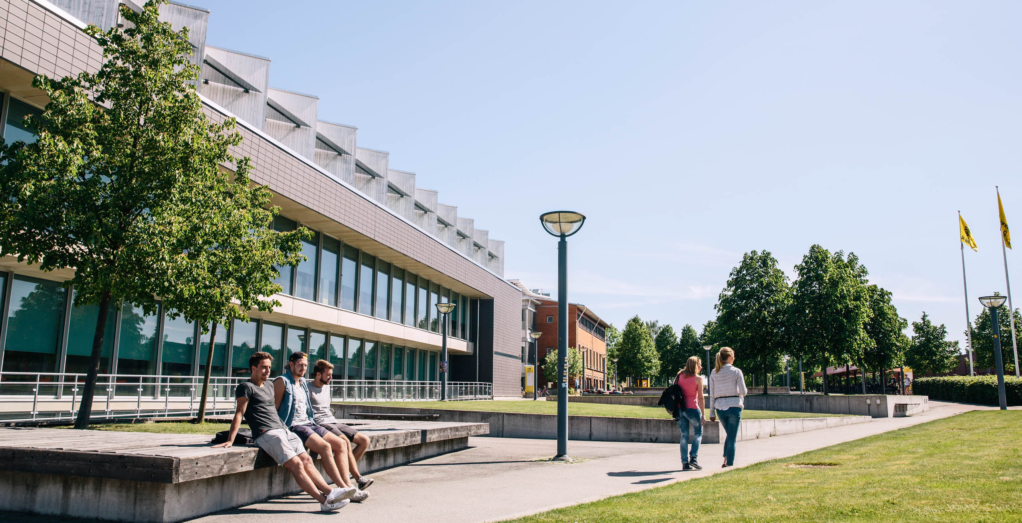
Info center – Växjö
House H
General questions, services and sale of promotional products
Opening hours: Monday – Friday, 8:00 – 16:00
Notes:
You are always welcome to info center for general information and service, questions regarding directions and forwarding inquires through the organisation.
The store also sells promotional products, office material and course compendium. At info center Växjö you can also find copycenter.

Slide 23
General grading criteria for the A-F scale at the School of Business and Economics
Your performance is measured in proportion to how well you have met the course objectives.
Grade | Assessment | Your results are equivalent to one of the following criteria for each objective for the course
A | Excellent | Outstanding results with only a few minor shortcomings
B | Very good | Very good results with only a few shortcomings
C | Good | Generally good but with some shortcomings
D | Satisfactory | Acceptable level but there are several shortcomings
E | Sufficient | The results meet the minimum criteria
Fx | Insufficient | The Examiner/course coordinator may, in exceptional cases, decide that a student who is close to the threshold for E may perform assignments for extra credit to reach the grade of E. The examiner/course coordinator notifies the student in writing of the rules for submitting such extra credit assignments. The grade of F is assigned in anticipation of the extra credit , and the grade is changed to E if the extra credit is approved.
F | Insufficient | Significantly more work is required
Notes:
The School of Business and Economics’ grading scale
The header is a link to the document of rules, which can also be found through Information from the School of Business and Economics at Moodle.
Go through the different grades.

Slide 24
Weighing up of grades for the whole course
The performance is weighted in relation to how well the goals of the course have been met.
All of the course’s assessment tasks must be passed before the cumulative grade can be calculated.
The programme administrator performs the mathematical calculation using set principles.
The grade documentation is submitted to the examiner for a decision by signing the results list.
Grades are weighted when the programme administrator translates all assessment tasks graded for a course into figures in accordance to the table on the right.
A-F grading scale | Number scale for weighted average
A | 9.0
B | 8.0
C | 7.0
D | 6.5
E | 6.0
A-F grading scale | Mathematical grade thresholds
A | 8.51–9.00
B | 7.51–8.50
C | 6.76–7.50
D | 6.26–6.75
E | 6.0–6.25
Each assessment task is given the percentage weight that corresponds to the amount of credits it covers. As a result, the sample course gets a C, given that the average was 7.4.
Course X, 15 credits | Grade | Translation | Weighted average
Assessment task 1; exam 7.5 credits | B | 8 | 8*(7.5/15) = 4.0
Assessment task 2; case 4.5 credits | C | 7 | 7*(4.5/15) = 2.1
Assessment task 3; lab work 3 credits | D | 6.5 | 6.5*(3/15) = 1.3
Total |  |  | 7.4
Notes:
Grade weighting
A course consists of different assessment tasks which are calculated to make up the final grade.

Slide 25
Course evaluations
After each completed course – please fill out the course evaluation! The course evaluation is your chance to influence, comment and contribute to good course quality
Notes:
Course evaluations
The student fills out a course evaluation after completed course. This matters in order for us to evolve and have a higher quality for our courses.
If any student is interested in previous course evaluations they can email arkiv@lnu.se.

Slide 26
Apply to your programme courses
Applications for next semester’s courses are done through www.universityadmissions.se
In some cases you will not need to apply for courses in the coming semester, in which case you will be given infomation about this.
Information about how you apply, you will find at Information from the School of Business and Economics
As a programme student you have a guaranteed seat on programme courses.
The application period for the 2025 spring semester is during October.
The application period for the 2025 autumn semester is during April.
Application problems? Contact admisson@lnu.se
Other questions ekonomihogskolan@lnu.se
Notes:
Apply to your programme courses
Ahead of every semester the education administration uses Information from the School of Business and Economics on Moodle to inform which programmes will need to apply to the upcoming semester courses. As a student you only apply to the next coming semester and this is done via universityadmissions.se, in the same way they applied to the programme. The information the administration gives out includes:
If the student needs to apply
Which courses that should be applied with application codes
Instructions on how to apply
Contact information in case problems with the application arise

Slide 27
The Education administration at the School of Business and Economics
E-mail: ekononomihogskolan@lnu.se
Switchboard: +46772 – 28 80 00
Visit us
Kalmar
Faculty offices, House Forma, 2nd floor
Växjö
Faculty offices, house K, 1st floor
Information from the School of Business and Economics – An information page on Moodle
Like us on Facebook:
Ekonomihogskolan vid Linnéuniversitetet /School of Business and Economics

Slide 28
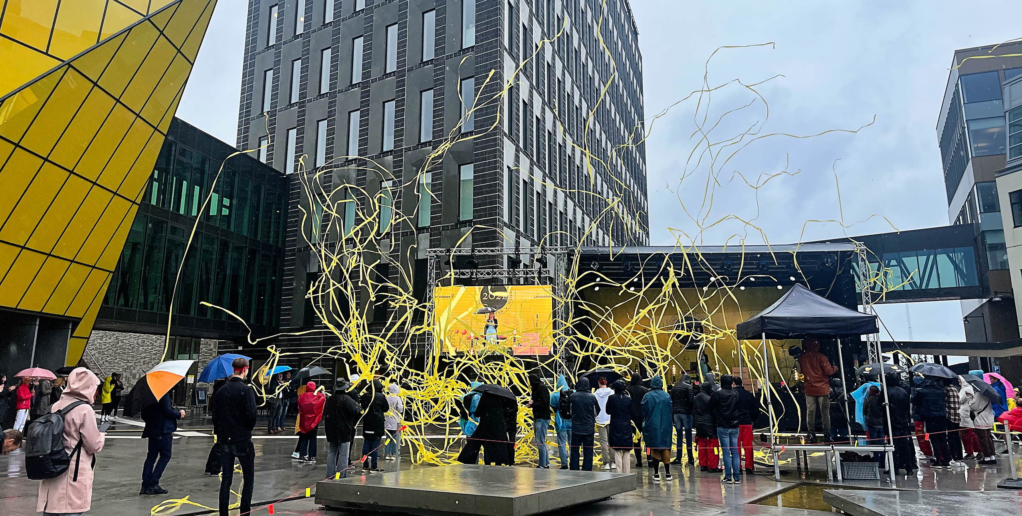
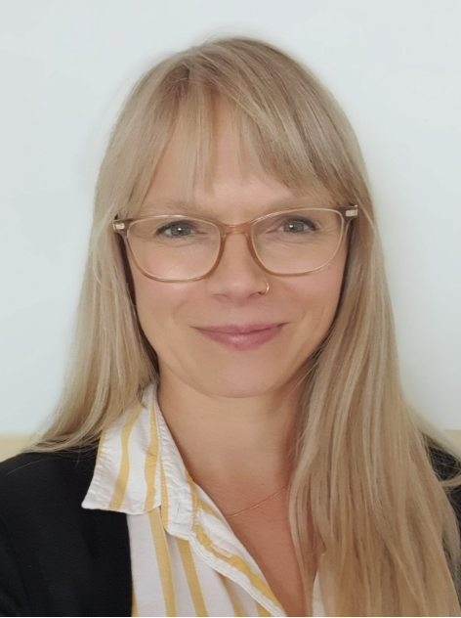
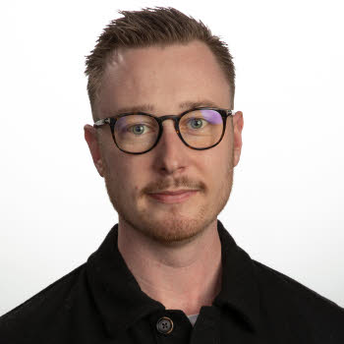
Internationalisation
Contact : mobility.feh@lnu.se
As a student you have several opportunities for internationalisation: exchange programmes, internships and the possibility of writing your degree project abroad.
Maria Barath Internationell koordinator Växjö
Teresa Pauditz International coordinator Kalmar
Victor Bohman
International coordinator
Kalmar
Notes:
Internationalisation
Linnaeus University offers students great opportunities to studies abroad. Going on exchange studies means you complete a semester or an academic year at a university that Linnaeus university has an agreement with. There are also opportunities for internships and writing your final thesis abroad.
Show the link with information on the picture.
Contact people:
Kalmar Teresa Pauditz, teresa.pauditz@lnu.se
Kalmar Victor Bohman, victor.bohman@lnu.se
Växjö Maria Barath, maria.barath@lnu.se

Slide 29
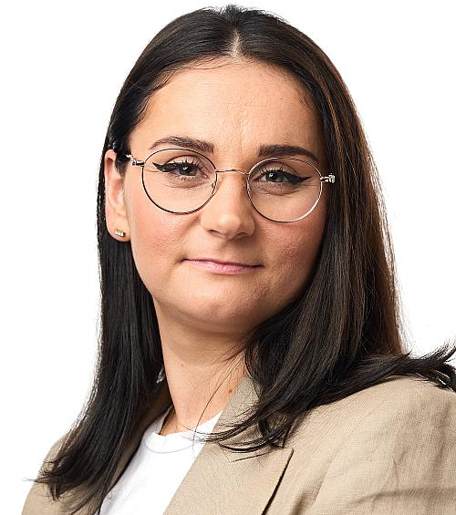
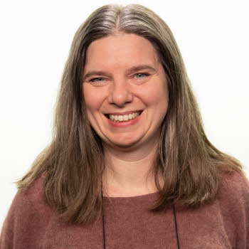
Student counselling at the School of Business and Economics
Ivana Stanic Student Counsellor, Kalmar Email: ivana.stanic@lnu.se Visiting adress: House Forma, floor 2
Mirja Sjögren Student Counsellor, Växjö Email: mirja.sjogren@lnu.se Visiting adress: House K, floor 1
Angelica Önder Student Counsellor, Växjö Email : angelica.onder@lnu.se Visiting adress: House K, floor 1
Notes:
Student counselling at the School of Business and Economics
the School of Business and Economics have three student counsellors, one in Kalmar and two in Växjö. They help the students with the following:
Student counselling and individuell student planning
Matters involving choices within programmes
Approved leave of studies
Taking a break from studies
Changing programmes
Make an appointment if you need to meet with a student counsellor, be prepared with your questions to optimise your visit.

Slide 30
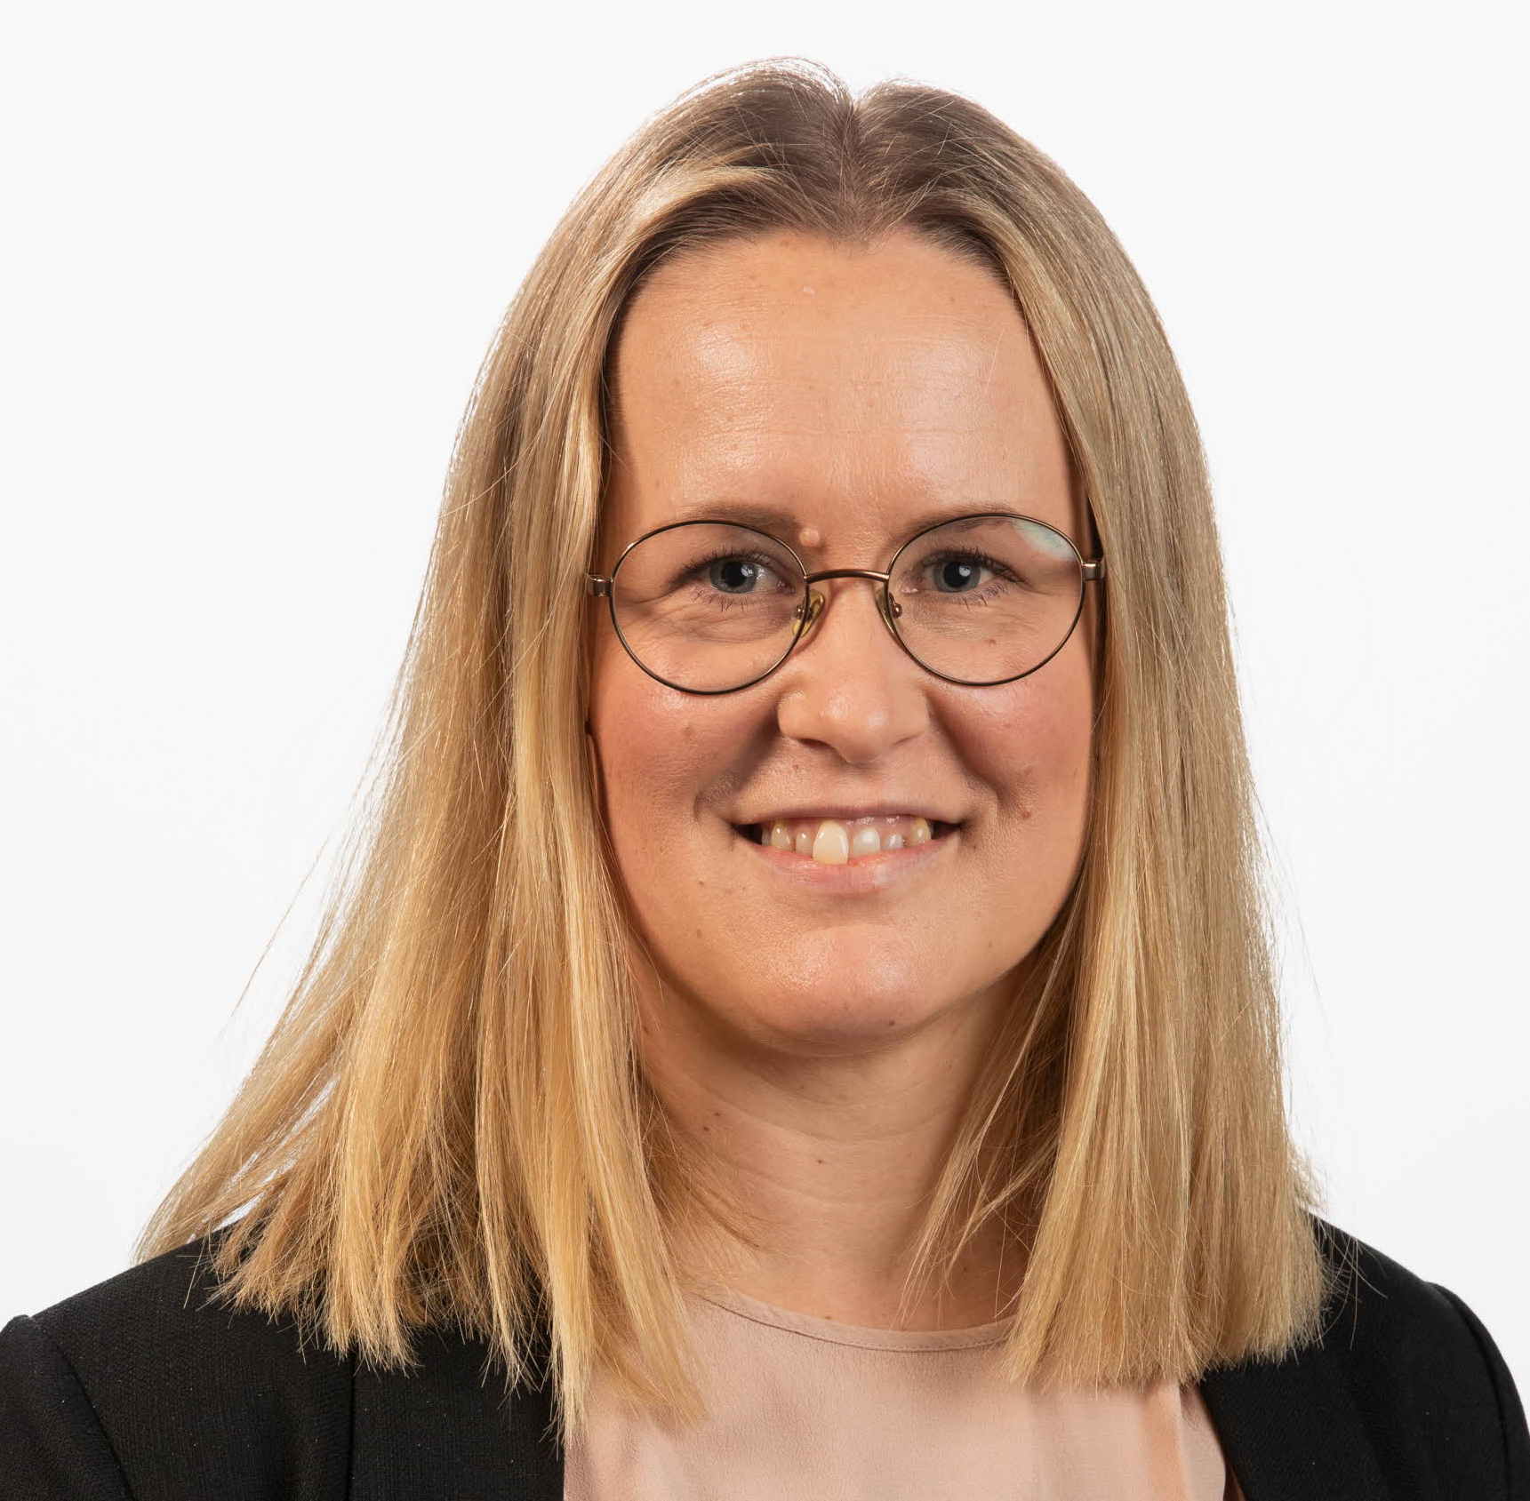
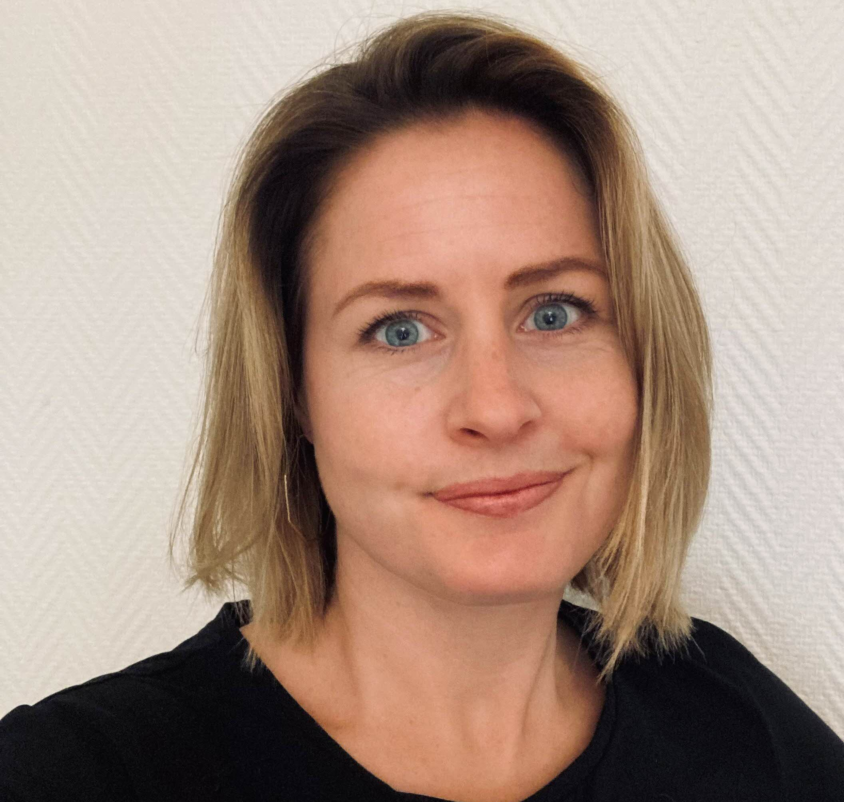
Career counselling service
Do you need help starting up your job search process? The career counselling service at Linnaeus University, Lnu Career, will offer you support when you try to figure out how your education, your experience, and your personal qualifications are best summarised into a powerful job application.
Sofie Edström
Career Counsellor, Kalmar
+46480-44 62 38
sofie.edstrom@lnu.se
Fanny Elheim
Career Counsellor, Växjö
+46470-70 84 05
fanny.elheim@lnu.se
Notes:
Career counselling service
The link in the header directs to the Career counselling service
Career counselling service arranges different Lectures, workshops och events, such as:
CV-writing help
career course
interview training and lectures
your personal trademark- lecture
LinkedIn – lecture and workshop
Students also have the opportunity to meet a career counsellor.

Slide 31
Learning support for your studies
If you are a student and have some form of disability, it is possible for you to get pedagogical support during your studies. Examples of such help are, help taking notes, sign language interpreter or extended time at examination sittings.
Notes:
Learning support for your studies
If you are a student and have some form of disability, it is possible for you to get pedagogical support during your studies. Examples of such help are, help taking notes, sign language interpreter or extended time at examination sittings. Contact via – funksam@lnu.se
Link in the picture for more information.

Slide 32
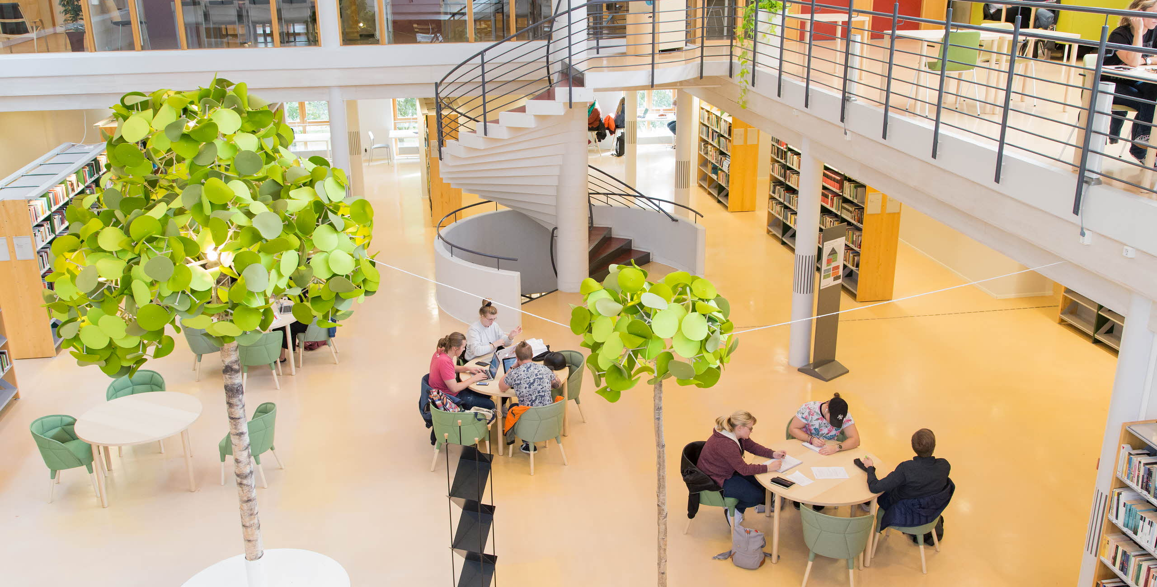
The University Library and Academic Support Centre
Search and writing assistance is available at the University Library and through the writing guide. At the Academic Support Centre you can get support with your academic writing as well as help with study techniques.
Read Refero – the anti-plagiarism Tutorial a web-based textbook that shows you how you properly use others’ texts in your academic writing.
Notes:
The University Library and Academic Support Centre
At the university library there are a number of places to study and group rooms. A few of the group rooms and study places are available for booking via the library webpage lnu.se/ub. Contact via ub@lnu.se. Students can also recieve search and writing assistance (link in picture).
At the academic support center students can recieve guidance in matters regarding academic writing and study techniques, in swedish and english.

Slide 33
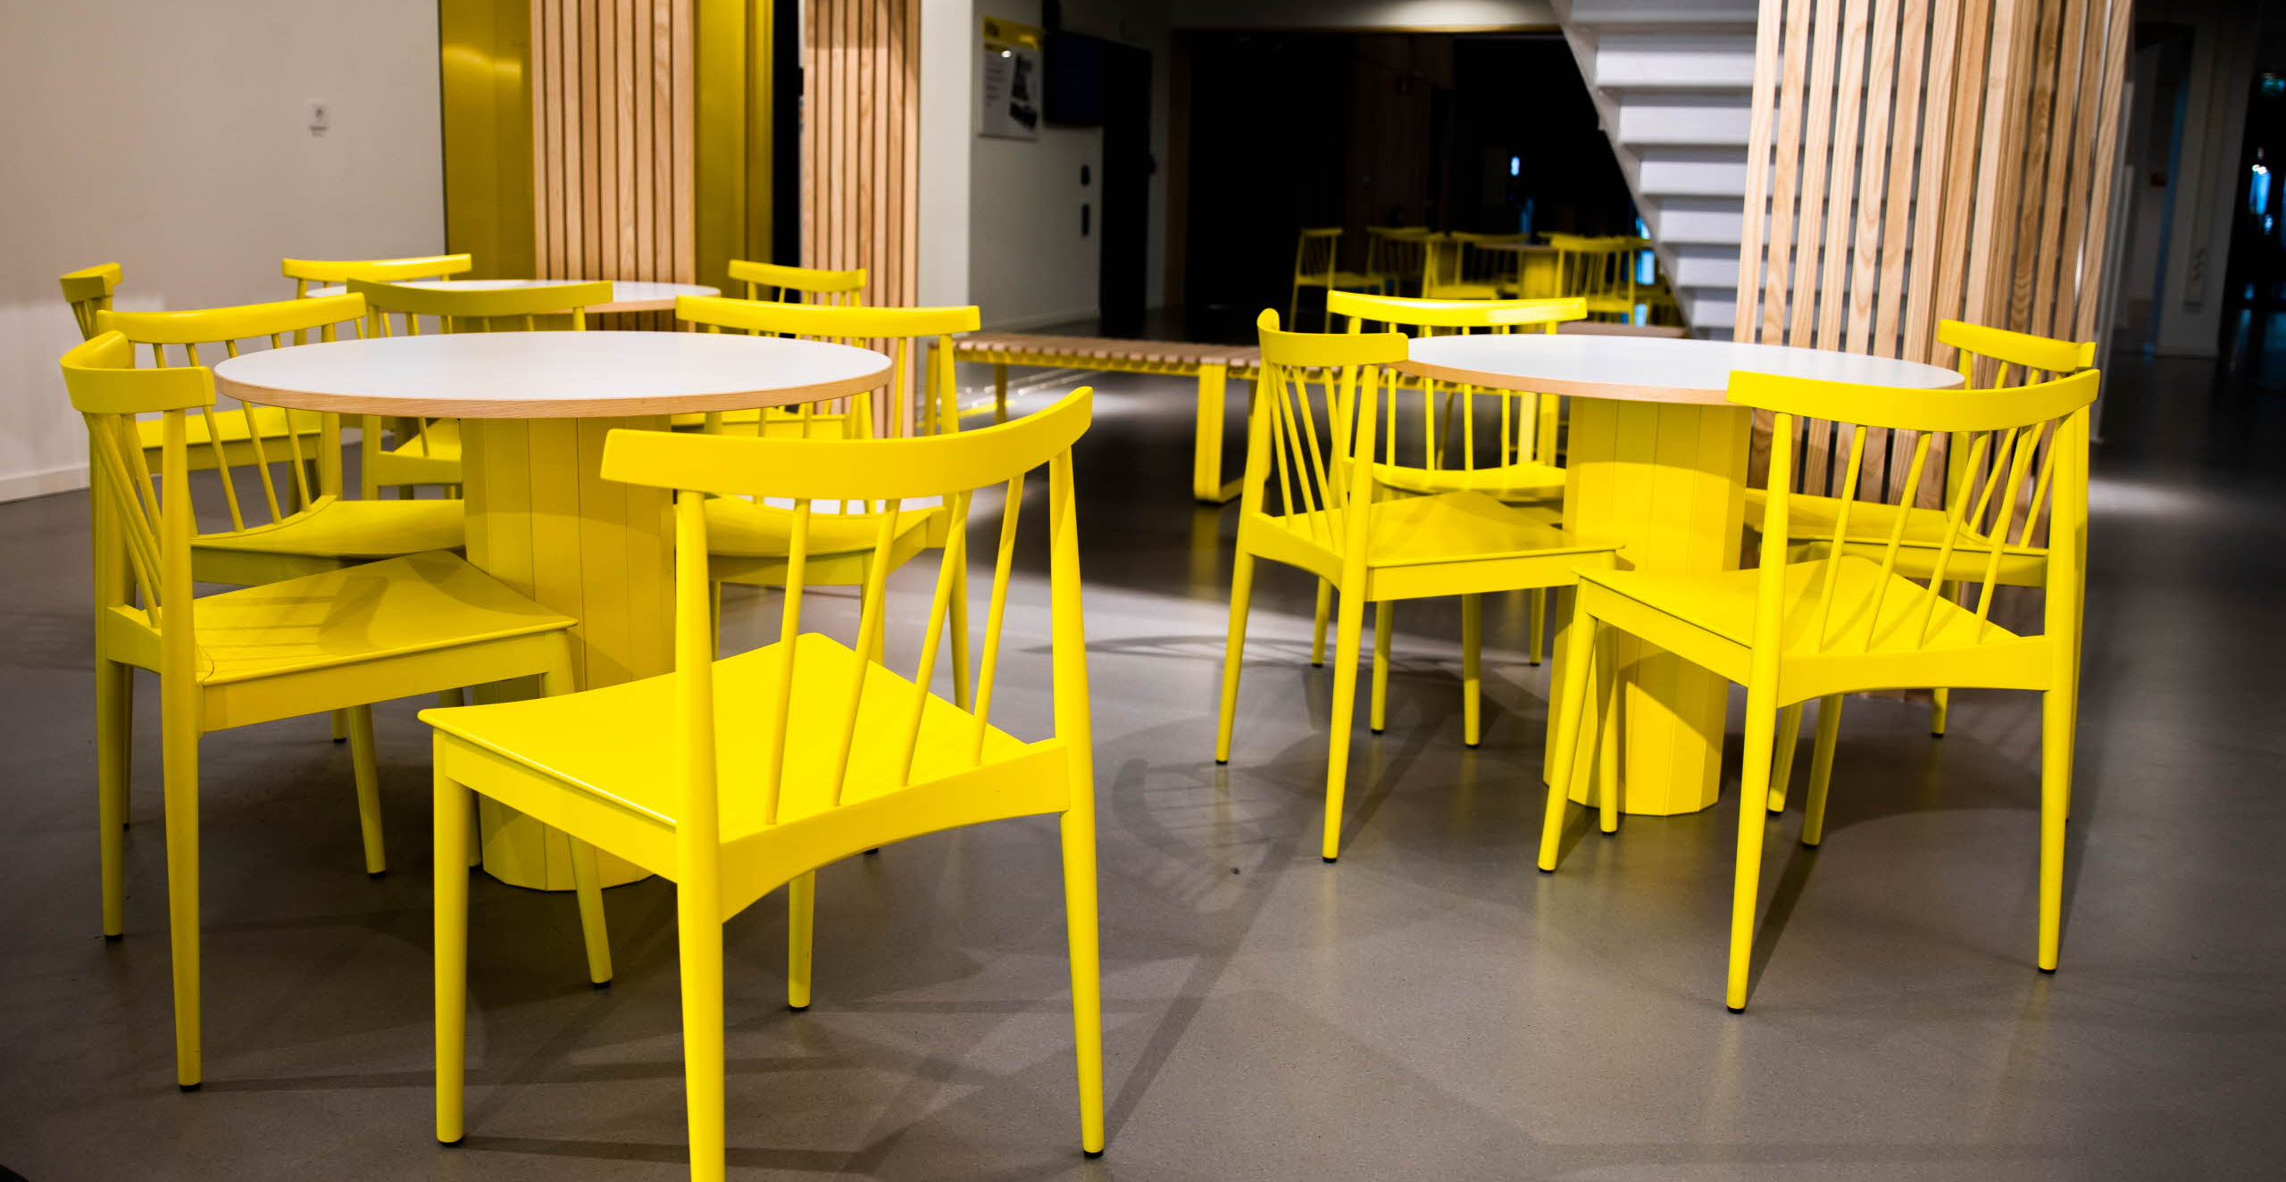
Student Welfare Office
The Student Welfare Office is available to students at Linnaeus University in both Kalmar and Växjö. They take a preventative approach to lifestyle issues and provides counselling and coaching.
At times the transition to higher educations can be daunting. That is why we offer the lecture series How to succeed with your studies and The academic support model SI
Notes:
Student Welfare Office
The Student Welfare Office organises several different classes for students.
Visit the lnu.se page for the student welfare office for contact information - webpage (link in slide) https://lnu.se/utbildning/under-studierna/studenthalsan/
** You as a programme Director are encouraged to envite the Student Welfare Office to visit with your students in order to tell them about the support they can offer, through meetings and in groups, workshops etc. **
The Student Welfare Office know that many new students find the transition to higher educations difficult. That is why they offer the lecture series How to succeed with your studies https://lnu.se/en/library/library-consultation/how-to-succeed-with-your-studies/ and The academic support model SI https://lnu.se/en/student/during-your-studies/student-counselling/si-pass-peer-assisted-study-sessions/

Slide 34
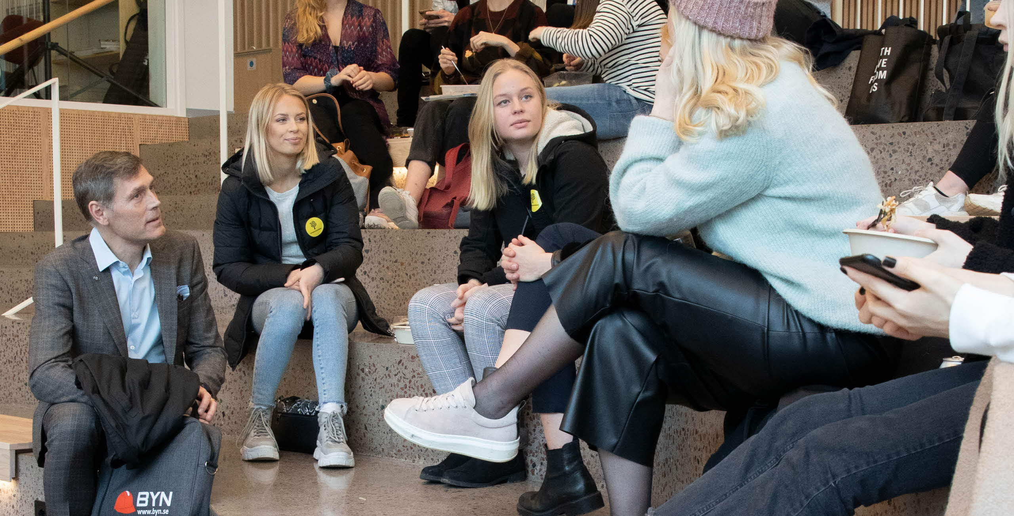
Get involved in your studies
Programme council
Linnaues Union
Student associations
Course evaluations
Linnébarometern
Notes:
Get involved in your studies
Take your time filling out course evaluations, it is important in our quality work.
Contact your teacher if any problems should arise. The programme responsible and Linnaeus Union can also help.

Slide 35
Onboarding to your Academic Journey
Full introduction day for all first-year bachelor students
Växjö: 9th September
Kalmar: 10th September
Notes:
An introduction day for new bachelor students where the main objective is to create onboarding experiences that addresses the academic skills of our new programme students. The focus will be on academic onboarding where we will introduce the students to academia and what it means to study at a university. The OnBoarding will be conducted via a full introduction day for all first-year bachelor students where they are presented with the opportunity to listen to and participate / ask teachers and current students, as well as learn what it means to be a student at Linnaeus University. Swedish fika and lunch are included as well as the chance to win a prize! Monday the 9th of September in Växjö and 10th of September in Kalmar.
More information will be given. The event can be found on the programme schedule.
We ask you as Programme Director to please inform the course coordinator for the first course of the programme to remind the students not to forget the event!

Slide 36
Welcome to the
School of Business and Economics!
Don't forget to register for your first course today!
Notes:
Do not forget to remind the students to register today.

