Slide 1
Welcome to the School of Business and Economics and the International Tourism Management Programme
Programme Director: Christer Foghagen
Notes:
Glöm inte bort att uppmana studenterna att registrera sig idag.

Slide 2
What will happen today?
Roll-call
Introduction
Kalmar Ess
Notes:
Upprop
Jag ropar upp – studenten ställer sig upp
Säger sig namn själv
Var kommer hen ifrån (jag skriver tavla)

Slide 3
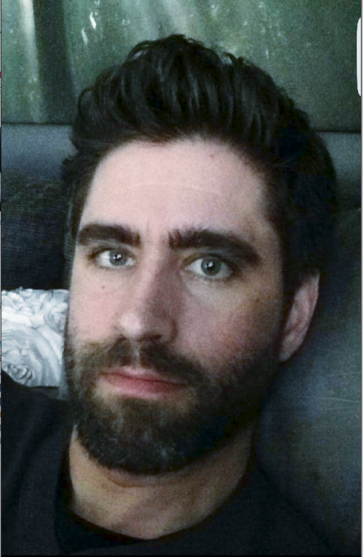
Programme Director
Christer Foghagen
E-mail: christer.foghagen@lnu.se
Programme development
Programme quality assurance
Accreditation AACSB
Student Programme Council

Slide 4
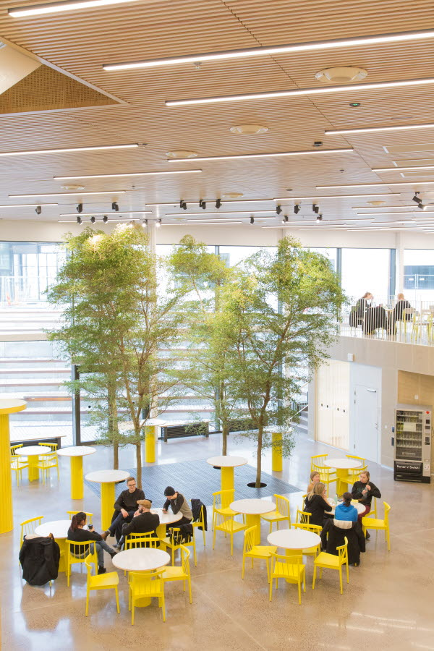
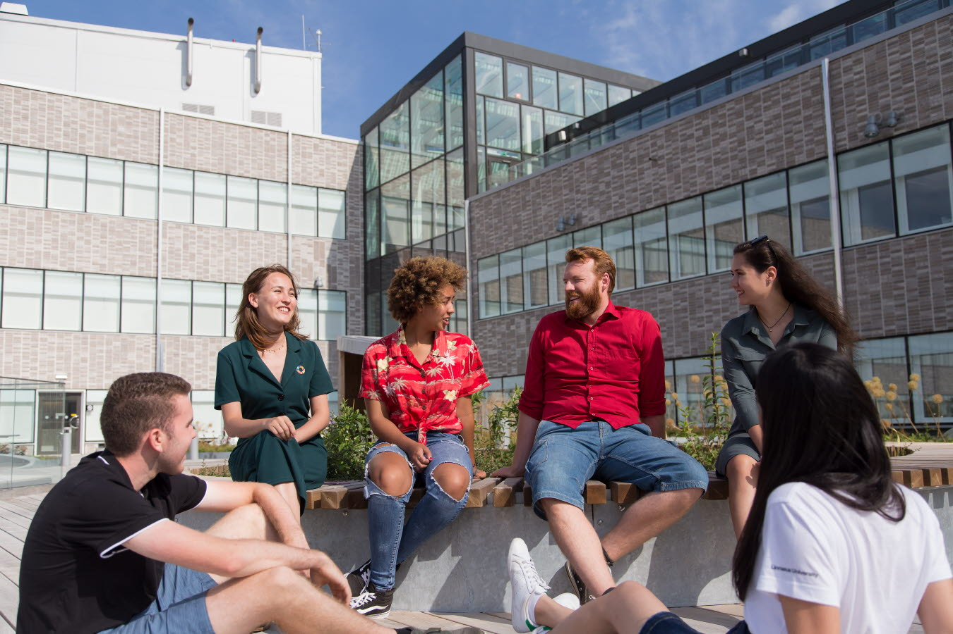
A modern, international university in Småland, southern Sweden We set knowledge in motion for a sustainable societal development
Linnaeus University – a creative and international knowledge environment promoting curiosity, creativity, companionship and utility.
Notes:
Vi sätter kunskap i rörelse för en hållbar samhällsutveckling Carl von Linnaeus from Småland 1800th century – world famous Swedish scientist who developed a biological classification system (taxonomy) for the natural world to standardize the naming of species of plants and animals and order them according to their characteristics and relationships with one another.
var en svensk botaniker, läkare, geolog och zoolog som lade grunden till den moderna nomenklaturen inom biologin och den moderna systematiken, som grupperar växter och djur.
Nyfikenhet Nytänkande
Nytta
Närhet (användbarhet)

Slide 5
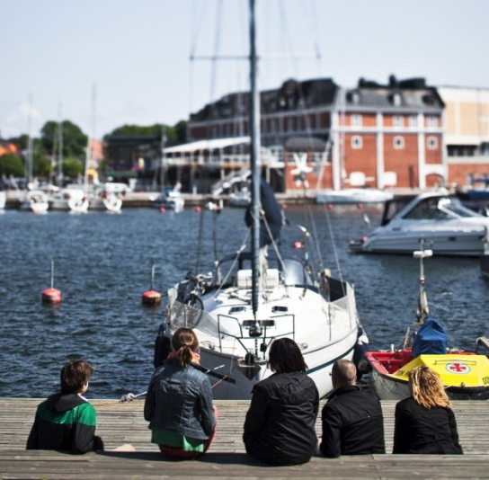
Linnaeus University – facts & figures
6th largest university in Sweden
40 000 students (16,600 full-year students)
2,200 employees
180 professors
292 doctoral students
120 degree programmes (first-cycle level)
80 degree programmes (second-cycle level)
1,500 freestanding courses
1100 international students
160 outgoing exchange students
600 partner universities in more than 80 countries
campus in Kalmar and in Växjö
Notes:
Denna sida har jag uppdaterat för 2024

Slide 6
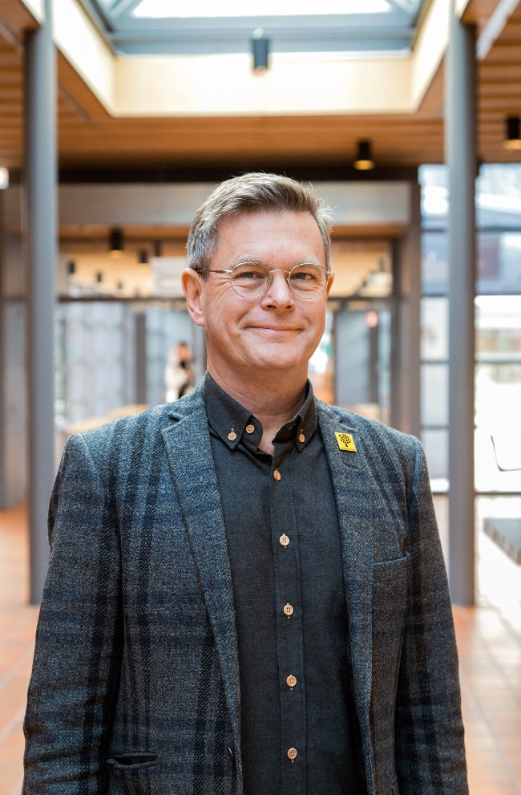
Linnaeus University Vice-Chancellor and faculties
School of Business and Economics
Faculty of Health and Life Sciences
Faculty of Arts and Humanities
Faculty of Social Sciences
Faculty of Technology
The board of teacher education

Slide 7
School of Business and Economics – SBE (FEH)
We co-create knowledge, making people grow
200 employees och 3,200 students in Kalmar and Växjö.
Programmes and research in the fields of economics, marketing, entrepreneurship, management, accounting, international business, retail, statistics, legal science, tourism, Event management, logistics, and corporate governance
SBE is organized in 3 Institutions and 2 Subject Collegiums

Slide 8
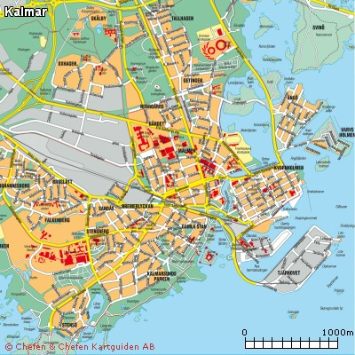
Kalmar
Universitetskajen

Slide 9
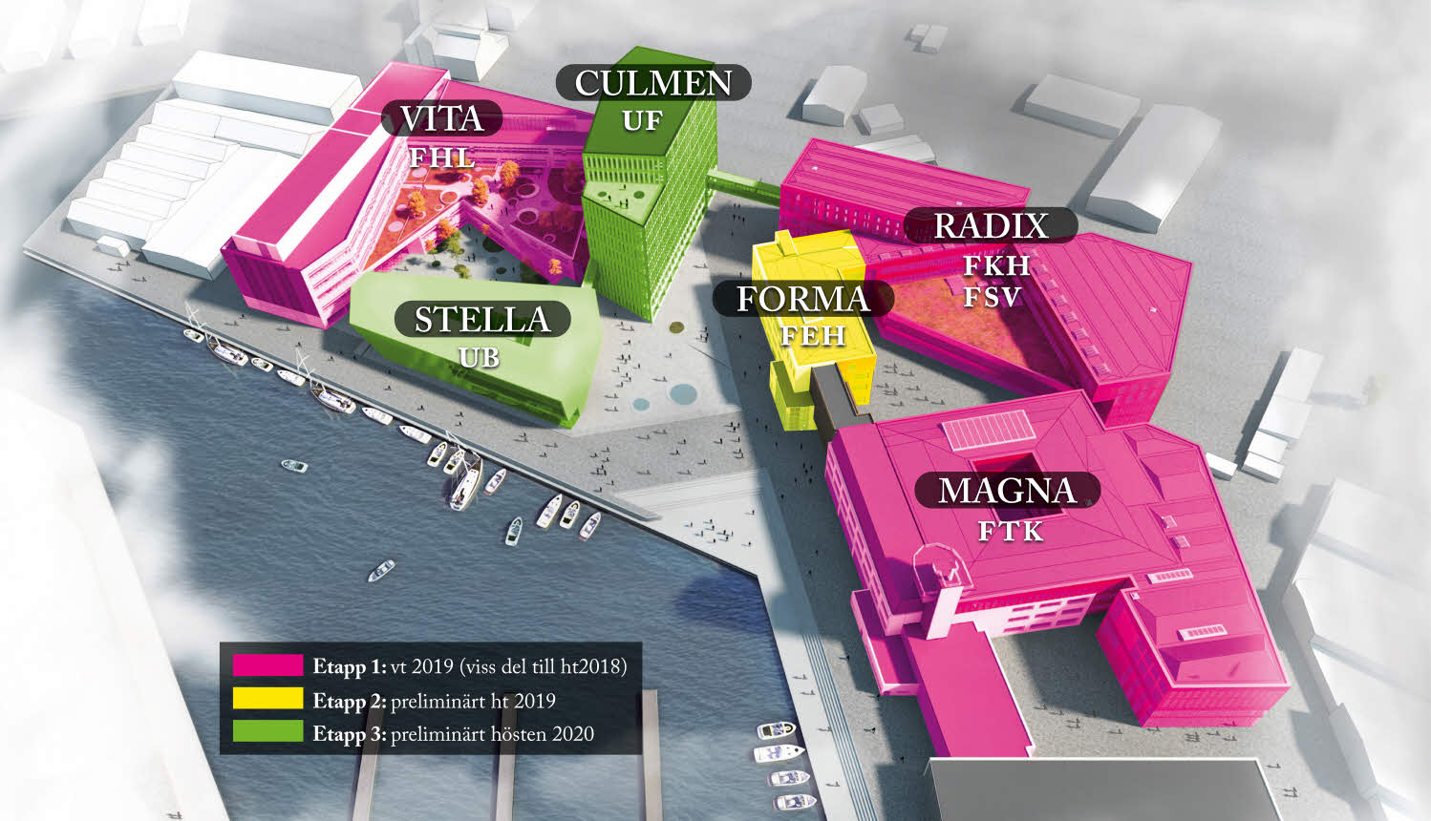
Universitetskajen SBE in Kalmar – House FORMA

Slide 10
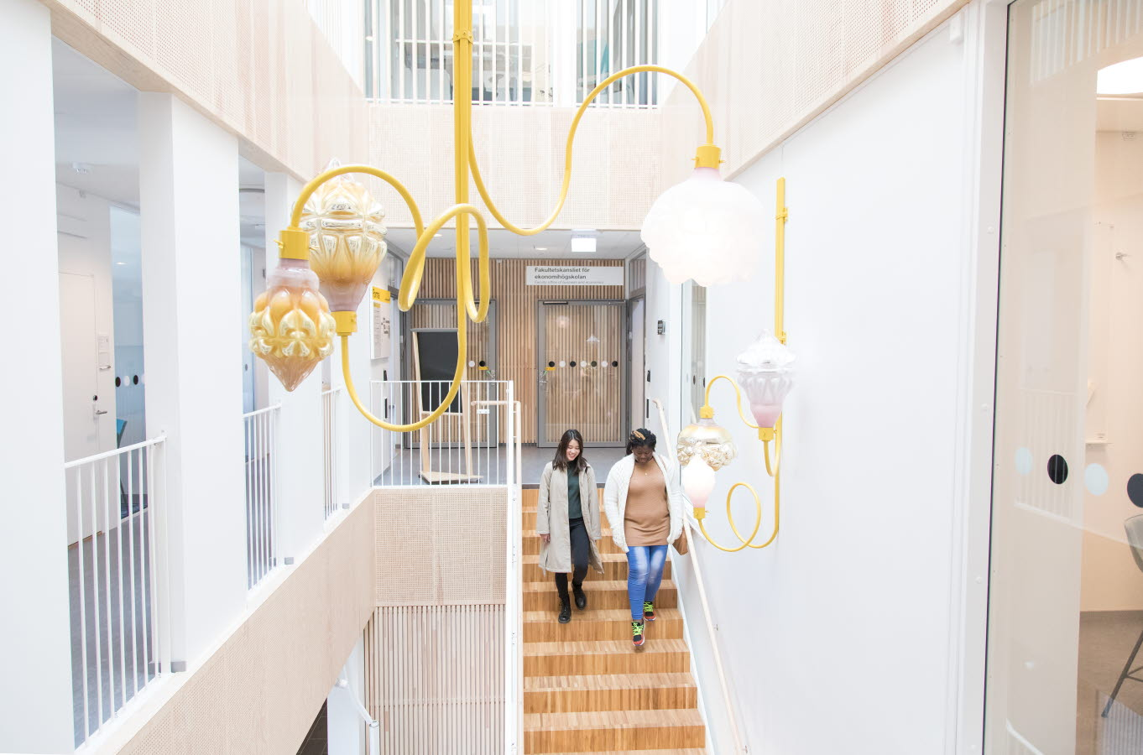
New student at the Linnaeus University
Before your start – checklist
Obtain your student account!
Register at the studentweb! Latest 28th of August!
Check your schedule 1TR514!
Read the syllabus and literature list!
Your e-mail! Connect your current to your student account!
Questions:
ekonomihogskolan@lnu.se
Infocenter, University Library
Notes:
Student på Ekonomihögskolan
Checklista ny student: https://lnu.se/nystudent
Följande information hittar studenterna här:
Hämta studentkonto
Registrera sig: 21 – 28 (30) augusti
Samt praktisk information som:
Studentwebben
E-post
Passerkort
To ensure you do not miss out on important information regarding your studies we advise you to connect your current email to your student account.
You can change this setting via your student account at Lnu.se/student/mypages in ’My Ladok’ under ’My pages’.

Slide 11
First course: 1TR514 Tourism Studies I – Introduction to tourism 15 cr.
The course will be carried in classroom on campus.
Cross listed course
Schedule
Course literature: All information regarding the course and the literature will be notified by course start.
Please see the course room at the learningplatform MyMoodle.

Slide 12
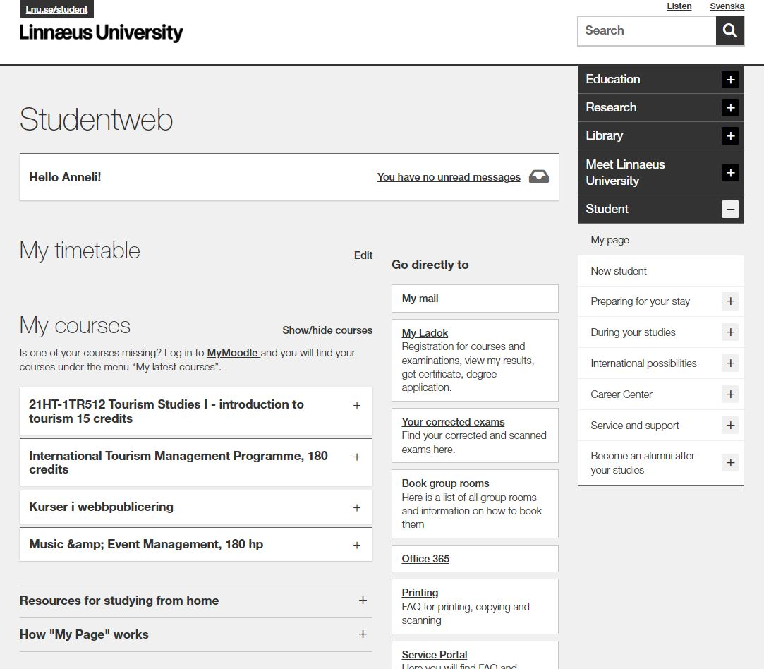
Studentweb on Lnu.se
To the studentweb
My schedule
When you are registered on a course you will find the schedule here
My page
Important information during your studies
My mail
My courses:
Link to the course room at MyMoodle
My Ladok:
Registration
Results
Sign up for examination
Certificates
The programme room:
Link to the programme room at MyMoodle
My student news My student calendar
Notes:
Studentwebben
I inloggat läge på lnu.se/student så ser det ut såhär. Här hittar studenterna följande:
Mitt schema
Mina kurser – finns länk direkt till kursrummet på MyMoodle. När studenten är registrerad på kursen kommer den att dyka upp under Mina kurser här på studentwebben
Under rubriken Gå direkt till kommer studenten till Ladok och kan göra följande:
Mitt Ladok:
Registrera sig på kurs: 21-28 (30) augusti
Se mina resultat
Anmäla sig till tentamen
Hämta intyg
”My Pages” – the e-mailaddress you use
Till höger i inloggat läge hittar studenter viktig information såsom:
Under studierna: Kursplaner, IT-tjänster och support, Tentamensschema och Examensarbete
Internationella möjligheter: Studera utomlands
Jobb och karriär: Mentorsprogrammet, Aktiviteter, Mycareer, etc.
Stöd och Service: Infocenter, teknisk support, studenttjänster, etc.
I inloggat läge får de även upp Studentnyheter och Studentkalender. Det kan vara öppna föreläsningar, påminnelser etc.

Slide 13
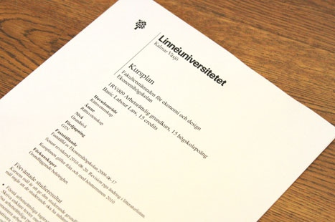
Programme syllabus and Course syllabus
The programme syllabus governs a programme’s objectives, structure, content and degree.
The course syllabus governs the learning objectives, content, examination, literature etc. of the respective course. It always specifies what prerequisites must be met to be eligible to register for the course.
Always read through the course syllabus prior to each new course.
You find all course names and course codes in the Programme Room on the Student Web.
Notes:
Course and programme syllabi
Show the students where to find program- and course syllabi, namely via the following link:
https://lnu.se/en/education/during-your-studies/studentweb/course-and-programme-syllabi/
Important to show in the course syllbus is:
Prerequisites - Mention that the student’s prior courses and credits determine whether or not the student is eligible for a course (show where in the course syllabus this is mentioned). In other words, a student can be denied access to a course, if said student does not meet the requirements and terms for that course.
Also, make sure to show the students where to find the course literature in the course syllabus.

Slide 14
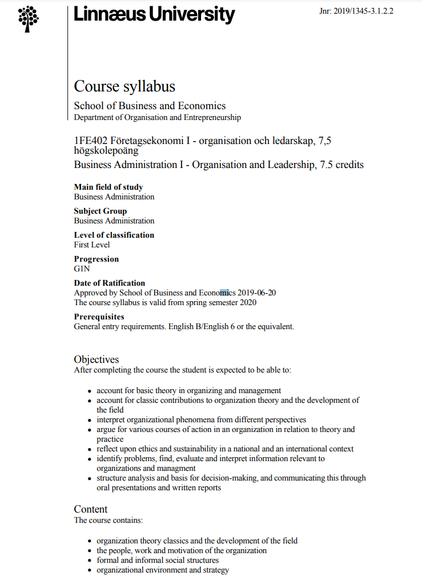
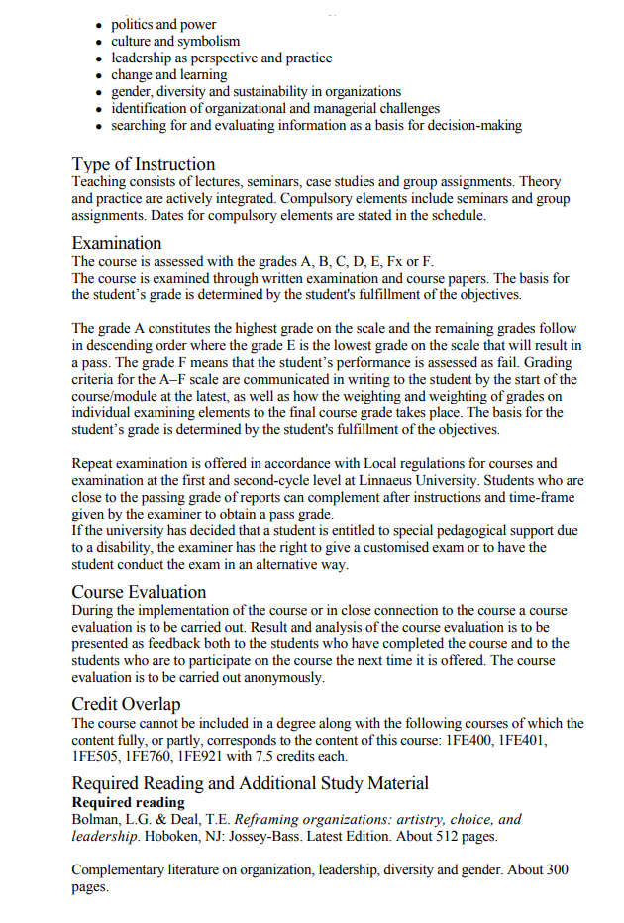
Notes:
Gå igenom de olika sätt som det finns att bli examinerad på så som:
Skriftlig tentamen, hemtentamen, inlämningsuppgift, dugga, digitala test, case etc.

Slide 15
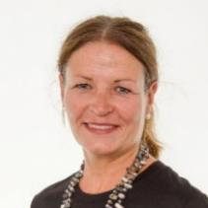
Contact persons at the School of Business and Economics
Education Administration Office
E-mail: ekononomihogskolan@lnu.se Phone: 0772 – 28 80 00 Visiting address: House Forma, floor 2 Information from the School of Business and Economics
Contact person – international students
Terese Nilsson
E-mail: terese.nilsson@lnu.se
Education Administration Office, House Forma, floor 2
For questions regarding Tuition fees: tuitionfees@lnu.se
Notes:
Make sure to present Information from the School of Business and Economics (link in slide). Here, students can find information about:
Contact information for the education administration
Semester- and course periods
Information regarding qualification requirements and conditions, as well as course options within programmes
Exam registrations, exam timetable and exams in different city
Help and support for academic writing

Slide 16
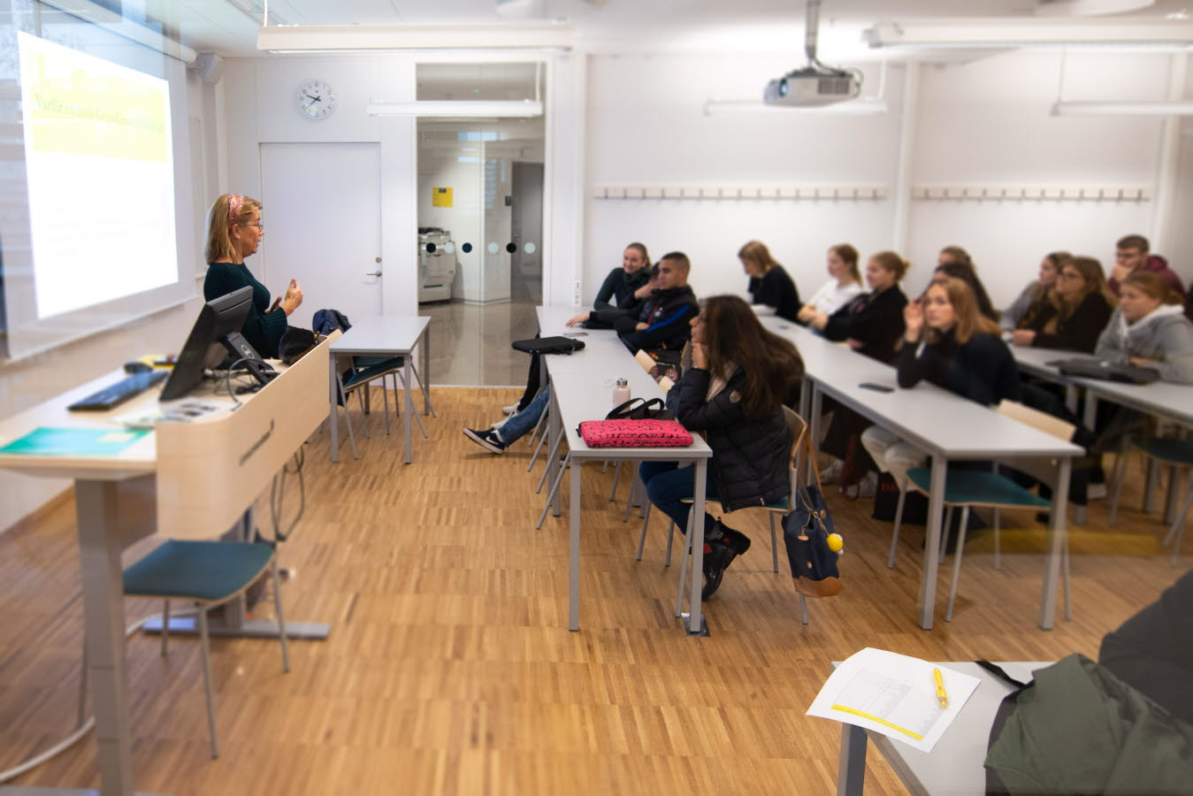
Programme meeting Wednesday September 25 13:00-14:00
Continuing introduction to your studies
Detailed information regarding the programme
Internationalisation
Quality assurance
Student help and counselling
Engagement outside your studies
”Bits and Bobs”

Slide 17
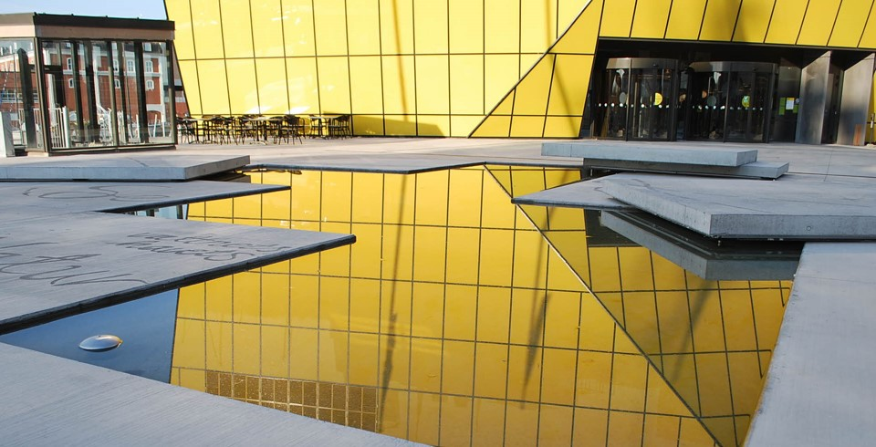
Student Programme Council
2-3 students from each year cohort
Meeting 1-2 times per semester
Certificate of participation
Experience of board work
Social network
Possibility of an impact of your education and programme quality assurance.
Who wants to join?
Notes:
- 1 år i taget
Linnékåren utser formellt
2-3 students from each year cohort + Programme Director and KalmarEss representative
Meeting 1-2 times per semester á 1.5h
Elected formally by the student union Linnékåren as a representative for one academic year
Remuneration per meeting (today 350SEK)
Certificate of participation can be issued both from Programme Director and Linnékåren.
Above this; knowledge experience between the year cohorts, experience of board work, social network and above all have a possibility of an impact of your education and programme quality assurance.

Slide 18
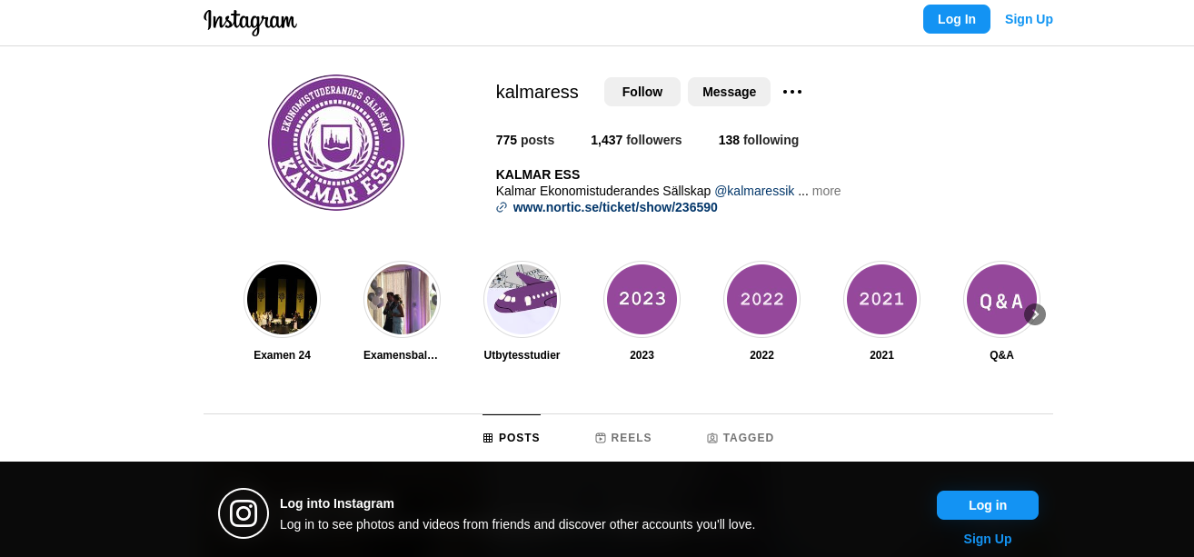
KALMAR ESS

Slide 19
Welcome to the School of Business and Economics!
Don't forget to register for the programme and the first course today!
Notes:
Don’t forget to urge the students to register today.

