Slide 1
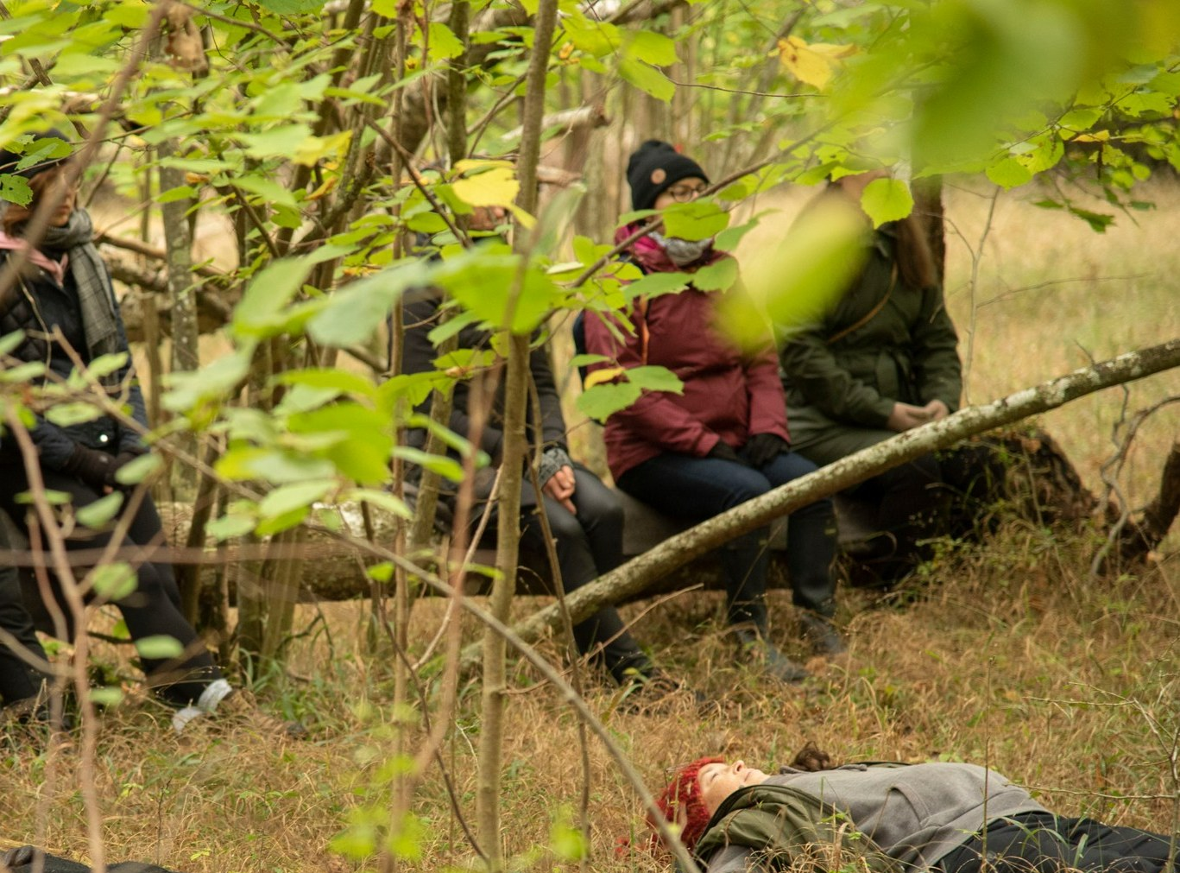
Self-guided forest bathing for wellbeing

Slide 2
Self-guided forest bathing for wellbeing
Low cost
Flexible
Easy

Slide 3
Self-guided forest bathing for wellbeing
Forest bath with certified forest bathing guide
Self-guided forest bathing, ca 120min each week
- You can divide the time into shorter sections but keep in mind that each session should last at least 20 minutes.
- You can perform forest bathing on the days and times that suit you.
- You can do the forest bath with a forest bath buddy, remember to focus on your inner experience and interaction with the forest, and do the forest bath in silence.
- Choose a forest or grove that works for you. You can go to a nature reserve, a forest outside the city, or to a park where there are forest groves where you can perform the forest bath.

Slide 4
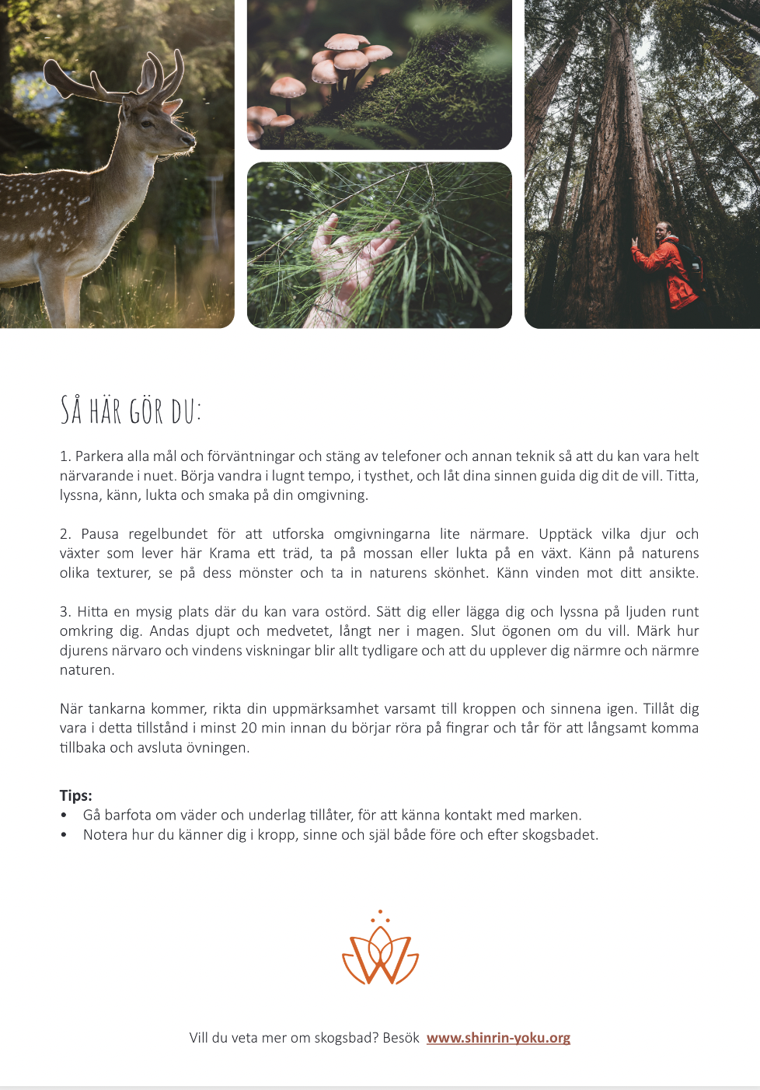
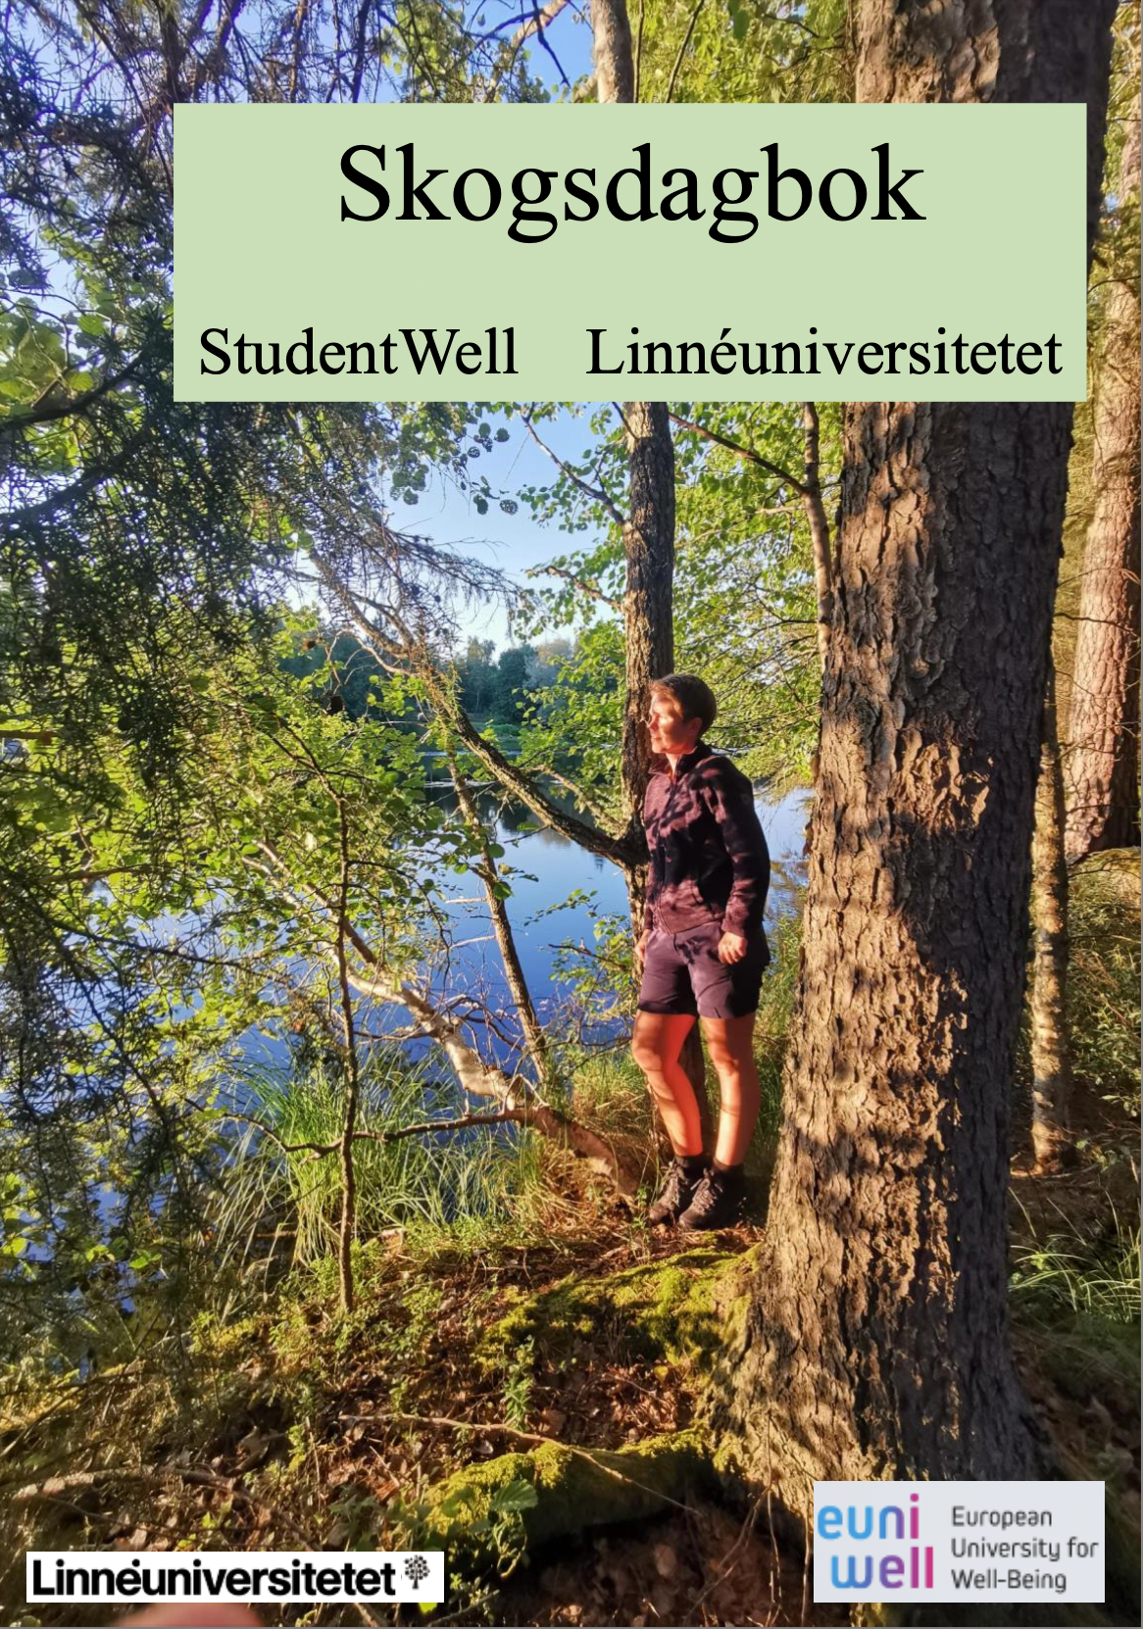
Self-guided forest bathing for wellbeing
Forest bath with certified forest bathing guide
Self-guided forest bathing, ca 120 min each week
Tools
Zoom-meetings
‘Forest bath buddy’
Forest bath card
Forest bath diary
Guided meditations

Slide 5
Self-guided forest bathing for wellbeing
Forest bath with certified forest bathing guide
Self-guided forest bathing, ca 120 min each week
Tools
Zoom-meetings
‘Forest bath buddy’
Forest bath card
Forest bath diary
Guided meditations
The Zoom meetings take place on 4 occasions. They are sharing experiences of how it worked and felt to bathe in the forest.
It's ok to miss one meeting.

Slide 6
Self-guided forest bathing for wellbeing
Forest bath with certified forest bathing guide
Self-guided forest bathing, ca 120 min each week
Tools
Zoom-meetings
‘Forest bath buddy’
Forest bath card
Forest bath diary
Guided meditations
In the forest diary, you write down the date and time of the forest bathing, and for how long you were in the forest. It is also good to write down in text or words how it felt before and after each forest bath. You do not need to show the contents of the book.

Slide 7
Self-guided forest bathing for wellbeing
Forest bath with certified forest bathing guide
Self-guided forest bathing, ca 120 min each week
You will receive 4 audio recordings that will help you relax and start the forest bath.
-5 min with & without background sound -10 min with & without background sound
The short one you can e.g. do on the bus to the forest and the longer one as a start to your forest baths.
Tools
Zoom-meetings
‘Forest bath buddy’
Forest bath card
Forest bath diary
Guided meditations

Slide 8
Our forest bathing method- research study
Fill in questionnaire
Fill in questionnaire
v38 Forest bathing in group
v39 Self-guided forest bath
v40 Self-guided forest bath
v41 Self-guided forest bath
v42 Self-guided forest bath
v43 Self-guided forest bath
v44 Self-guided forest bath
v45 Self-guided forest bath
v46 Program ends
Zoom-meet
Zoom-meet
Zoom-meet
Zoom-meet
Fill in questionnaire

Slide 9
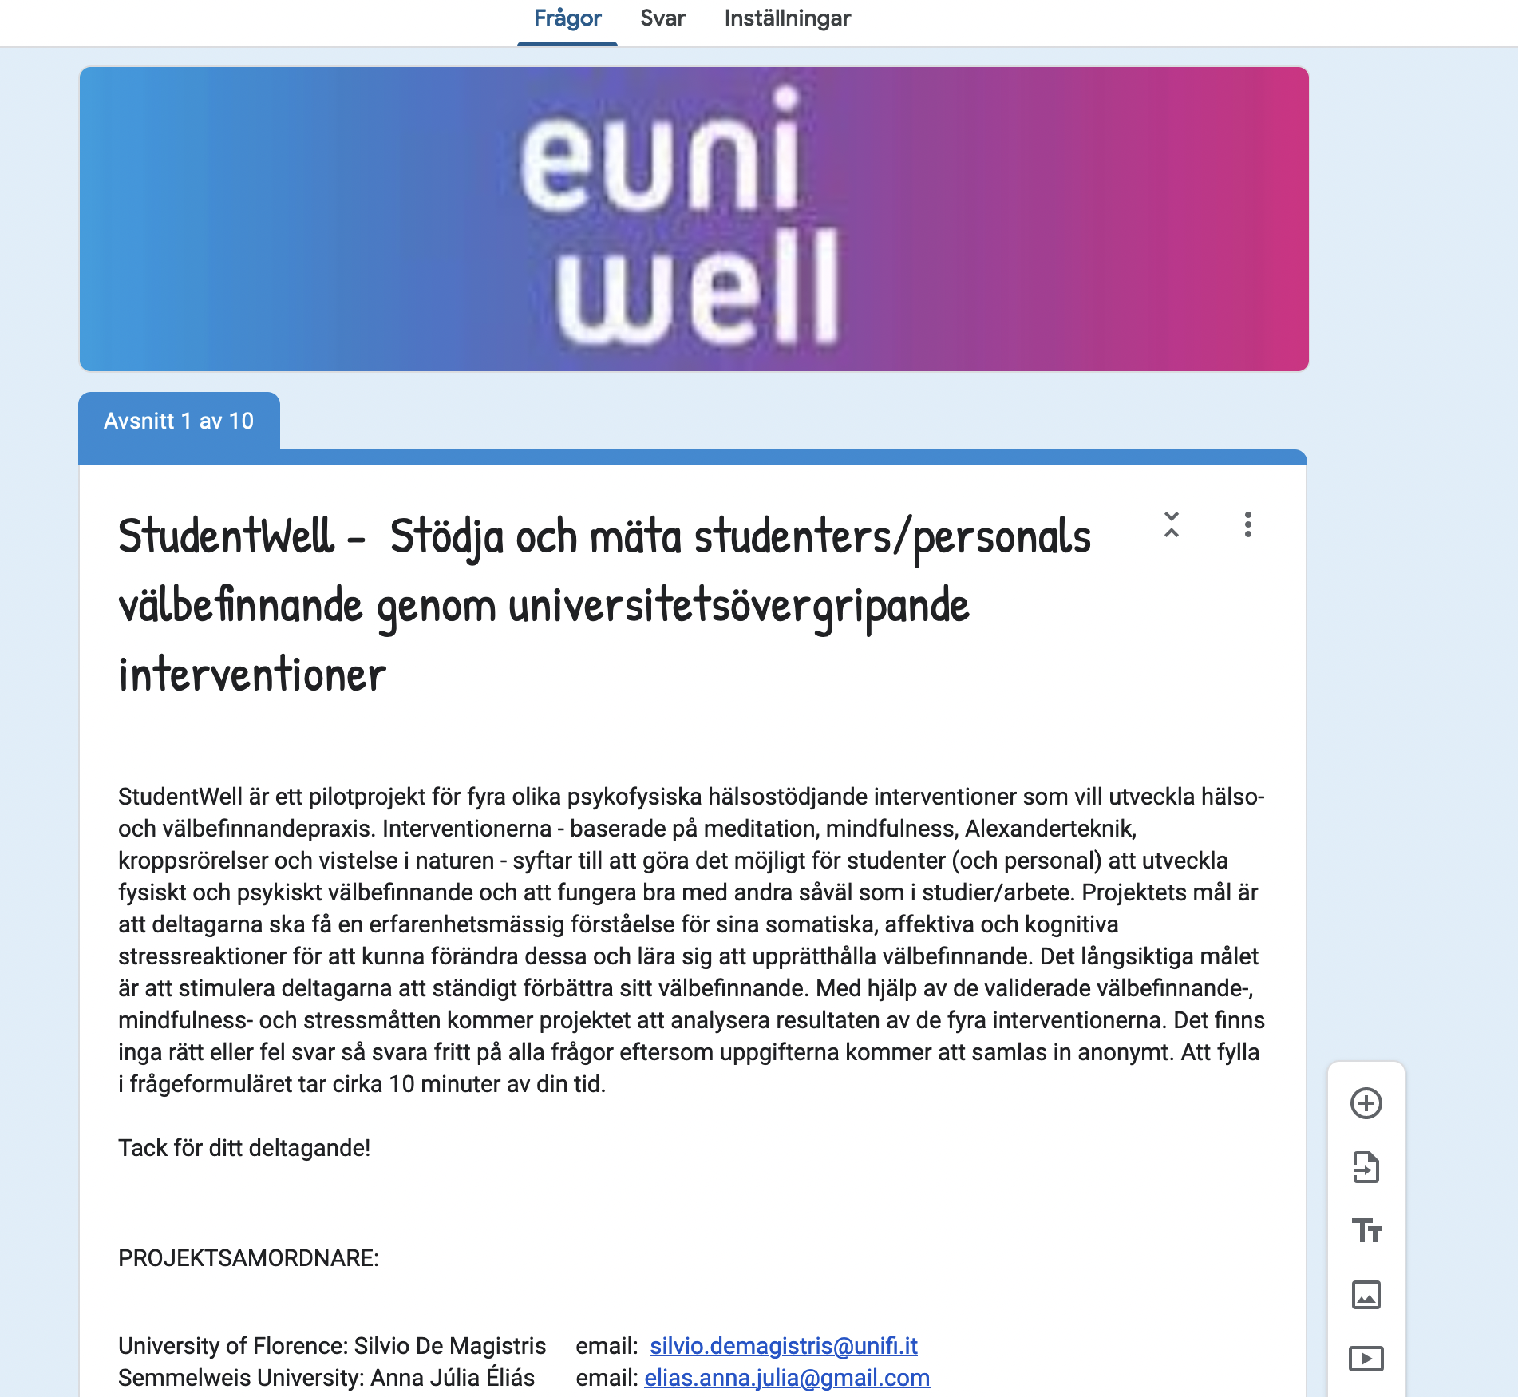
Our forest bathing method- research study

Slide 10
Our forest bathing method- dates
Information meet (now)
Forest bath in Växjö 22/9 at 16-17.30
Forest bath in Kalmar 23/9 at XXX
Zoom-meetings kl16.00-17.00 these Wednesdays: 28/9, 12/19, 26/10, 9/11
Zoom-meets in Swedish on Thursdays same weeks and times.

Slide 11
Self-guided forest bathing for wellbeing
Forest bath with certified forest bathing guide
Bring your own cover, preferably a sleeping
mat or yoga mat, alternatively a blanket or
towel, or seating pad.
Warm clothes because we will be still.
Water resistant shoes.

Slide 12
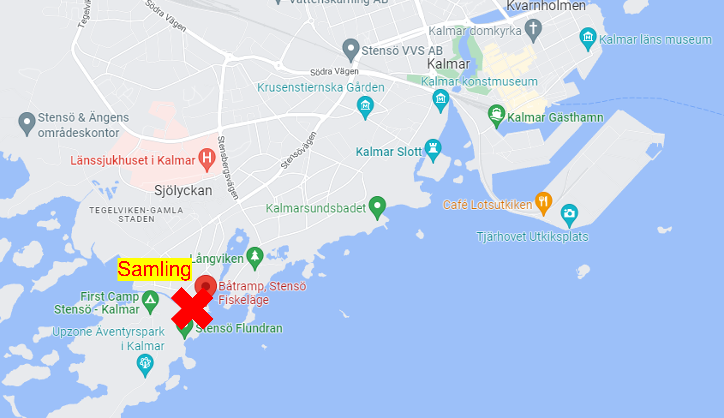
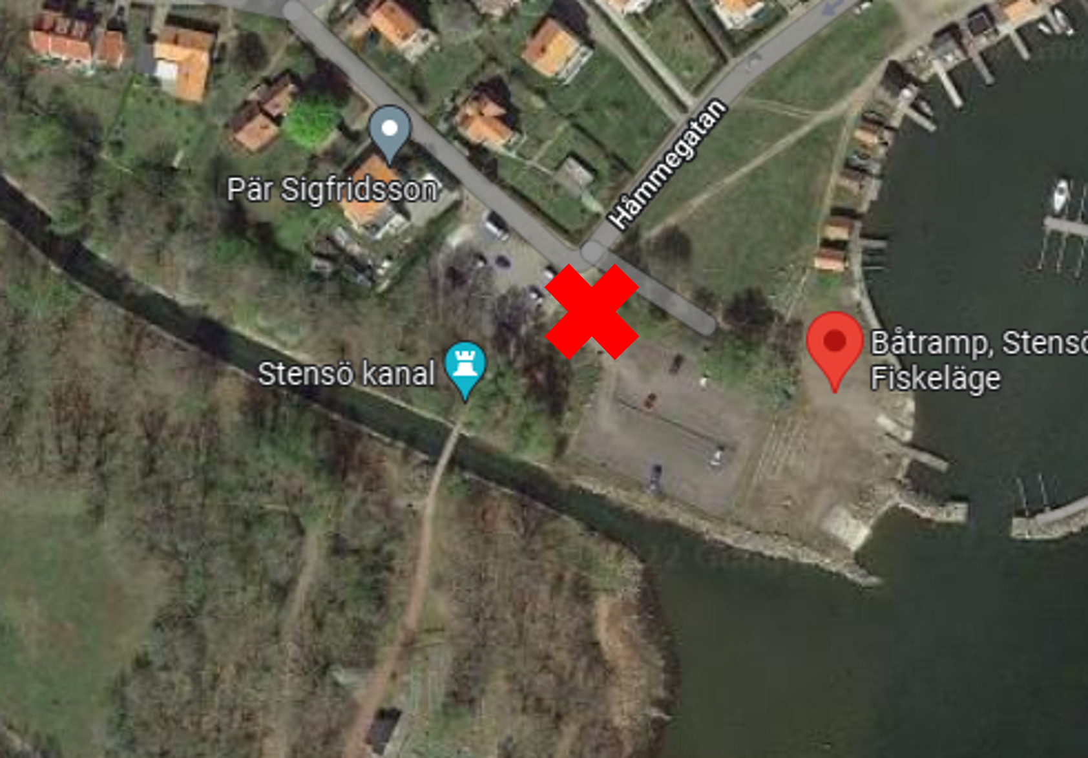
Meeting place Kalmar
Stensö outdoor recreation area
Meeting place: Before the bridge over the canal ‘Stensö’ by the fishing site.

Slide 13
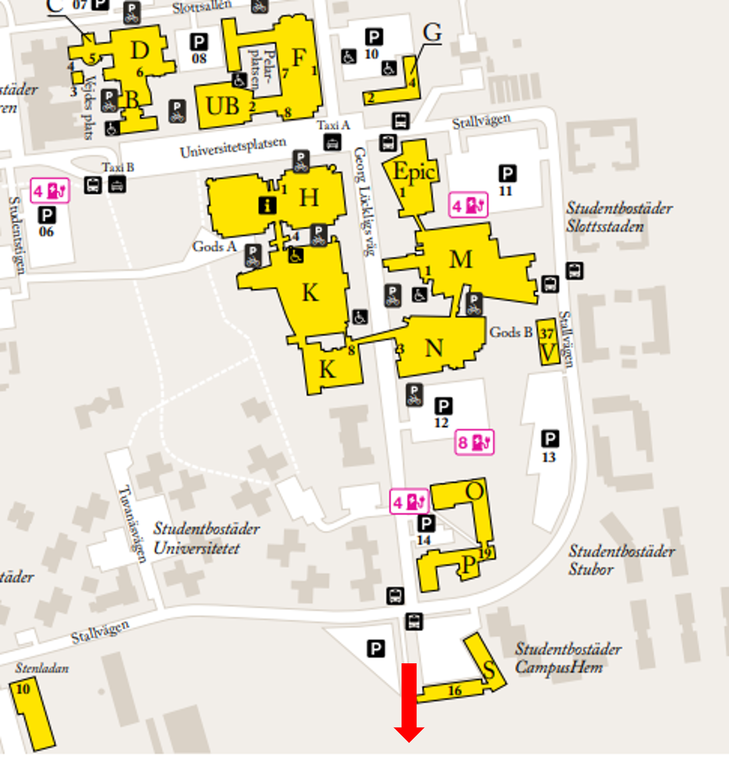
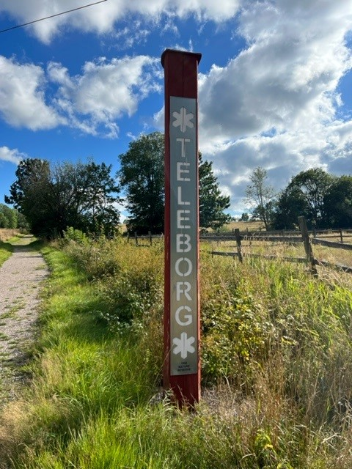
Meeting place Växjö
Near bus stop Georg Lyckligsväg
Parking available (free)
Meeting point: the Teleborgs Nature Reserve sign

Slide 14
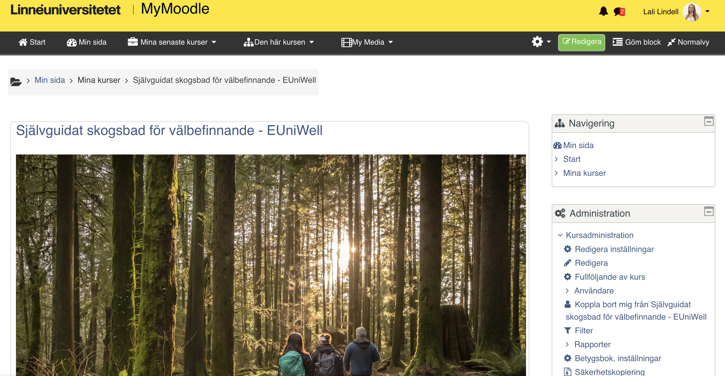
Our forest bathing method- resources
Moodle-room
Access to moodle is via your lnu-email.
Project website:
https://lnu.se/skogsbad

Slide 15
Thank you for your participation. See you soon!
Lali: lali.lindell@lnu.se
Jenny: jenny.lovebo@lnu.se

