Slide 1
Creative Commons
By Catherine Zoerb
Emporia State University
November 2015
Creative Commons by Catherine Zoerb is licensed under a Creative Commons Attribution-NonCommercial-ShareAlike 4.0 International License.
Notes:
I’m starting by announcing that this very presentation is under a Creative Commons license! I’ll get more into what you can and cannot do to my work here- I just wanted to point this feature out!

Slide 2
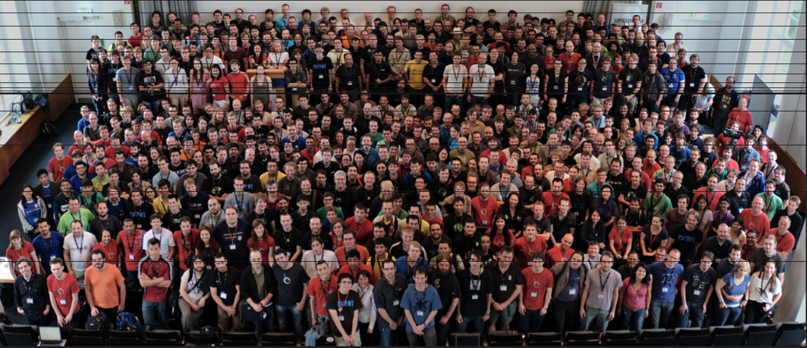
What is Creative Commons?
" Desktop Summit group photo" by Kat, Flickr is licensed under CC BY 2.0
Notes:
Creative Commons is a nonprofit organization that enables the sharing and use of creativity and knowledge through free legal tools. The free, easy to use licences provide a way to give the public permission to use or share your work within the limits that you choose. It changes the automatic term from “All Rights Reserved” to “Some rights reserved.” It works alongside copyright to help suit the creator’s needs. It’s great for creators- giving people permission to use your work within certain terms can save time (no more having to wade through “Can I use this?” e-mails) and increases your work’s exposure. It protects people who use your work- they no longer have to worry about copyright infringement, provided that they use the work within the limits set out but the creator of the work.

Slide 3
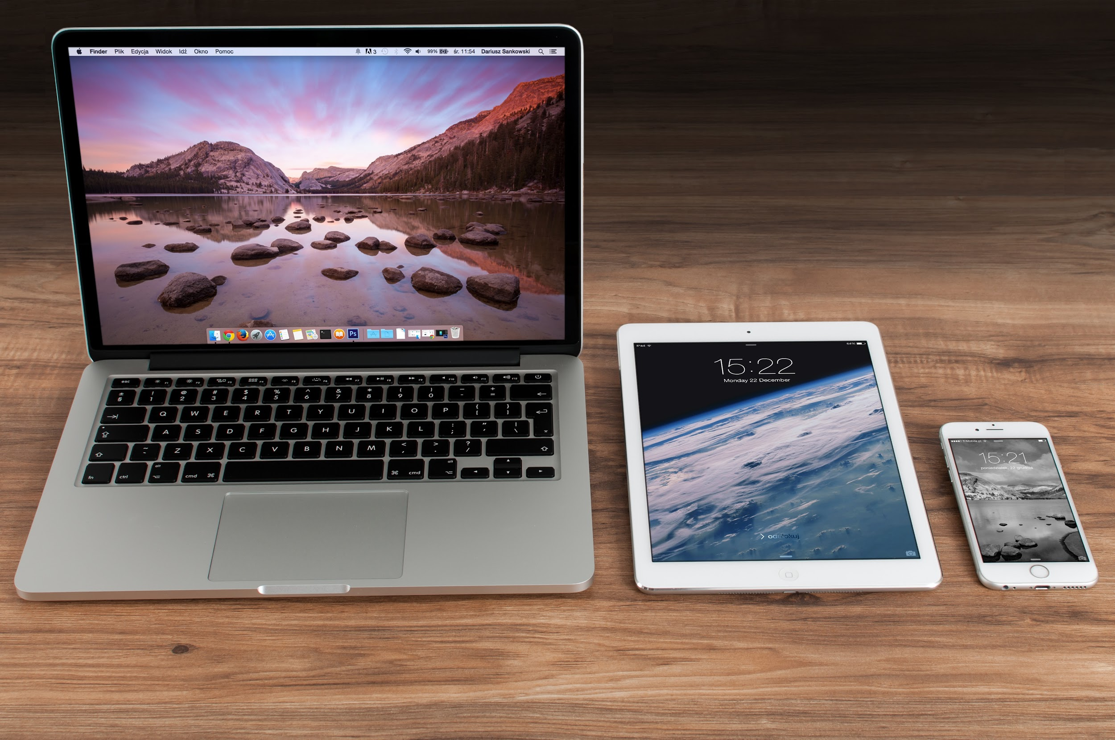
Why Creative Commons? Can’t I just Google things?
"MacBook Pro, iPad, iPhone" by Boss Fight! is in the Public Domain, CC0
Notes:
Creative Commons is a great way to make sure that the items used are safe to use! Many people think that everything on the internet is public domain and can be used for anything, but this is incorrect. Copyright exists when something is created- All Rights Reserved is the default! Just because something is freely available, such as on the internet, does not mean that it is always free to use. Saying “no copyright infringement intended” does NOT protect you. Creative Commons was designed to help share information in a controlled way. It applies to works that are subject to copyright. THis does not include works that are already in the public domain per current copyright law. Creative Commons allows a creator to define how they want their work to be used.

Slide 4
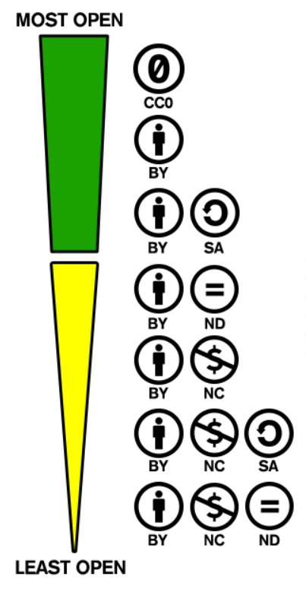
"Examples of Creative Commons Licence Use" by Creative Commons is licensed under CC BY 4.0 / A derivative from the original work
Notes:
Each licence has different levels of allowable use. It can be as free as CC Zero, which means no attribution is required and the user can do whatever they want with the work, do CC BY NC ND, which means that a user can only share a work, credit the author, and not change them, make money off them, or use them commercially in any way. You will see that I pulled this example from the Creative Commons webpage and attributed it to them under the CC:BY licence.

Slide 5
Key Terminology for Creative Commons
By means that others can copy/distribute/display/
remix your work- but only if they give you credit.
C f
Noncommercial means that you can remix and build on the work, but cannot sell it or use it for commercial purposes.
No Derivis means that the work can be used commercially or non-commercially- but it cannot be changed in any way. It must be used as-is.
Work can be adapted/remixed/built on, as long as the original author is credited and the new creation is licenced under identical terms.

Slide 6
The terms are then used in the way the original author wishes.
Notes:
CC: BY- this means that others may use the work, remix, change, etc- but they must attribute it. This is reccomended by Creative Commons for maximum distrubution and use.

Slide 7
Who Uses Creative Commons?
Teachers, artists, photographers, musicians- everyday people!
There are many companies that use CC licensure as well.
"Logo of Flickr" by Bernard Goldbach, Flickr is licensed under CC BY 2.0
Unless otherwise noted, all pictures are from "Who Uses CC" by Creative Commons is licensed under CC BY 4.0
Notes:
Creative Commons mentioned several, but I’m going to highlight a few here. Wikipedia, MIT Open Coursewear, PLOS, Flickr, and the White House! Nine Inch Nails also used CC licensure- and still managed to make a fortune via a sold out tour!

Slide 8
Best Practices for Citing Creative Commons Works
Cite as much information as possible, including
Title of the Work
Author’s Name
Source
License
Notes:
Cite as much information as possible, including links when possible. You want to be sure that the information can be found by others easily!

Slide 9
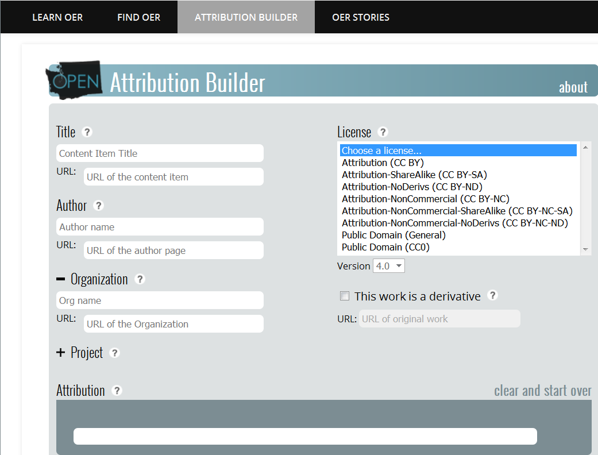
My favorite Attribution Builder: Open Washington
Open Attribution Builder is licensed under CC BY 4.0. Managed by WA SBCTC.
Notes:
I love the Open Washington attribution builder. It walks you through all the steps and has great help. If you are ever unsure of what any of the entries mean, simply click the question mark next to it and it will pop up some easy to understand information. A good attribution cites the title, the author, the source, and the licence. The Open WA attribution builder accounts for all of these parts of a good attribution.

Slide 10
Questions?
For an instant copy of this presentation and additional resources, e-mail CWildmanZoer+CC@gmail.com

