Slide 1
Welcome to the School of Business and Economics at Linnaeus University
Andreas Jansson (andreas.jansson@lnu.se)
Corporate Governance – Accounting and Finance
Notes:
Welcome to the School of Business and Economics at Linnaeus University
Fill in your name and the programme title at the red text
Feel free to post this ppt in your MyMoodle course room.

Slide 2
The program
First semester:
Corporate Governance, 30 credits
Together with a group of Swedish students (Civilekonomprogrammet, specialisation in Accounting and finance)
Second semester:
Choose two out of:
The corporation in society, 7,5 credits
The intellectual foundation of financial reporting, 7,5 credits
Financial institutions and markets, 7,5 credits
Degree project (master thesis), 15 credits

Slide 3
Student at the School of Business and Economics
Checklist for new students
Student account
Course registration
Notes:
Student at School of Business and Economics
Checklist for new students: https://lnu.se/en/student/new-student/
The following information is available via this link:
Obtaining a student account
Registration – is possible one week before the course starts, must have student account to be able to register. Any issues, ask students to contact the education administration at ekonomihogskolan@lnu.se. On the next slide, you can show the students where to click to register.
Some practical information like:
Student web
E-mail
Lnu-app
Swipe card
etc.

Slide 4
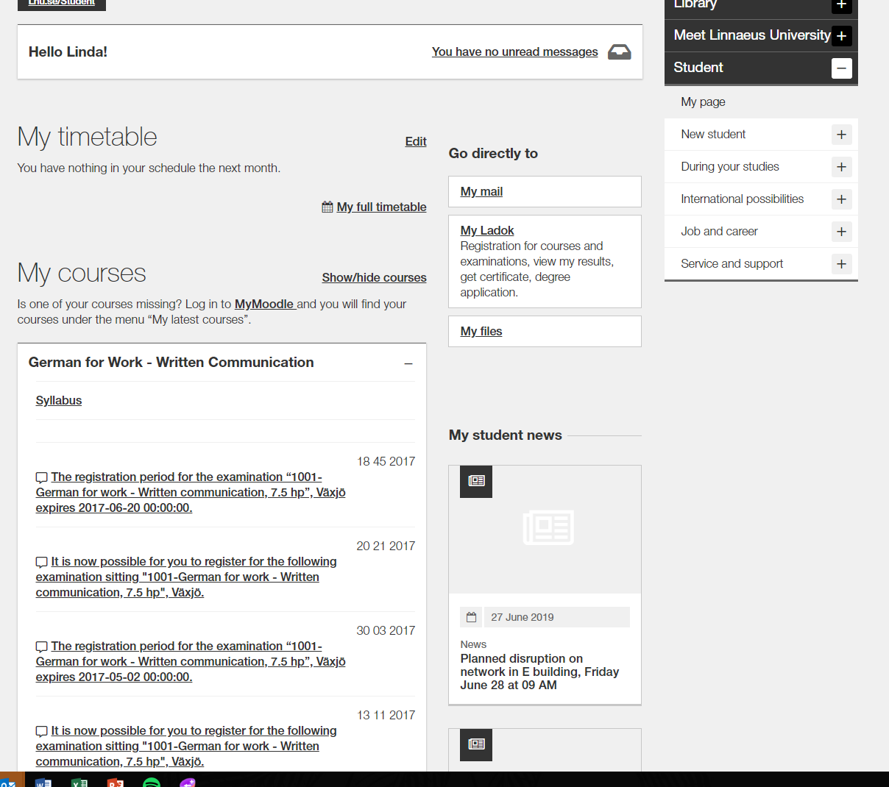
Studentweb
Important information during your studies
My timetable
When you are register on a course, you will finns your schedule here
Ladok:
Registration
Results
Sign up for examination
Certificates
Click on the course:
Link to course room on MyMoodle
Link to course syllabus
Information about registration period for examination
My student news:
Latest news
Notes:
Studentweb
This is the view when the student is logged in to lnu.se/student, and they will be able to find the following:
My timetable
My courses – There is a direct link to the MyMoodle course room. When the student is registered to the course it will be visible under My Courses.
Under Go directly to students will be directed to Ladok and will be able to find the following:
My Ladok:
Registration for course – opens one week before the course starts
View my results
Registration for examinations, exam at alternative location
Get certificate
Etc.
When they are logged in, they can find important information on the right hand side of the screen, such as:
During your studies: Registration, Timetables, Course syllbi, IT support, registration for examination and degree project information
International possibilities: International Office, information abour study abroad
Job and career: Activites, Mycarrer, the metor programme etc.
Service and support: info center, Technical support, student services, etc.
While logged in they can also find My student news, where information regarding them is published, such as open lectures or reminders.

Slide 5
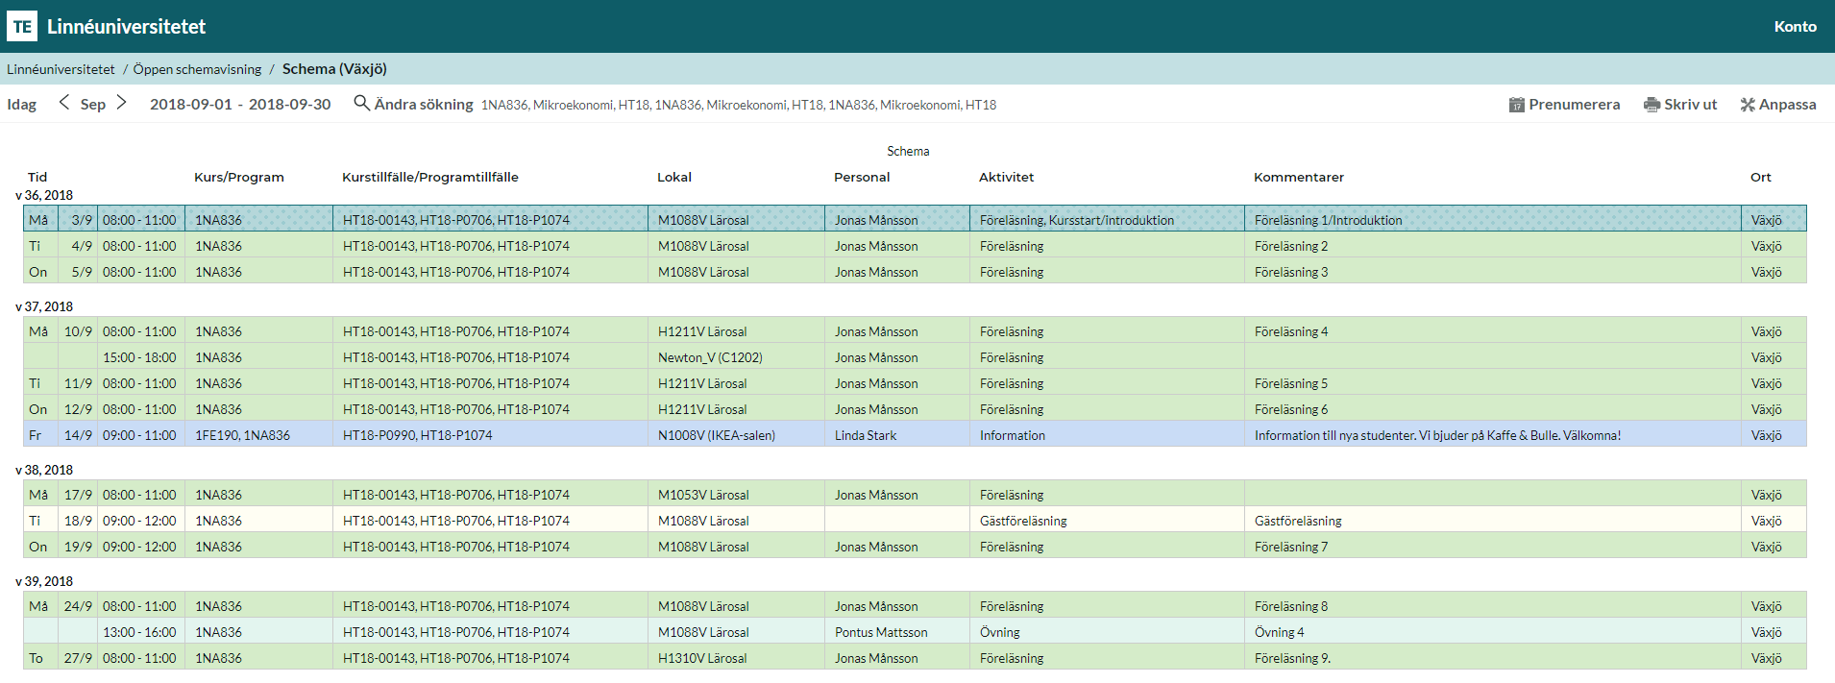
Timetable
Before you are registered to a course, you can find your timetable via TimeEdit
Notes:
Timetable
Once the student is registered to a course, he or she can access a personalized timetable via ”My full timetable. Again, the student must be registered in order to be able to access the timetable on lnu.se/student.
If a student wants to check a course timetable prior to the registration period of said course, this can be done via TimeEdit. Beware that timetables on TimeEdit are usually published, at the earliest, one month prior to course start.

Slide 6
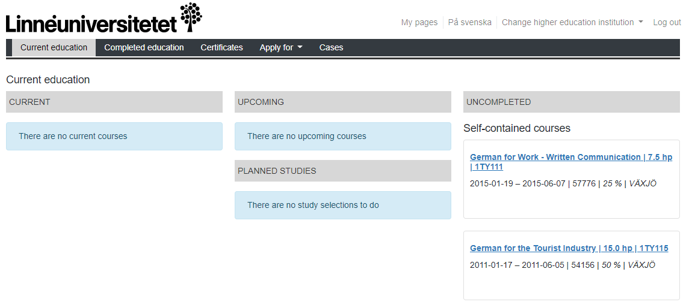
LADOK
Results, Certificates and sign up for examinations
Notes:
Ladok
Students will be directed here from their student web (slide 3). They can do the following:
Registration for course – opens one week before the course starts.
View my results
Registration for examinations
Get certificates
Etc.

Slide 7
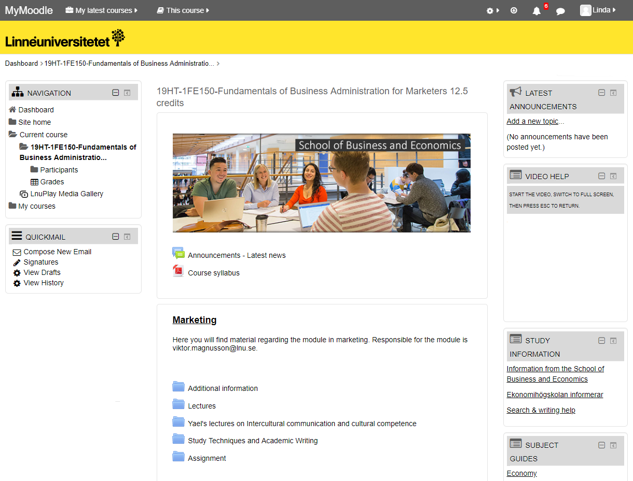
Here you can find student related information
The learning platform MyMoodle
Programme room
Course room
Information from the School of Business and Economics
Notes:
Add the link to your programme room at the first row of red text.
Add the link to the first course room at the second row of red text.
Here you can find student related information
LNU uses the platform MyMoodle, which is a digital course- and program platform.
Feel free to present the different platforms of MYMoodle:
Programme
Course
Attention! Make sure to present Information from the School of Business and Economics (link in slide). Here, students can find information about:
Term- and course periods
Information rergarding qualification requirments and conditions, as well as course options within programmes
Exam registrations and exam timetable
Examples of prior exams
Help and support for academic writing

Slide 8
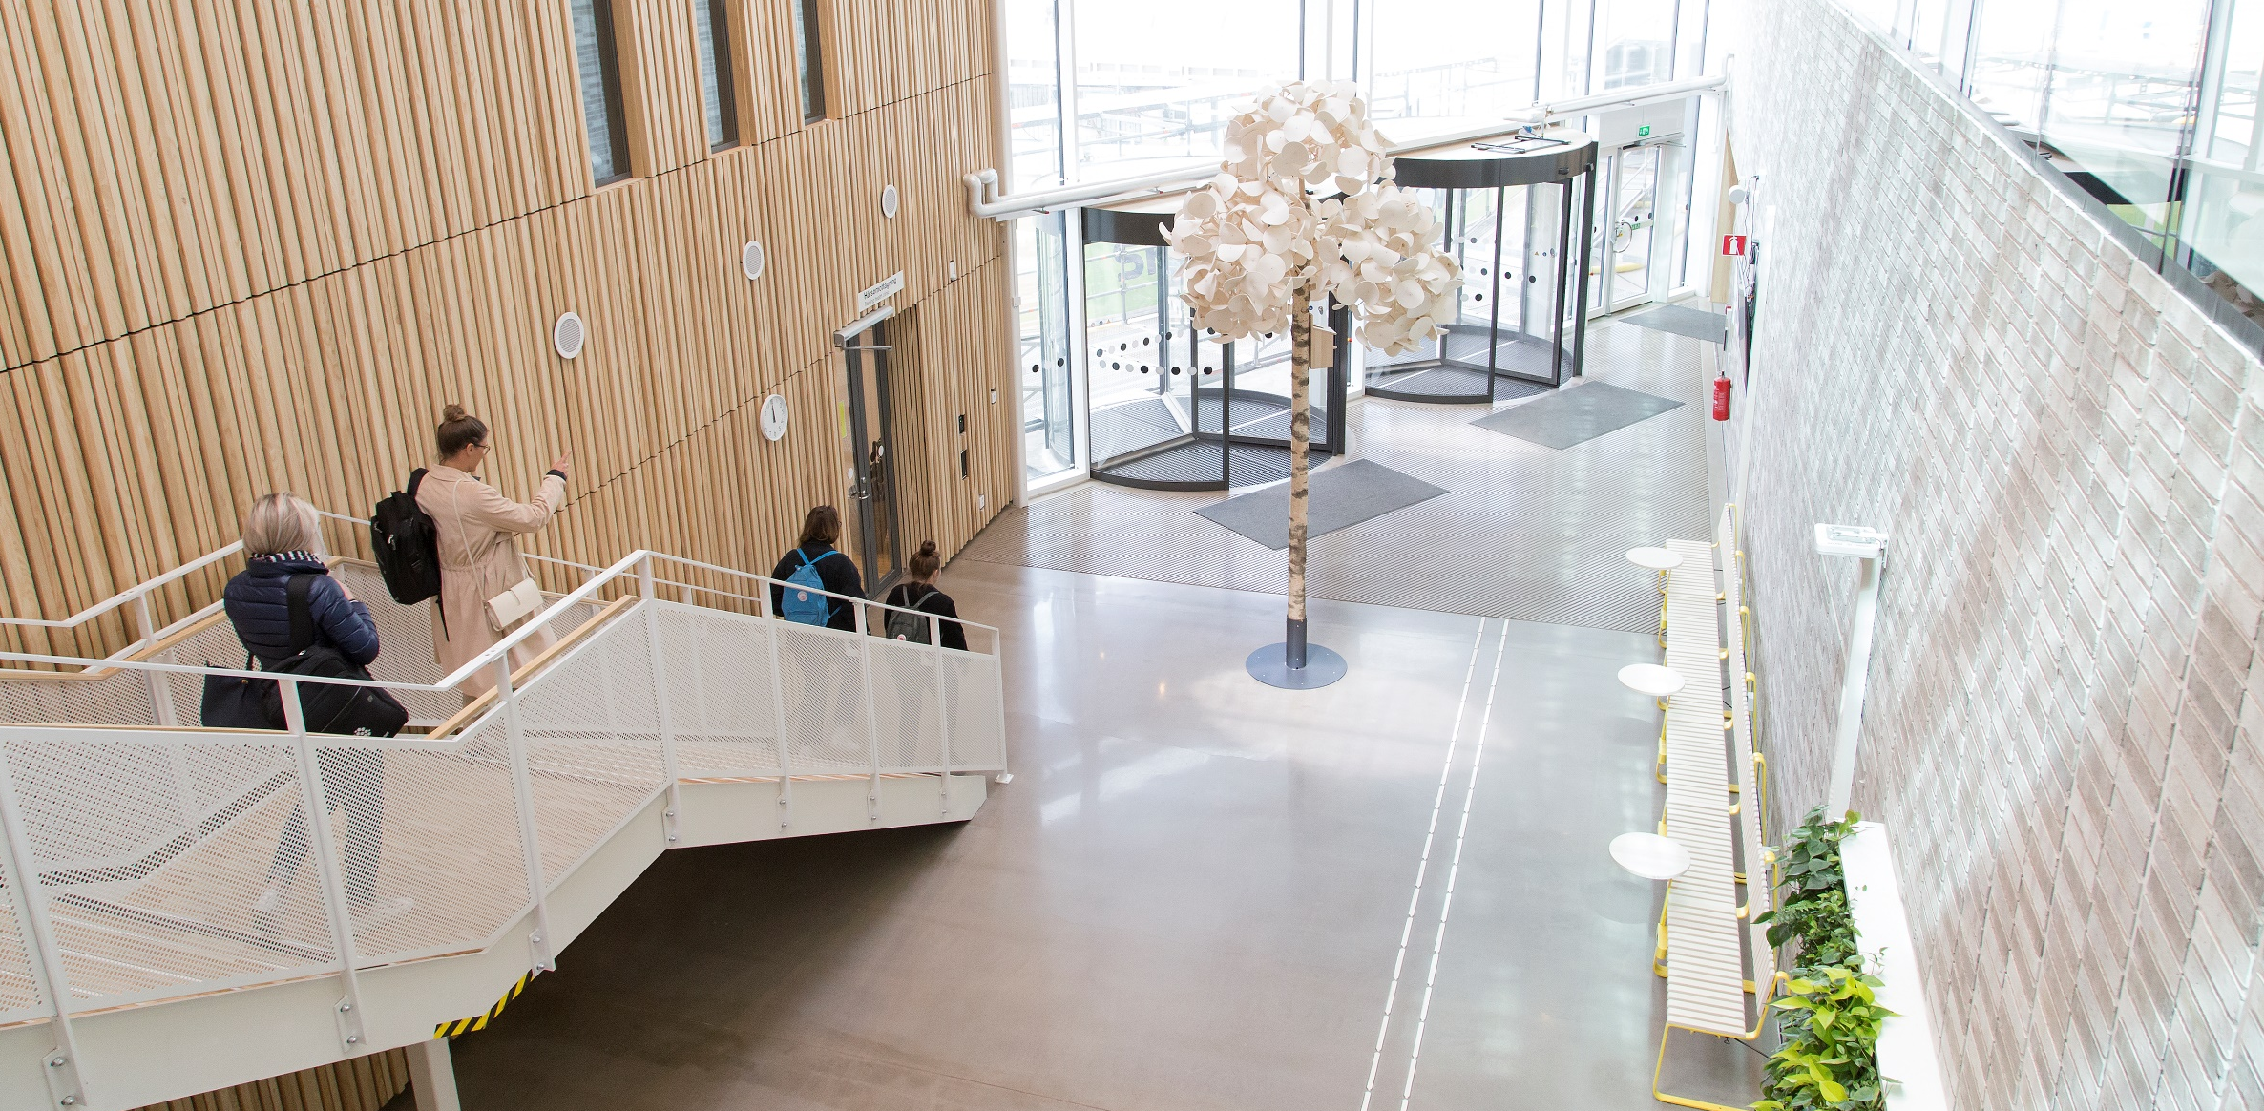
Course and programme syllabi
The programme syllabus governs a programme’s objectives, structure, content and degree. The course syllabus governs the learning objectives, content, examination, literature etc. of the respective course. It always specifies what prerequisites must be met to be eligible to register for the course.
Always read through the course syllabus prior to each new course.
Notes:
Course and programme syllabi
Show the students where to find program- and course syllabi, namely via the following link:
https://lnu.se/en/education/during-your-studies/studentweb/course-and-programme-syllabi/
Important to show in the course syllbus is:
Prerequisites - Mention that the student’s prior courses and credits determine whether or not the student is eligible for a course (show where in the course syllabus this is mentioned). In other words, a student can be denied access to a course, if said student does not meet the requirements and terms for that course.
Also, make sure to show the students where to find the course literature in the course syllabus.

Slide 9
Course examination
There are different types of examination, for example written exams, digital exams, written assignments and seminars. The responsible course coordinator informs about how the course is assessed. This is also stated in the course syllabus. If you recived a passing grade you cannot retake the same examination in order to obtain a higher grade.
Notes:
Course examination
List the different types of course examination, such as:
Written exam,
Take-home examination,
Written assignment,
Quiz,
Digital exam,
Case,
etc.
Feel free to make an example of the first course and its forms of examinations and present its course syllabus.
Important to mention is: If you recived a passing grade you cannot retake the same examination in order to obtain a higher grade.

Slide 10
Failed examinations…
… can lead to you not fulfilling the prerequisites for the next course and cannot study further.
… may involve problems with Visa, the Swedish Migration Agency or CSN as they are required for study performance.
Do not delay too long with re-examination as the course structure may change to the next academic year.
Notes:
Fail examinations
Om studenten får ett underkänt på tentamen kan det resultera ibland annat att hen inte uppfyller de förkunskapskrav till nästa kurs eller nästa termin. Det är därför viktigt att inte hoppa över första examinationstillfället och att de lägger ner 40 h eller den tiden de behöver för att klara examinationen.
For additional questions regarding CSN, tell students to contact CSN directly. NO one on lnu is working with CSN questions.
Viktigt att poängtera att kursen examination kan ändras år från år och det är därför viktigt att inte skjuta upp en tentamen.

Slide 11
General grading criteria for the A-F scale at the School of Business and Economics
The grading scale is A-F (NOT ECTS). Your performance is measured in proportion to how well you have met the course objectives. All parts of the examination are relatable to specific learning objectives for the course. Some tasks have G/U (P/F).
Grade | Assessment | Your results are equivalent to one of the following criteria for each objective for the course
A | Excellent | Outstanding results with only a few minor shortcomings
B | Very good | Very good results with only a few shortcomings
C | Good | Generally good but with some shortcomings
D | Satisfactory | Acceptable level but there are several shortcomings
E | Sufficient | The results meet the minimum criteria
Fx | Insufficient | The Examiner/course coordinator may, in exceptional cases, decide that a student who is close to the threshold for E may perform assignments for extra credit to reach the grade of E. The examiner/course coordinator notifies the student in writing of the rules for submitting such extra credit assignments. The grade of F is assigned in anticipation of the extra credit , and the grade is changed to E if the extra credit is approved.
F | Insufficient | Significantly more work is required
Notes:
The School of Business and Economics’ grading scale
The header is a link to the document of rules, which can also be found through Information from the School of Business and Economics at MyMoodle.
Talk through the different grades and note that Fx is not a possible grade to receive on a written exam.

Slide 12
Weighing up of grades for the whole course
All of the course’s assessment tasks must be passed before the cumulative grade can be calculated.
The programme administrator performs the mathematical calculation using set principles.
The grade documentation is submitted to the examiner for a decision by signing the results list.
Grades are weighted when the programme administrator translates all assessment tasks graded for a course into figures in accordance to the table on the right.
A-F grading scale | Number scale for weighted average
A | 9.0
B | 8.0
C | 7.0
D | 6.5
E | 6.0
A-F grading scale | Mathematical grade thresholds
A | 8.51–9.00
B | 7.51–8.50
C | 6.76–7.50
D | 6.26–6.75
E | 6.0–6.25
Each assessment task is given the percentage weight that corresponds to the amount of credits it covers. As a result, the sample course gets a C, given that the average was 7.4.
Course X, 15 credits | Grade | Translation | Weighted average
Assessment task 1; exam 7.5 credits | B | 8 | 8*(7.5/15) = 4.0
Assessment task 2; case 4.5 credits | C | 7 | 7*(4.5/15) = 2.1
Assessment task 3; lab work 3 credits | D | 6.5 | 6.5*(3/15) = 1.3
Total |  |  | 7.4
Notes:
Grade weighting
A course consists of different assessment tasks which are calculated to make up the final grade.

Slide 13
Course evaluations
After each completed course – please fill out the course evaluation! The course evaluation is your chance to influence, comment and contribute to good course quality
If you want to take part of previous course evaluations, you can order them by: arkiv@lnu.se
Notes:
Course evaluations
After each and every completed course, students fill out a digital course evaluation. Stress the importance of this tool!
Students can access prior course evaluations, via mailing arkiv@lnu.se . By doing so, they will receive a compilation in a pdf format.

Slide 14
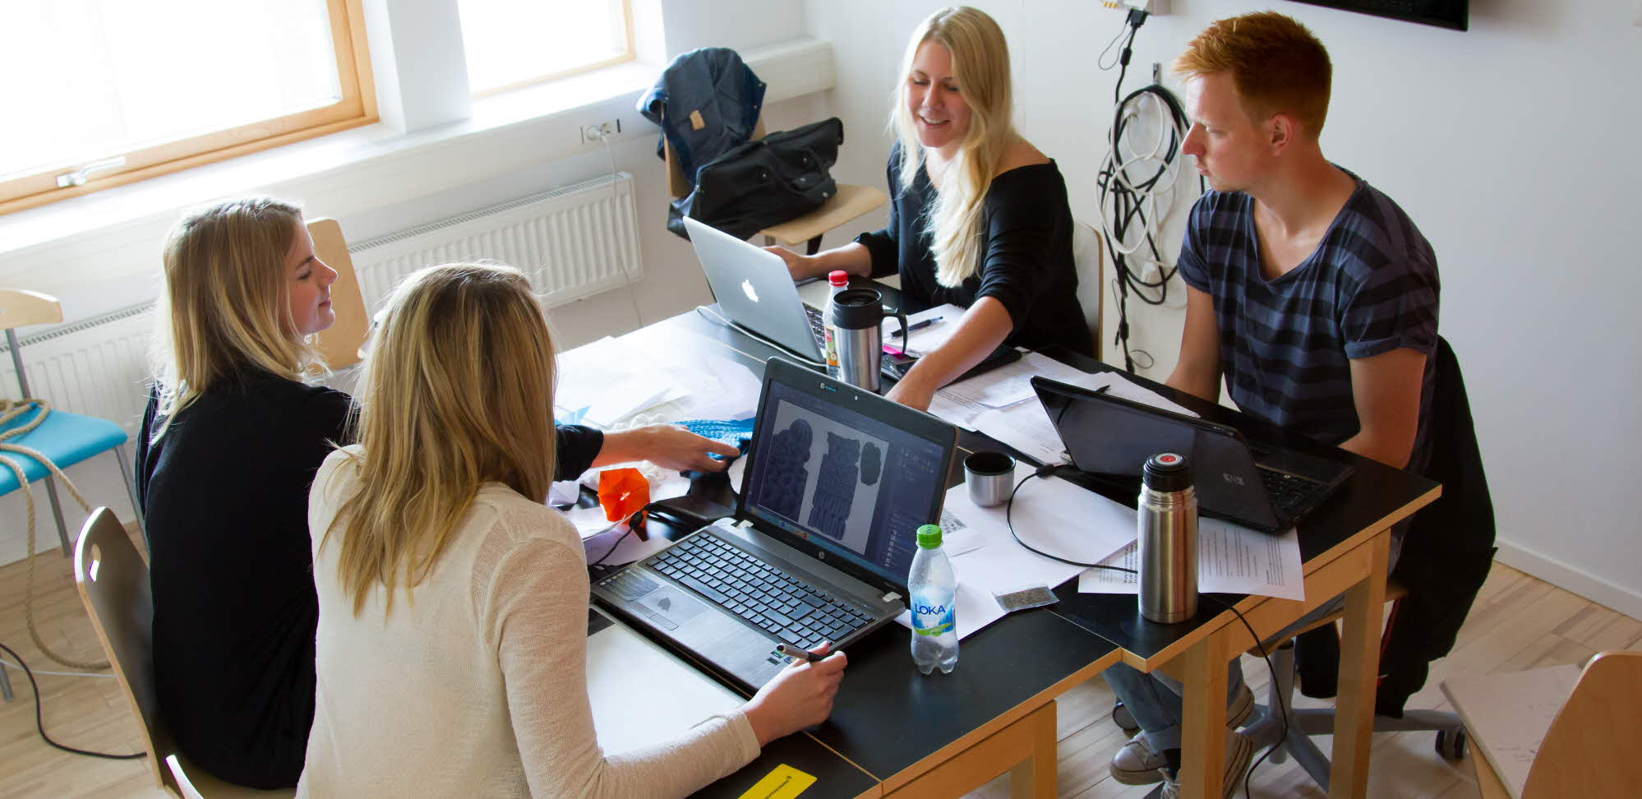
Apply for your programme courses
Applications for next semester’s courses are done through www.universityadmissions.se
In some cases you will not need to apply for courses n the coming semester, in which case you will be given infomation about this.
Information about how you apply, you will find at Infromation from the School of Business and Economics
As a programme student you have a guaranteed seat on programme courses.
Application period is open September 16 to October 15 for Spring semester.
Application period is open mars 15 to april 15 for Autumn semester.
Application problem? Contact admisson@lnu.se
Other questions ekonomihogskolan@lnu.se
Notes:
Apply for your porgramme courses
The administration will inform via Information from the School of Business and Economics at MyMoodle which students need to apply for courses for next semester. As a student you need to apply for the courses in the upcoming semester and this is done via antagning.se/universityadminssions.se just as when they applied for their programme. Information which will be available on MyMoodle is:
Which courses to apply for – with application codes
Instructions on how to apply
Contact information in case any problems arise

Slide 15
Contacts for Education administration at School of Business and Economics - Växjö
E-mail: ekononomihogskolan@lnu.se
Phone: +46772 – 28 80 00
Or visit Education administration in the Office Corridor, building K, floor 1
Information from the School of Business and Economics – information page for you!
Like us on Facebook:
@ekonomihogskolan vid Linnéuniversitetet /School of Business and Economics

Slide 16
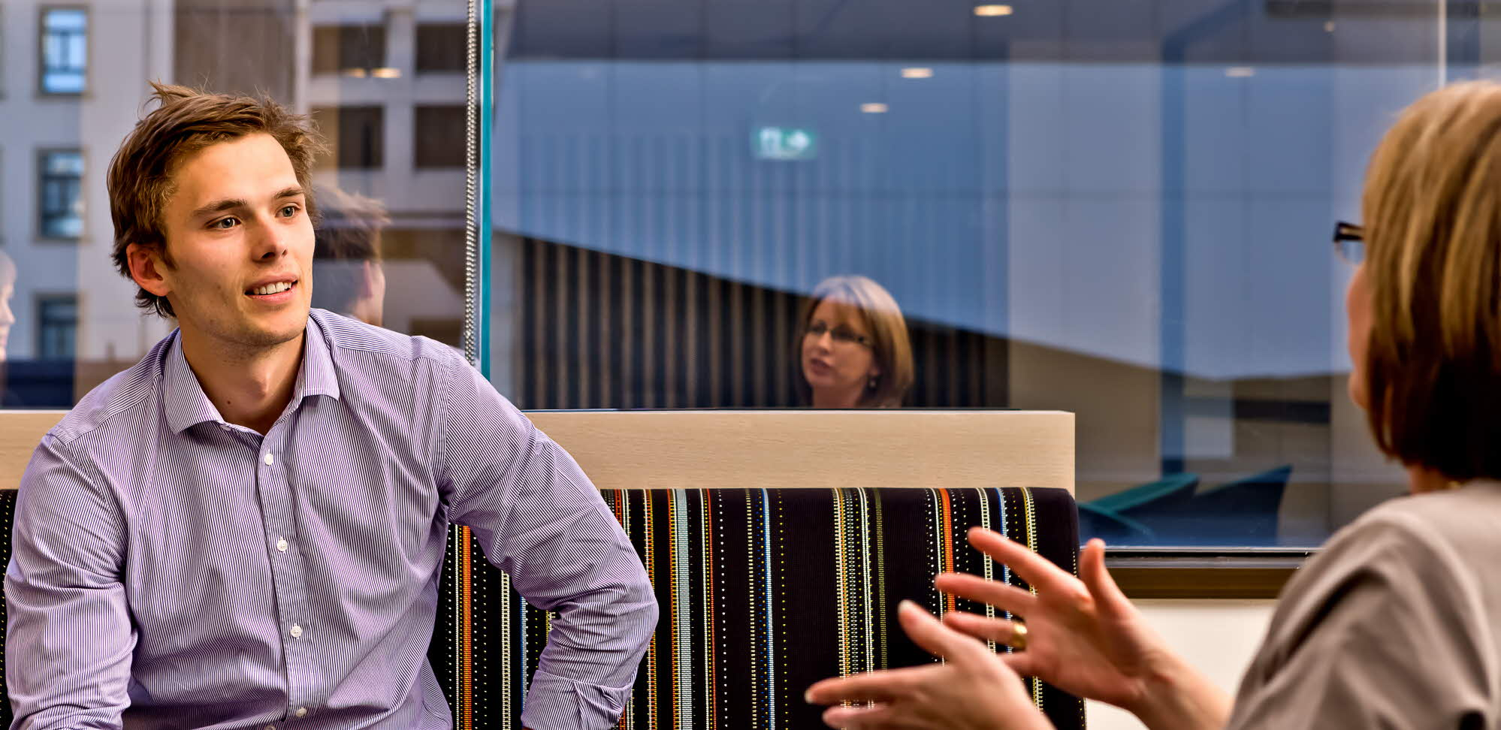
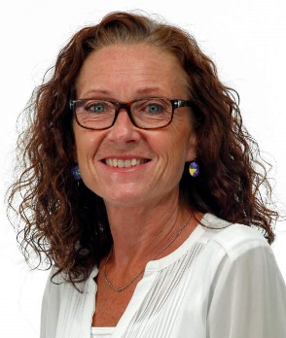
Student counselling at the School of Business and Ecnomics
Susan Grahl Student Counsellor, Kalmar Email: susan.grahl@lnu.se Visiting adress: Building Forma, floor 2
Petra Hunt Student Counsellor, Växjö Email: petra.hunt@lnu.se Visiting adress: K-building, floor 1
Notes:
Student counselling at the School of Business anf Economics
The School of Business and Economics have two student counsellors, one in Kalmar and one in Växjö. They can assist in the following:
Student guidance and individual study planning,
Electives within programmes,
Leave from studies,
Study non-completion,
Change of programme,
Etc.
Make an appointment with the student counsellors and prepare your questions before to get the best help.

Slide 17
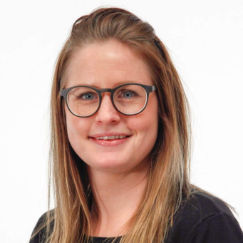
Career counselling service
Do you need help starting up your job search process? The career counselling service at Linnaeus University, Lnu Career, will offer you support when you try to figure out how your education, your experience, and your personal qualifications are best summarised into a powerful job application.
Anna Kågestad
Career Counsellor, Kalmar
+46480-44 62 38
anna.kagestad@lnu.se
Fanny Elheim
Career Counsellor, Växjö
+46470-70 84 05
fanny.elheim@lnu.se
Notes:
Career counselling service
The link in the header directs to the Career counselling service
Career counselling service arranges different Lectures, workshops och events, such as:
CV-writing help
Career course
Interview training and lectures
Your personal trademark- lecture
LinkedIn – lecture and workshop
Students also have the opportunity to meet a career counsellor.

Slide 18
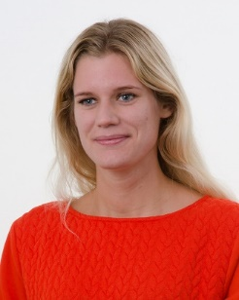
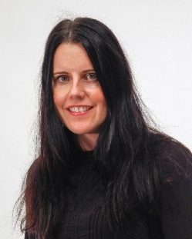
Learning support for your studies
If you are a student and have some form of disability, it is possible for you to get pedagogical support during your studies. Examples of such help are, help taking notes, sign language interpreter or extended time at examination sittings.
Mathilda Karlsson Coordinator, Kalmar
+46480-44 64 90 mathilda.karlsson@lnu.se
Mari Ericsson
Coordinator, Växjö
+46470-70 81 95
mari.ericsson@lnu.se
Notes:
Learning support for your studies
If you are a student and have some form of disability, it is possible for you to get pedagogical support during your studies. Examples of such help are, help taking notes, sign language interpreter or extended time at examination sittings. There is a contact person for Kalmar and one for Växjö
Länk i bilden för mer information om Learning support for your studies

Slide 19
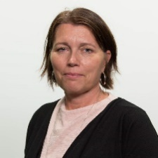
Contact persons for international students at
the School of Business and Economics
Kalmar
Terese Nilsson
terese.nilsson@lnu.se
Forma Building
2:nd floor
Växjö
Lollo Leijner
lollo.leijner@lnu.se
K Building, 1:st floor
Room: K1101
For questions regarding Tuition fees:
tuitionfees@lnu.se
Notes:
You are most welcome to contact Terese (Kalmar) and Lollo (Växjö) if you have questions regarding your studies.
Please contact tuitionfees@lnu.se concerning all tuition fee matters.
Make sure you pay the tuition fee in time, otherwise you may not be allowed to study the course.
All questions regarding residence permit is to be communicated with the Swedish Migration Agency
You need to be registered for full time studies and show good progress in your studies in order to get extension of your residence permit.

Slide 20
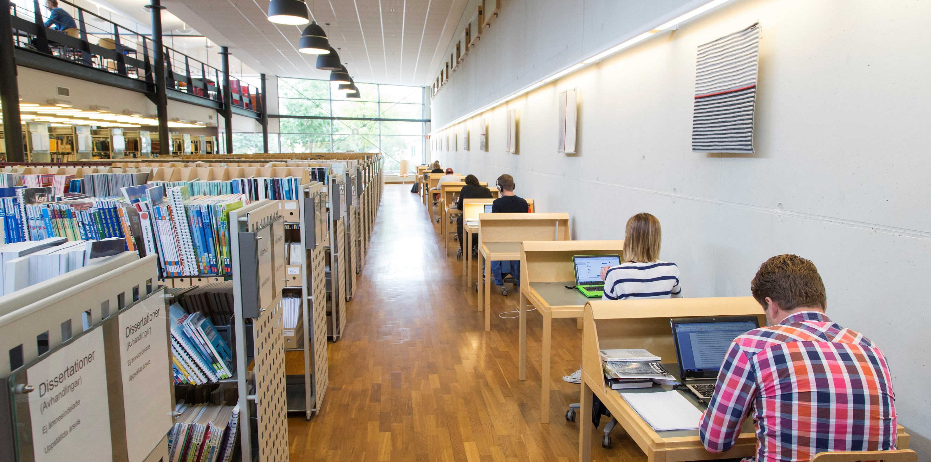
The University Library and Academic Support Centre
Search and writing assistance is available at the University Library and through the writing guide. At the Academic Support Centre you can get support with your academic writing as well as help with study techniques.
Read Refero – the anti-plagiarism Tutorial a web-based textbook that shows you how you properly use others’ texts in your academic writing.
Notes:
The University Library and Acacemic Support Centre
At the university library there are a large number of places and rooms to study. Some of the rooms and seats are available for booking via the library’s web page lnu.se/ub. Contact info: ub@lnu.se. Contact the library for searching and writing assistance (link in slide).
At Academic support centre students at bachelor and master levels of study can receive guidance in academic writing and study techniques.
Show and talk about the writng guide available via the library (Link in slide), availble in both Swedish and English.

Slide 21
Student Welfare Office
The Student Welfare Office is available to students of Linnaeus University in both Kalmar and Växjö. Student Welfare Office takes a preventative approach to lifestyle issues and provides counselling and coaching.
Notes:
Student Welfare Office
The Student Welfare Office organises several different classes for students, such as:
The power of yoga
Våga tala
Mindfulness
Visit the lnu.se page for the student welfare office for contact information - webpage (link in slide) https://lnu.se/utbildning/under-studierna/studenthalsan/

Slide 22
Get involved in your studies
Programme council
Linnéstudenterna
Student associations
Course evaluations
Linnébarometern
Notes:
Get involved in your studies
The student associations elect student representatives from every year.
As a student, make sure to ask for when the course evaluation will be sent out, and make sure to complete the evaluation survey.
Contact the teacher directly if you experience any issues. Your programme coordinator and the Student Union (Linnéstudenterna) are also able to help.

Slide 23
The journey of education – from upper secondary school through university to career!
Your attitude and ambition affects you and your surroundings
Your responsibility!
Requirements and expectations of students and from students
Academic freedom
Scientific knowledge
Notes:
The journey of education – from upper secondary school through university to career!
Your attitude and ambition affects you and your surroundings
Your responsibility!
Requirements and expectations of students and from students
Academic freedom
Scientific knowledge

Slide 24
LNU’s Alumni Network
Your work-related experiences are important to us and our students.
As an alumnus, you can contribute to your former study programme.
For instance, we have alumni who lectur or have companies that are available as case companies for different project.
If you are interested in becoming an alumnus in the future, please contact us, more information at lnu.se.
Alumni evaluations – 3 years after the exam
Focus on the evaluation of your education
Between studies and work
Work tasks
Notes:
LNU’s Alumni Network
The link in the header directs to a short information video (2,5 minutes) explaining what an alumni network is.
More information about the alumni network can be found on lnu.se, where they can also join the network.

Slide 25
Warm welcome to the School of Business and Economics!
Don't forget to register for the first course today!
Notes:
Don’t forget to urge the students to register today.

